Slide 1
Women’s Association of Tigray (WAT)
Briefing on Conflict Related Sexual Violence (CRSV) in Tigray
December 8, 2023

Slide 2
Presentation Outline
Introduction
Over view of WAT
Major interventions of WAT
Briefing of war effects on Tigriayan women
Measures taken by WAT
Way forwards

Slide 3
Women Association of Tigray (WAT)
Vision
Our vision is to create a prosperous society where complete gender equality is ensured.
Mission
WAT's mission is to empower women through direct participation in advocacy and development initiatives.

Slide 4
Introduction
A non-political, not-for-profit and independent gender based civil society organization
WAT is independent civil society organization dedicated to gender equality and established in 1992G.C
The Association has a well-stratified structure from headquarter, zonal, woreda, kebele and WDG level
WAT works with different donors, different stakeholders and right holders.

Slide 5
Overview of WAT
Focuses on preventing and responding to GBV and promote & protect women’s human rights at all levels.
In all development efforts in Tigray, WAT places a high priority on promoting women's empowerment.
A pioneer women's rights organisations play a central role in spearheading change in support of gender equality in Tigray.

Slide 6
Structure of WAT
WAT is led by the 13 Board of Directors elected every three years
Over 800,000 paying women members at the apex of its structure,
There are seven zones and 93 chairwomen in the woreda offices.

Slide 7
Major interventions of WAT
Consultation & lobbies with duty bearers to promote women’s right & their participation.
Sensitizing the society to prevent GBV and HTP in Tigray
WAT fights against abuse and sexual harassment of women, and provides legal support to those affected
Ensure that women have equal opportunities to participate in politics and hold leadership positions
Undertaking research on issues related to GBV & gender equality

Slide 8
Cont.…
WAT collaborates with women's associations like WDG to promote women's rights and empowerment
WAT is implementing various income generation schemes to establish business enterprises focused on women
WAT is assists women in forming business associations and cooperatives
Implement initiatives that aim to reduce poverty among women, with the active involvement of women of all ages

Slide 9
Brief account of the Tigray war and its effects on Tegaru women
The outbreak of the conflict has resulted in massive human and material losses over Tigrayan people
Tigreans of all age groups were indiscriminately massacred in mass and burned alive
Many women were turned to households heads
Tegaru women where masively become victims and survivors of CRSV of all forms
Of all the atrocities faced by Tegaru women, CRSV was taken as ethnic cleansing strategy of the invading forces

Slide 10
Cont. ...
Women (Nuns, wives of priests and sheiks, grandmothers) and girls as young as below ten were raped
The way the sexual violence committed on Tigrean women is very unusual, shocking, unethical and inhumane
Tigrain women and children, during theconflict and siege, were physically attacked, gang raped and subjected to sexual slavery
The violence includes ordering of family members to rape their own family (daughter, mother/grandmother) and killing them when they object

Slide 11
Con
Many were also raped in front of their own family (husband, mother, children, father, brothers and sisters)
ICHREE’s latest report has also revealed that Family members of survivors, in particular very young children, were also subjected to sexual violence by being forced to witness by their mothers or other female relatives
The act of CRSV still is continuing even after the Pretoria deal. According to the latest report of ICHREE, Eritrean and Amhara forces committed Sexual violence after the signing of CoHA and its reported as recently as June 2023

Slide 12
Cont.
Features of CRSV in Tigray
It was perpetrated on a massive scale (raping many women and girls in a place at a time),
Tigrayan women of reproductive age were primarily targeted Rape and other forms of sexual violence were also perpetrated that includes;
pregnant and lactating women
Underage girls and elderly women
Women with disability
The rape and gang rape was accompanied by burning body parts and/or reproductive organ and inserting objects to the womb that cause permanent health damage on the victims,
Forced pregnancy that leads to unknown father (children fathered by attackers)

Slide 13
Case Stories
Story of Hewan 1
Three Eritrean soldiers have broken in to Hewan 1’s house. They tied her husband in a style they refer number 8 (kneeling him and tieing his hand backwards) and brutally raped her in front of him. Though both the survivor and her husband begged them to leave her, they rejected her. Two of the soldiers raped her at a time, through her vagina and anus and the remaining continues alone. They raped her in such a way throughout the afternoon. After they forced her husband to watch such an incident, they killed him while he was crying. They did not allow her to move and burry her husband’s body. Throughout the area around they killed many innocents and ordered not to burry the corpus otherwise, they would be killed.

Slide 14
Case Stories
Story of Hewan 2
Soldiers were searching house to house in town X, one soldier with water in a plastic container ordered an 11 years old child to help him carry the water and she carried the container and went with him. Then he took her to a compound and told her to bend down and then raped her. She bled as she was a virgin 11-year-old child.

Slide 15
Case Stories
Story of Hewan 3
The survivor was married woman from Irob ethnicity with a 16-month-old baby girl from X town. One day, she together with her husband and brother reached at a checkpoint while she was fleeing the war where the Eritrean soldiers were in charge of verifying identity. Then the soldiers stopped them and asked her husband and brother to go towards the bushes and they acted according to the orders. Immediately, she heard gunfire and her husband and her brother never showed up. The soldiers snatched the baby from her arms and put her away, in a place visible to the survivor. Then the soldiers tied her up and gang-raped her one by one for days. During that time, her child was crying a lot and the survivor asked them to allow her to breastfeed her child to which they replied negatively. Unfortunately, her child passed away out of hunger. Then after they left her there with the body, she managed to stand up any way and cried while holding the body of her little one. She carried her body and walked to the street and she found a man who could help her carry the body and reached Y, the town she intended to reach before the incident happened. She met her relatives there and they helped her bury her baby girl. And now she is living a very hard life together with the mental illness that she as developed after the incident.

Slide 16
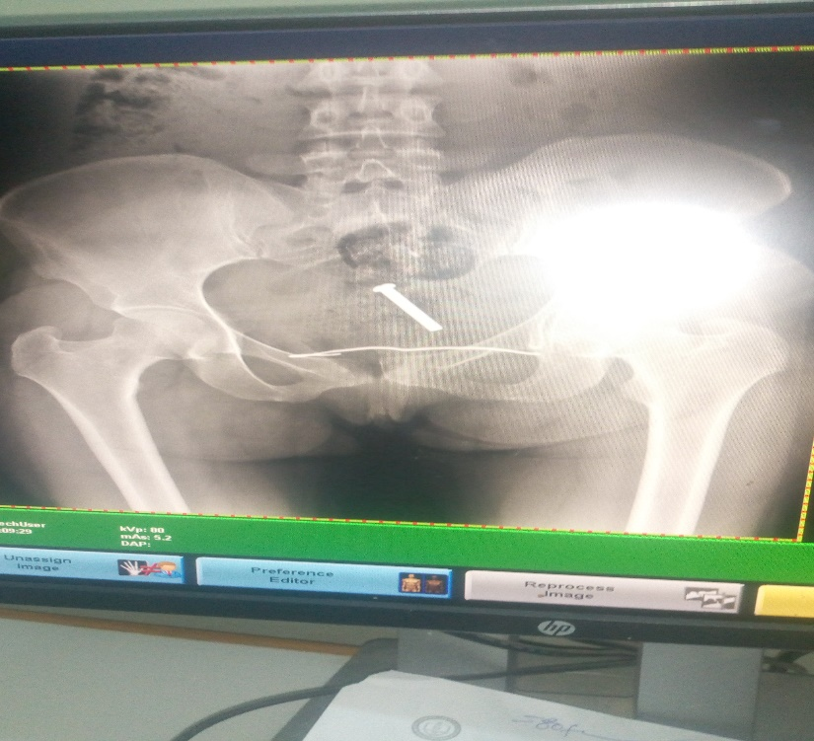
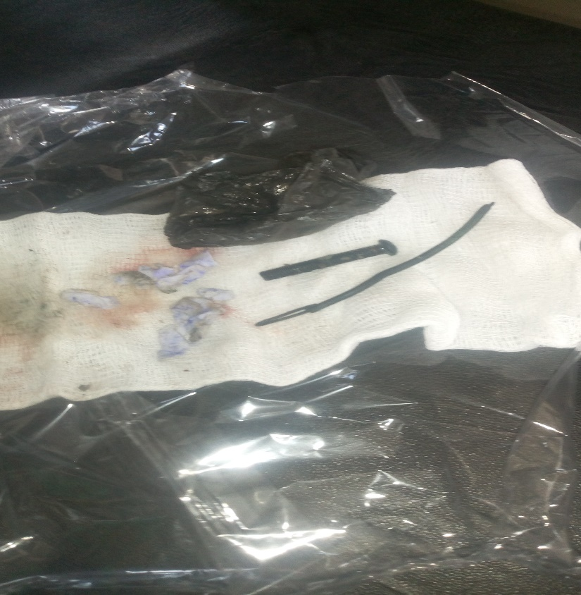
Cont.…
Images of foreign objected inserted into the womb

Slide 17
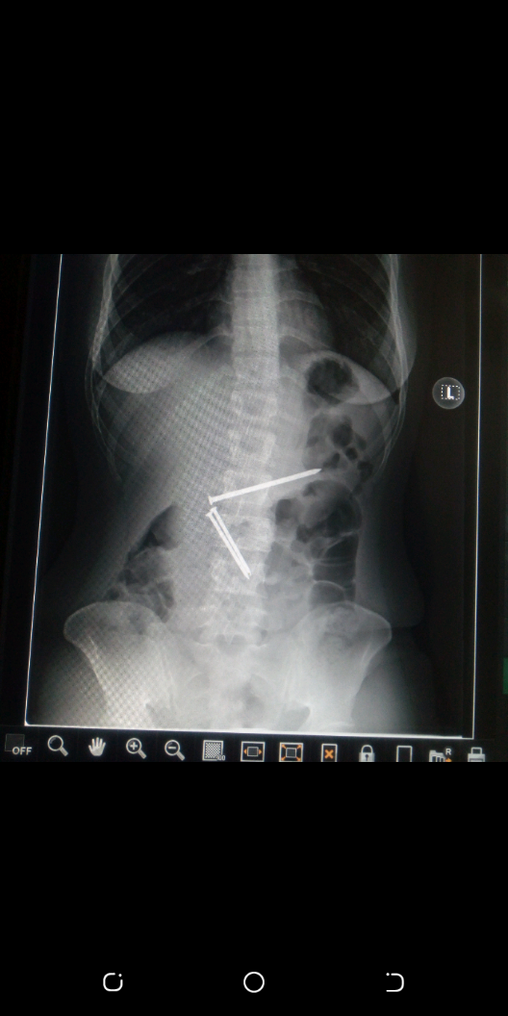
Cont.

Slide 18
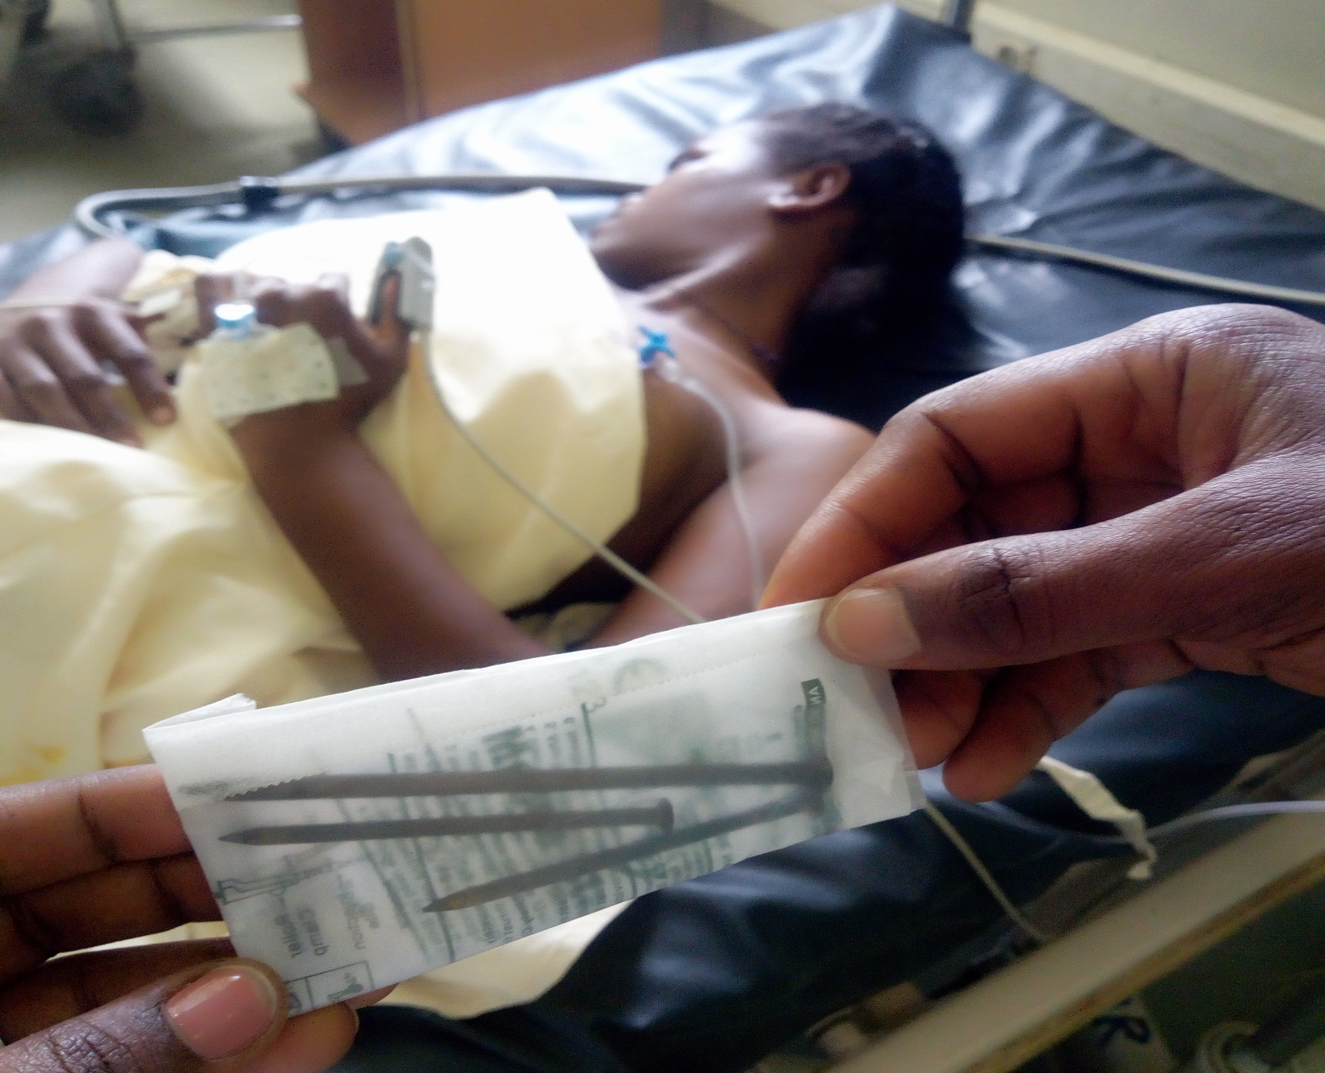
Cont.…

Slide 19
Physical damage resulted from the CRSV

Slide 20
Physical and Sexual and reproductive health (SRH) Impacts
Immobility
Bleeding
Injury
Physical disability
Scars
Burning
Bone fracture or dislocation
Back pain
Sprain and ligament problems
Teeth lose
Losing sight
Losing hearing
Incontinence or fistula
Genital, pelvic rectal, and oral injure,
Unwanted pregnancy
Miscarriage
Complications from unsafe abortions
Menstrual disorder
Pregnancy complications
Infertility
Pelvic pain & dysfunction
Sexually transmitted infections STI including HIV)
Sexual dysfunction
Others

Slide 21
Psychological problems
Suicide exercise (them self and new born child)
Acute stress (PTSD)
Comorbid depression
Anxiety
Psychosis cases
Fear
Hopelessness

Slide 22
Socio economic problems
Family separation
Discrimination
Social Stigma
Begging on street (children and women)
Under age prostitution taken as only option to survive
Lack of food and home materials
Common problems (lack of job, facility, basic services, etc.)
Lack of legal protection

Slide 23
Economic impact
Large numbers of women have no food to eat because it was either burnt or looted;
Household items of all kinds were looted, destroyed.
Domestic animals of all kinds were looted; chicken, goats and cattle of the rural community were thrashed
Farm tools & animal feed were destroyed & fired.

Slide 24
Cont.
Food shortage reached its peak leaving households to acute famine
Children suffered from malnutrition and related health problems
Women who were bread-winners of the family were forced to look for food handouts
Emergency food aid was not available for many or it was not sufficient and, at this time, not at all

Slide 25
Measures Taken By WAT
Providided comprehensive safehouse service to 2029 survivors during and after the conflict with the resource mobilized from Tegaru diaspora, UNFPA, ICRC and individuals in Tigray
1038 survivors reintegrated
Provided Business skill trainng to 788 survivors
Able to provide startup capaital to 430 survivors after the training provided
Provided health services to 45.5% of servivors through referral, (1.2% removed odd object, 30% unwanted pregnancy, 22.5% HIV/AIDS (+ve), 1.7% malignant cancer, 51% STI, 19.5% vaginal bleeding, 3% fistula, 29% URTI)
Provided legal support to 27% cases treated at police, 23.5% at justice and 41.5% at Court

Slide 26
WAT Managed Safe houses
Mekele Safe house
Adigrat Safehouse

Slide 27
Major Challenges observed.
Lack of access to critical support services such as healthcare and safe houses due to budget limitation
Fears of stigma
Victims not reporting cases to protect themselves from social stigma and the potential loss of a marriage
Children born of conflict-related rape. Several babies have been abandoned at the safehouses shortly after birth because their mother’s feared stigma and social rejection should they return to their communities
Fear to report the rape cases due to warnings recived by the perpetuaters
Access barriers for men and boys who have suffered sexual violence

Slide 28
Major Challenges
Economic vulnerabilities frequently associated with loss of livelihood or ability to work due to physical or psychological injuries and an increasing number of female-headed households due to the conflict make the problem more complicated.
The longer-term psychological impacts on children who were themselves violated or who were forced to watch the violation of their parents or other family members remains to be seen.
Minimal effort to psychological support of service providers such as WAT staffs
Magnitude of the problem and having very limited resources to address the demand

Slide 29
Recommendations
Increase funding to support the scale-up of service-providing centers such as safehouses and OSCs to mitigate and address the impacts of CRSV
Increase funding for physical and psycological rehabilitation of survivors who have lost their body parts for those who need surgeries and restoration to regain their dignity, i.e., fistula and uterine prolapse surgeries.
Strengthen the ability of local organizations to provide essential psychosocial support to survivors of atrocities, including CRSV,
Psychosocial interventions that address impacts suffered by children forced to witness CRSV committed against their family members.
Children-focused Shelter, with comprehensive service provision and intervention that focused on the abandoned children due to stigma,

Slide 30
Recommendations
Strengthen awareness of and response to CRSV at community level focusing on stigma
Fund programs providing livelihood training and support. Economic independence can help survivors of CRSV to combat stigma, reintegrate into society, and mitigate risks of further gender-based violence and sexual exploitation.
Programs that enable survivors’ self-sufficiency, including vocational training and micro-credit initiatives, can be an essential aspect of a holistic response to CRSV and longer-term recovery.
Ensure access to HIV-related healthcare support
psychological support of service providers
Transport access to facilitate safe house service

