Slide 1

Turning legal instruments into outcomes: 2030 Agenda as a driver

Slide 2

Agenda 2030 why is it important?

Slide 3
Sustainable development tradition
“Article 50.-The State will seek for the wellbeing of all the habitants in the country, organizing and stimulating the production and the most adequate distribution of wealth.
Every person has the right to a healthy enviorment and ecologically balanced. Thus, is legitimated to denounce the actions that infringe this right and claim for the repairing of the damage done.
The State wil guarantee, defend and preserve this right. The law will determine the responsabilities and regarding sanctions.”
Political Constitution of the Republic of Costa Rica

Slide 4


Slide 5

2030 Agenda: 2015
17 SDGs
169 targets
244 indicators
All countries: not just developing countries
Other directing principles
Human Rights enforcement

Slide 6
2020 Agenda Principles
Universality
Global agreement
Global challenges: migration, climate chance
Integrality
All the agenda
“Leaving no one behind”
All persons
All sectors and stakeholders as implementators
Inclusiveness
Not silo-based

Slide 7
Economic
Environmental
Social
Integrated development approach

Slide 8

Entry points
The government established three priority entry points for public policies to be considered from an integrated and multi sector perspective.
fighting poverty
sustainable production and consumption
resilient infrastructure and sustainable communities.
The aim is to transform the sectoral vision to an integrated vision, joining efforts by all the national actors
Principio
INTEGRALIDAD

Slide 9
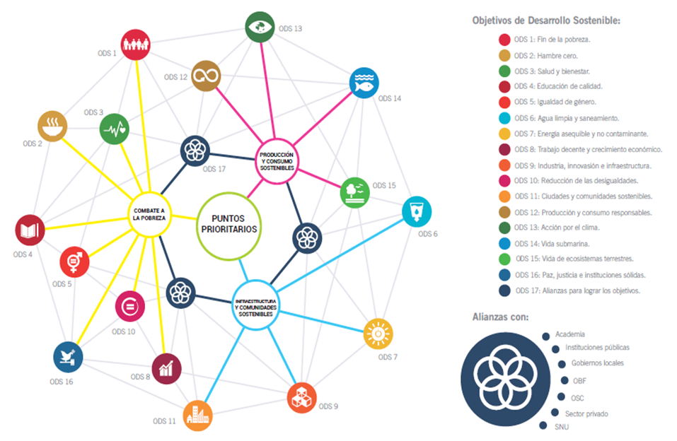
Entry points

Slide 10
2015 Agenda 2030
2016 National Pact for the SDGs
2017 Implementation Governace
2018-2019: Metholody
NDPIP
Time line implementation

Slide 11
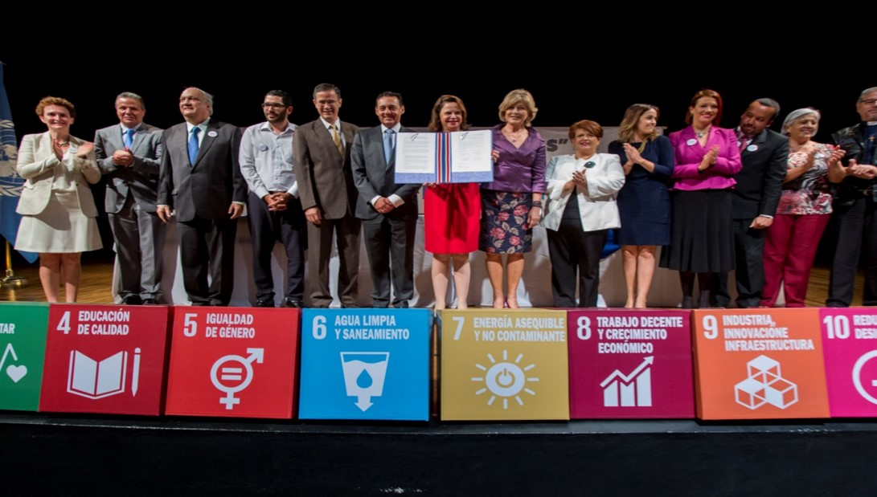
National Agreement for SDGs

Slide 12
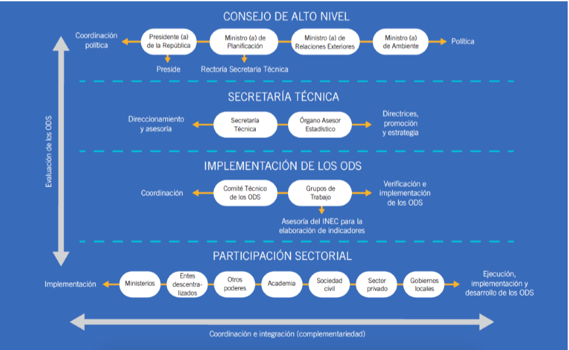
SDG National Governance
Consultive Committee
Notes:
Comité Consultivo de los ODS; Responsabilidades de Gobierno Nacional y Local, 3 grupos de trabajo.

Slide 13
National statistic capacity for SDG monitoring
SDG monitoring national indicators available, January 2019.
Production stage | Amount of indicators | Percentage
Total | 186 | 100
Indicator data is available | 121 | 65
Indicator is not produced but can be done with existing information, but INEC has not recieved the data already. | 35 | 18,82
Information unavailable | 30 | 16,13
Note: 58 indicators were excluded beacause do not apply to Costa Rica
Source: INEC.

Slide 14
Legal human rights instruments: policy issues

Slide 15

Considerations about HR legal instruments
There are indicators that do not give so much information:
SDG 5.c.1 indicator “Proportion of countries with systems to track and make public allocations for gender equality and women’s empowerment”
How?
How much budgetary allocation?
Outcomes of the system?
National HR agreements should have policy implementation complimentary tools
Is it focused on persons or in the approval of a legal instrument?

Slide 16
Considerations about HR legal instruments
Responsible agency for the monitoring: Foreign Affairs, Obudsmen, United Nations Agency…? Are those agencies working directly with the target population?
Where does the human being or the enviornment can be evidenced in the compliance reports?

Slide 17

Montevideo Consensus and SDGs

Slide 18
Montevideo Consensus chapters
A. FULL INTEGRATION OF POPULATION DYNAMICS INTO SUSTAINABLE DEVELOPMENT WITH EQUALITY AND RESPECT FOR HUMAN RIGHTS
B. RIGHTS, NEEDS, RESPONSIBILITIES AND REQUIREMENTS OF GIRLS, BOYS, ADOLESCENTS AND YOUTH
C. AGEING, SOCIAL PROTECTION AND SOCIOECONOMIC CHALLENGES
D. UNIVERSAL ACCESS TO SEXUAL AND REPRODUCTIVE HEALTH SERVICES
E. GENDER EQUALITY
F. INTERNATIONAL MIGRATION AND PROTECTION OF THE HUMAN RIGHTS OF ALL MIGRANTS
G. TERRITORIAL INEQUALITY, SPATIAL MOBILITY AND VULNERABILITY
H. INDIGENOUS PEOPLES: INTERCULTURALISM AND RIGHTS
I. AFRO-DESCENDANTS: RIGHTS AND COMBATING RACIAL DISCRIMINATION

Slide 19
Process
2017 Technical Subsecretariat of Population
2017 First report
2018 indicators + SDGs
2018 PNDIP: implementation

Slide 20

Prioritized measures: 2017
Chapter | Prioritized measures
A | 1 | 3 | 4 | 5
B | 7 | 10 | 16
C | 19 | 20 | 30
D | 34 | 35 | 36 | 37 | 46
E | 47 | 48 | 49 | 50 | 51 | 53 | 54
F | 67 | 68 | 72 | 73 | 74
G | 76 | 80 | 81
H | 85 | 86 | 87 | 88 | 89 | 90
I | 92 | 93 | 95 | 96 | 97 | 98

Slide 21
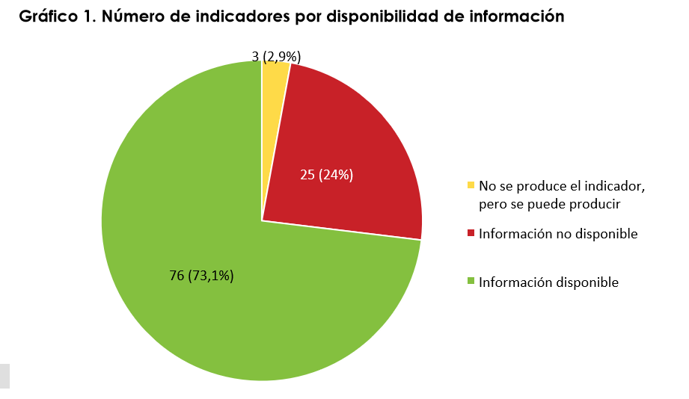
Indicators 2018

Slide 22
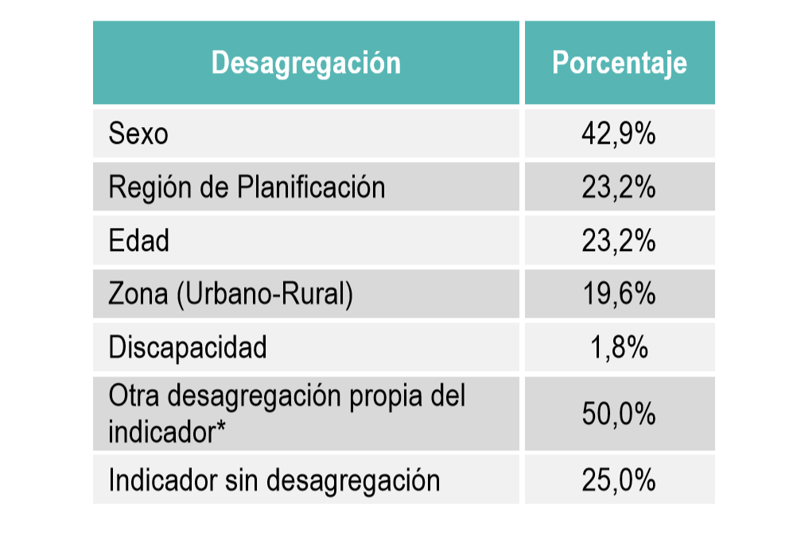
Indicadores 2018
Chapter | Indicators related with national SDGs indicators | %
A | 14 of 20 | 70%
B | 4 of 4 | 100%
C | 1 of 3 | 33,33%
D | 1 of 9 | 11,11%
E | 3 of 10 | 30%
F | 2 of 4 | 50%
G | 2 of 8 | 25%
H | 0 of 6 | 0%
I | 0 of 4 | 0%
Desagregación Porcentaje

Slide 23
National Development and Public Investment Plan (NDPIP):
Lessons learnt and SDG implementation

Slide 24
Lessons learnt
Regions: Evolution of unemployment rate according with interventions in scenario 2019-2022
All national
Some articulation area targets
were calculated through economic modelation methods
impact

Slide 25
National targets
Variable | Indicador
Economic growth | Real GDP growth
Unemployment Unemployment rate
Multidimensional Poverty Index | % of homes according with MPI
Descarbonization | Variation rate according with CO2 emissions due to fossil fuels use
Unequality | Gini Coefficient

Slide 26
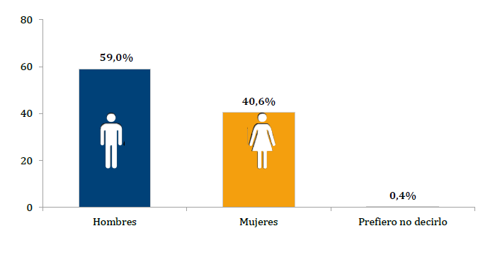
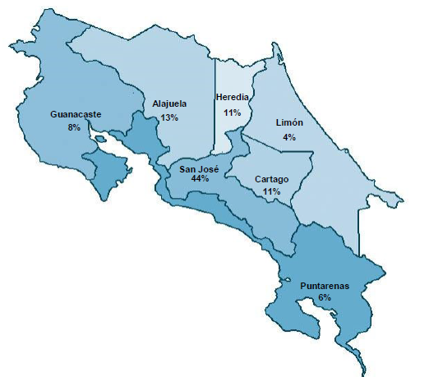
Public online consultation

Slide 27
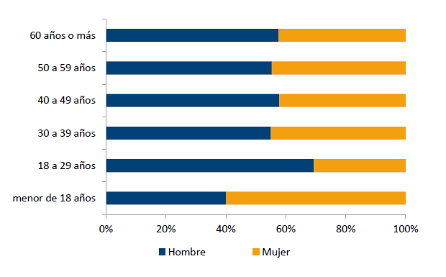
Public online consultation

Slide 28
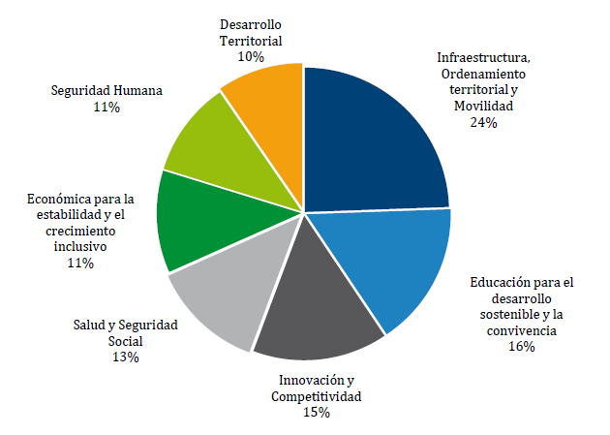
Public online consultation
Territorial development
10%
Infrastructure, territorial planning and mobility
24%
Human security
11%
Economic for stability and inclusive growth
11%
Education for sustainable development and coexistence
16%
Health and Social Security
13%
Innovation and competitiveness
15%

Slide 29
SDGs implementation
SDG indicators
Current targets for 2019-2022
Population specific targets
  Hadicapped populations (employment)
  LGBTIQ population (institutional affirmative actions).
  Afrodescents
Data disaggregation (population, sex, territory)

Slide 30
e.g. Poverty
Multidimensional poverty evolution 2019-2022 according with interventions
% homes under poverty line

Slide 31
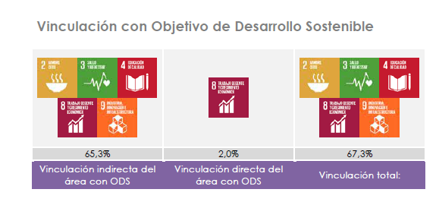
Innovation and competitiveness presidential area
SDG linkage
Indirect SDG linkage
Direct SDG linkage
Total SDG linkage

Slide 32
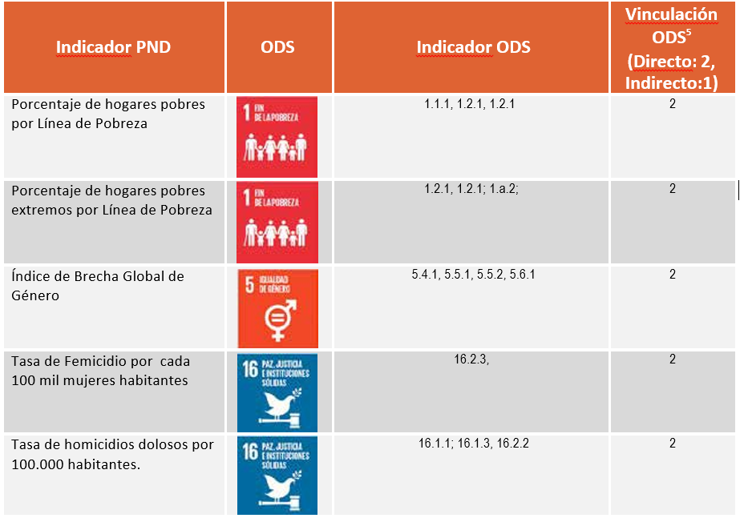

Slide 33
Other stakeholders….?
Projects and processes that contribute with the targets and indicators settled in National Planning
Traceable
Ambitious: transforming committments, not just activities
Rigorous feasibility

Slide 34
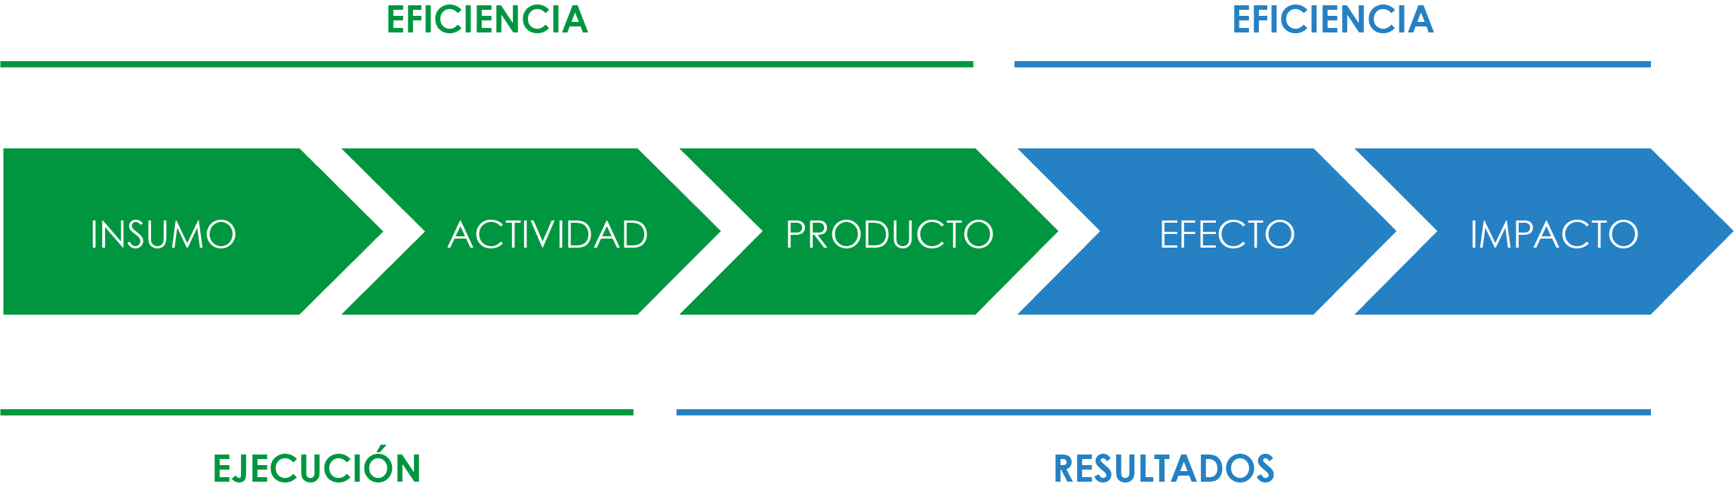
2030 Agenda: Transforming? our world….
Results chain
EFFICENCY
EFECTIVENESS
EXECUTE
RESULTS

Slide 35
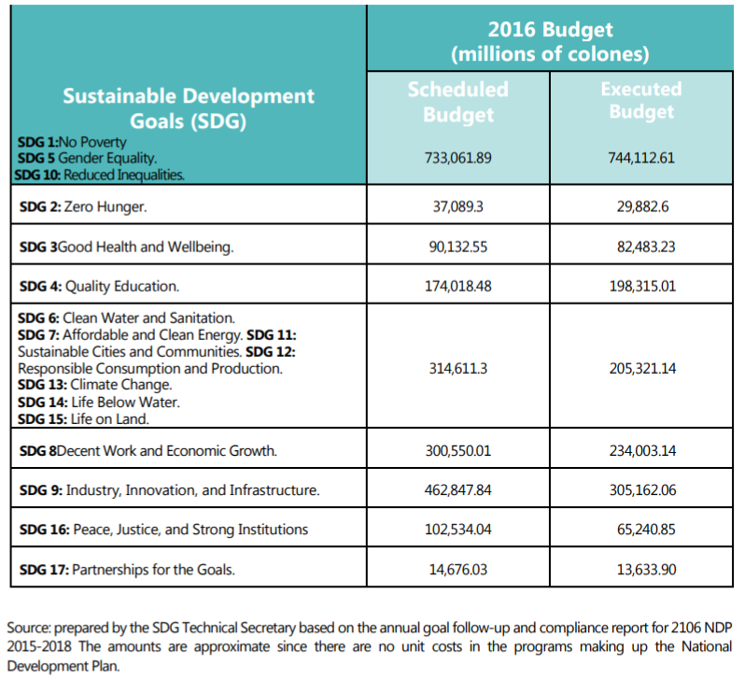
Approximate investment per SDG according to the 2015-2018 NDP

Slide 36
SDG 2019:
Human Rights

Slide 37
Key projects to ensure the respect of Human Rights
National Strategic Plan
2018-2022
Bridge to development: National Strategy for Poverty Reduction
Inclusive and Diverse development Strategy (Human Rights Protection Policies for women, children, teenagers, young adults, seniors, migrants, persons with disabilities, indigenous people and LGTBQ community)
Program “Go forward”
National Strategy to Adapt and Resist the Climate Change effects
Building Opportunities

Slide 38
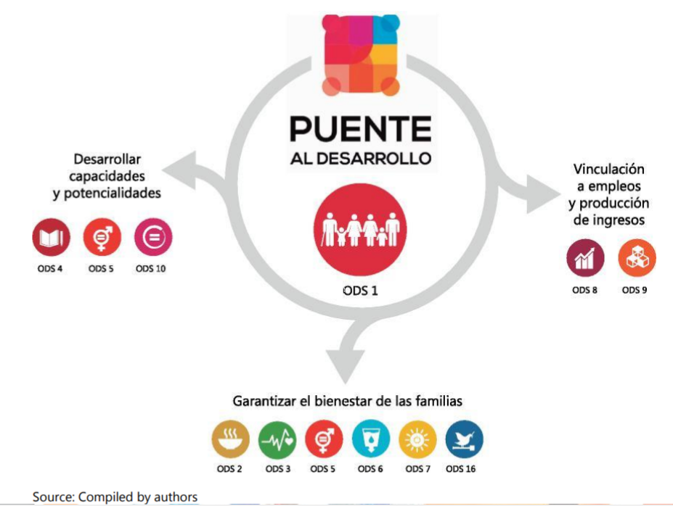
Bridge to development: National Strategy for Poverty Reduction

Slide 39
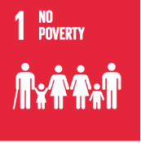




Inclusive and Diverse development Strategy
Indicators
Number of persons that benefit from the interventions of public entities articulated and accessible for the promotion and protection of human righs
Inclusive and Diverse development Strategy
According to schedule
Percent of the migrant population cover by the programs of “migramovil”
Percent of the public institutions that apply the “Accessibility Management Index”
Unaccomplisment risk

Slide 40






National Strategy to Adapt and Resist the Climate Change effects
Indicators
Number of community-based organizations that apply actions of adaptation of climate change, in their communities
National Strategy to Adapt and Resist the Climate Change effects
According to schedule
Amount of hectares that apply measures of adaptation based on their ecosystem

Slide 41

Program “Go forward”
Indicators
Program “Go forward”
Number of high school students that received a money transfer through the Program Go Forward, national and local level
According to schedule

Slide 42

Program “Building Opportunities ”
Indicators
Program “Building Opportunities”
Number of persons that engaged in labor remunerate activities inside the penitentiary system
According to schedule

Slide 43
secretariaodscr@mideplan.go.cr www.ods.cr

