Slide 1
The Tagal System
The Tagal System is an umbrella term used by the Sabah state government to refrer to a community-led indigenous water resource management practice used by indigenous communities in Sabah for generations.
Different communities have different names for the practice; however, the more widespread are either "Bombon” or “Tagal", with the latter the term preferred by the State government.
The practice involves the conservation & protection of waterways and water sources located in indigenous territories to ensure their water remains clean and unpolluted.

Slide 2
Though there are minor differences due to each community's local circumstances, the Tagal system operates by designating rivers within a community’s territory into zones.
These zones are usually identified by a committee set up in the village. The Tagal zones become non-fishing zones until the Tagal committee allows it for a limited time, for example, a few days of fishing every two years.

Slide 3
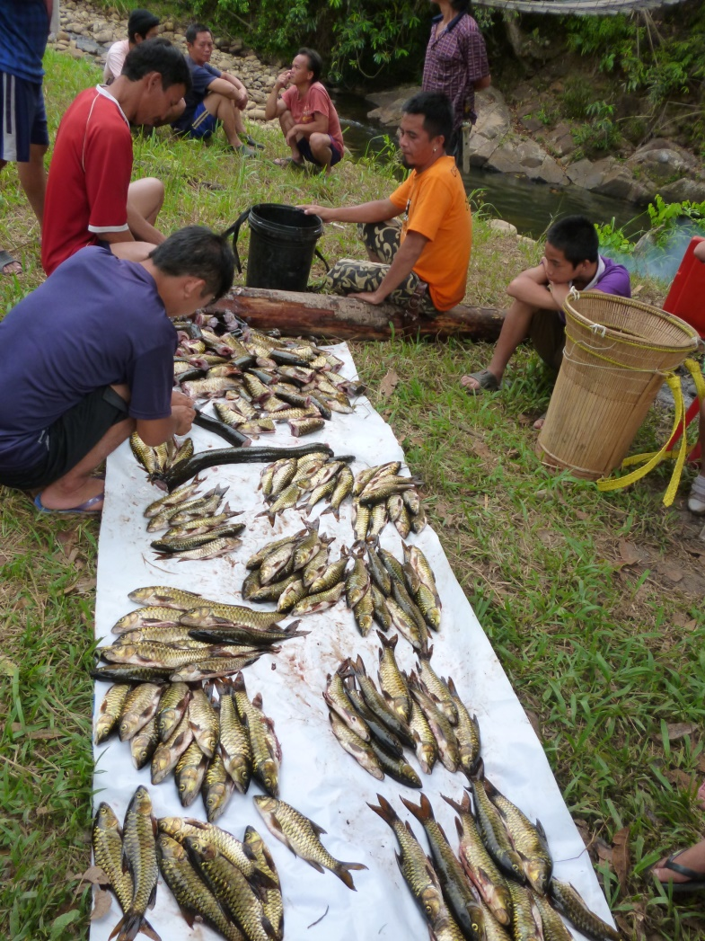
These periods are usually decided communally and often coincide with indigenous celebrations like harvest festivals or times of need such as indigenous customs requiring specific consumption of fish (e.g. pregnant mothers).

Slide 4
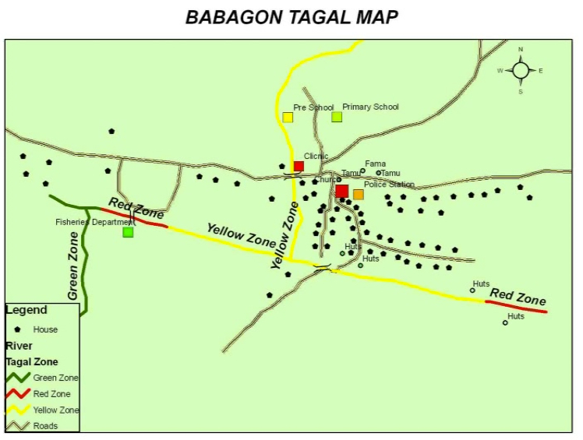
Example of Tagal zones:
  Red: fishing or other activity is entirely banned
  Yellow: prohibit fishing except for exceptional circumstances; Eg: Pregnant woman or elderly
  Green: Fishing is prohibited except for “buka tagal” fishing session usually for one-two days every one or two years.

Slide 5
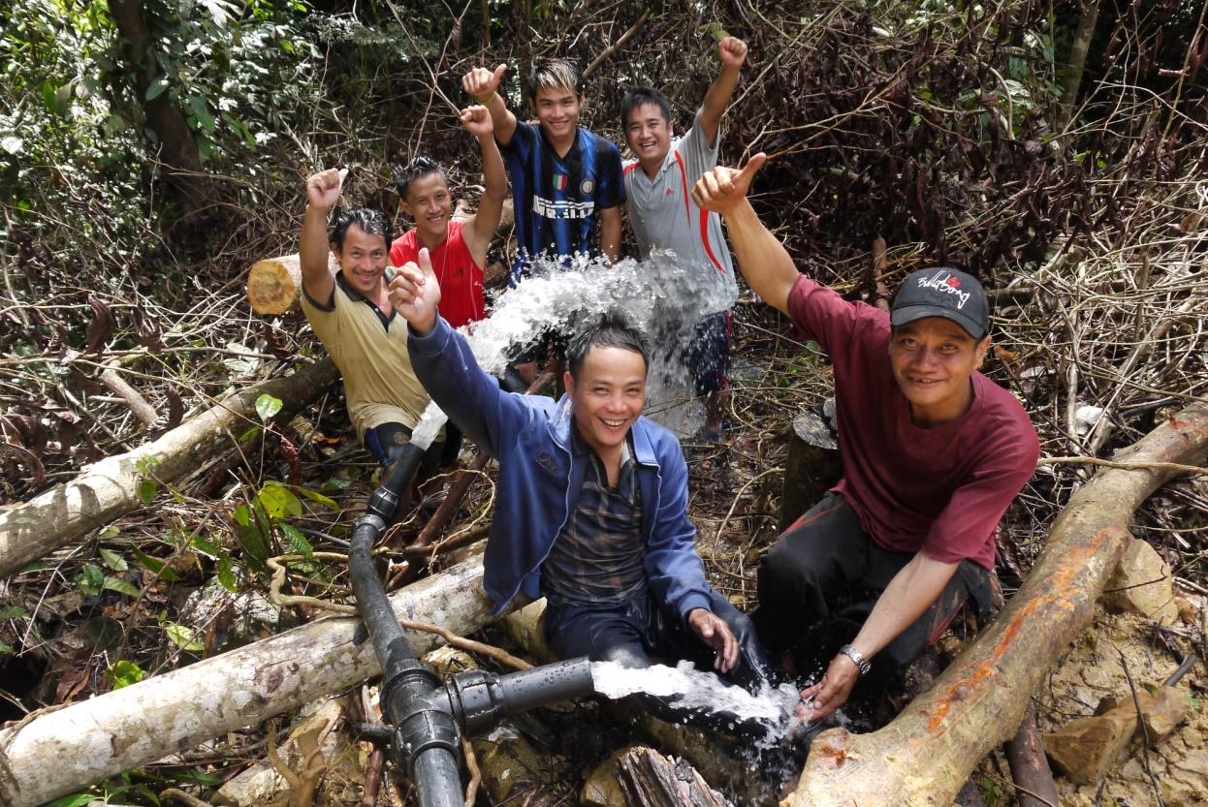
Often, especially for indigenous communities in the hills, these Tagal protection zones cover all waterways in the territory, including springs in catchment areas as these are acknowledged as tributaries to the downstream river.
This practice has especially benefited these communities that rely on surface water through gravity fed systems, as it has led to a direct improvement to the quality and consistency of the water supply drawn from these sources.

Slide 6
Any breaches by either community members or outsiders are heavily fined, often requiring a customary fine of livestock like a whole pig together with monetary fines.
These fines are then used to support the community in managing their river resources; if the fine is monetary, it usually used as operating funds for the Tagal committee. If the fine is livestock, then it is distributed to every household in the community.

Slide 7
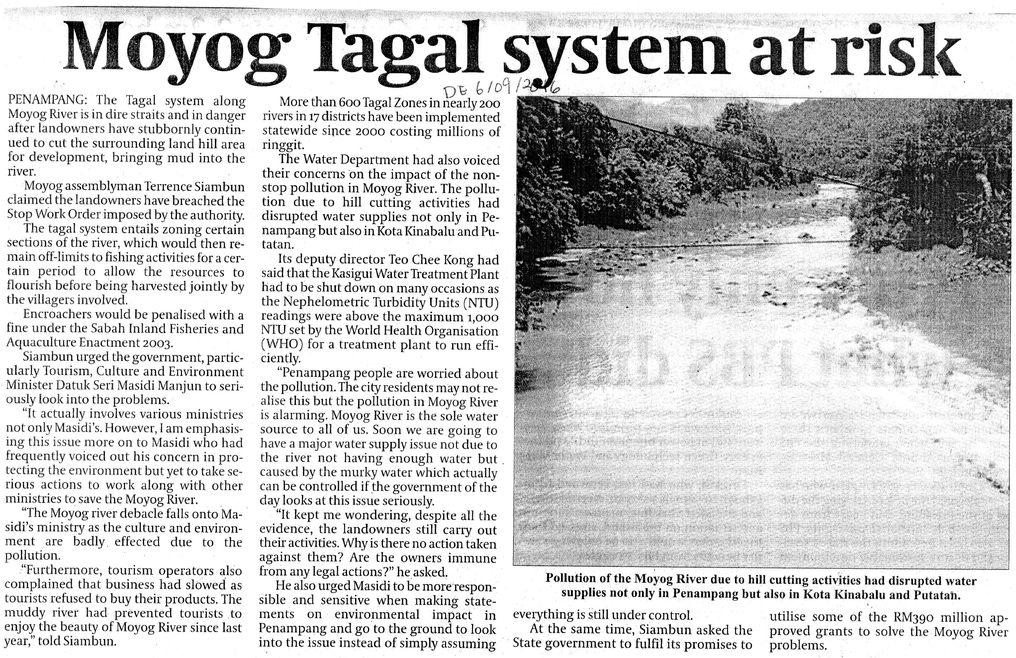
In 2017, damage to a community Tagal became one of the grounds for a civil suit by an indigenous community against the private enterprise involved and State government for their inaction. This case was later settled out of court in favour of the community.

Slide 8
The effective results produced by communities who practised the system convinced the state fisheries department to endorse and support communities implementing the Tagal System officially.
The State department provides fisheries management advice and even monetary support for committees wishing to erect signposts warning outsiders of Tagal Zones. The department also actively encourages communities with rivers to practice the Tagal system if they do not have traditional management practices.

Slide 9
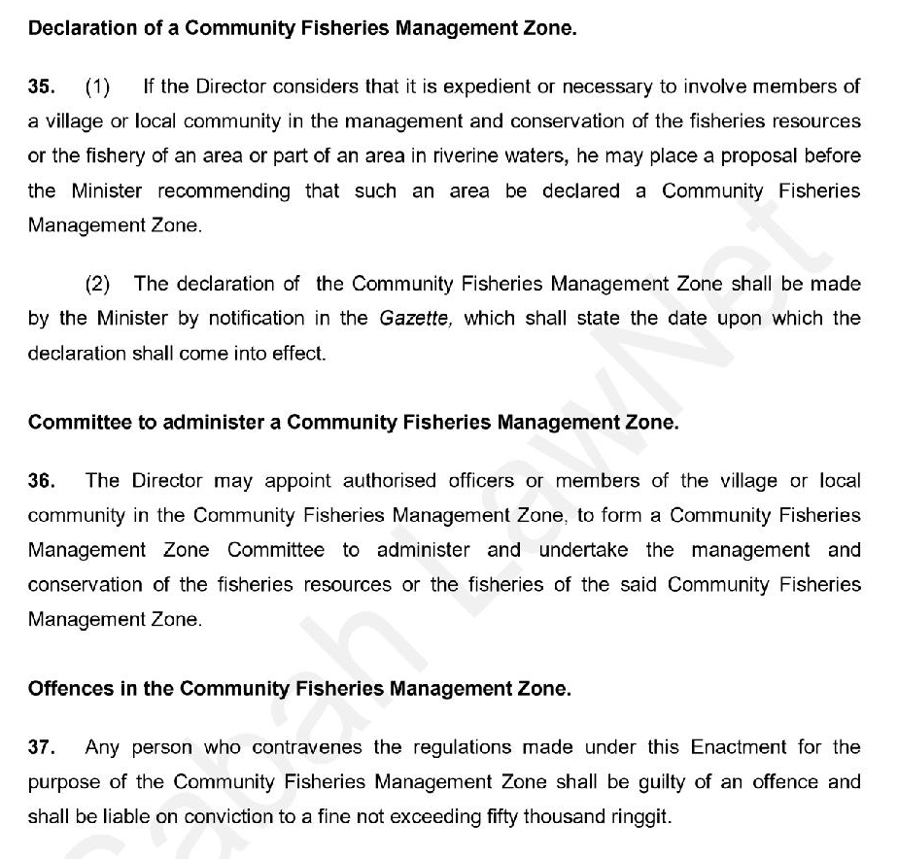
In 2003, the State Government legislated the Tagal system into the Sabah Inland Fisheries and Aquaculture Enactment, defining them as “Community Fisheries Management Zones”. The Tagal system is now replicated in many more communities with riverine systems due to state endorsement and encouragement.

