Slide 1
Mapping international recoveries and returns of stolen assets under UNCAC
An insight into the practice of cross-border repatriation of proceeds of corruption over the past 10 years

Slide 2
The “club” of states that are pursuing cross-border asset recovery cases involving corruption proceeds is growing rapidly.

Slide 3
Response Distribution
Table 1 - Responses by Income Level
 | No.
HIGH | 36
UPPER-MIDDLE | 24
LOWER-MIDDLE | 16
LOW | 2
Total | 78
Table 2 - Responses – Regional breakdown
 | No.
EAP (East Asia & Pacific) | 11
ECA (Europe & Central Asia) | 31
LAC (Latin America & Caribbean) | 11
MENA (Middle East & North Africa) | 12
NA (North America) | 1
SA (South Asia) | 3
SSA (Sub-Saharan Africa) | 9
Total | 78

Slide 4
Table 4 – Responses by Involvement in Cross-Border Asset Recovery Cases Involving Corruption Proceeds | Total
# of countries reported involvement in at least one case | 59
# of countries reported involvement in at least one completed return | 40
# of countries reported involvement in at least one confiscation | 24
# of countries reported involvement in at least one freeze | 48
# countries responded & did not report any cases | 19
Total # of responses received | 78

Slide 5
States reporting involvement in largest numbers of international asset recovery cases in StAR survey
Table 6 - Total Reported Cases (returns/confiscations/freezes)
 | Reporting Country | No of Cases Reported
1 | USA | 29
2 | Nigeria | 25
3 | Australia | 15
4 | Latvia India China (incl. Hong Kong SAR and Macao SAR) | 14
5 | United Kingdom | 15
6 | South Africa | 12
7 | Singapore | 11
8 | Panama Liechtenstein | 10
9 | South Korea | 9
10 | Malaysia Argentina Brazil Italy | 8
To assess progress towards the goals of chapter V of UNCAC, the number of cases pursued and the level of participation in international asset recovery actions by countries around the world matter just as much as asset amounts frozen, confiscated, and returned.

Slide 6
While proceeds of crime often wind up in the largest or regional global financial centers, survey data show a diversification of international destination countries for stolen assets by corrupt public officials.

Slide 7
Based on survey data alone, close to US$10 billion (US$ 9.7 billion) in corruption proceeds have been either frozen, restrained, confiscated in a destination country or returned to a country that was harmed by corruption since 2010.

Slide 8
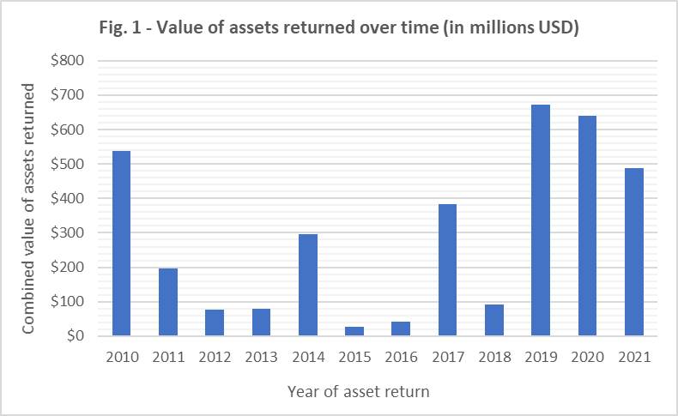
Table 12: Total values of assets in reported asset recovery actions in StAR survey, 2010-21
 | USD Value
Assets Returned | 4,114,938,949
Assets Confiscated | 266,868,642
Assets Frozen | 5,301,143,809
Total | 9,682,951,400
Duplicates excluded (where identified); any case with end date prior to 2010 excluded
Based only on data from StAR survey. Duplicates excluded (where identified). Using annualized
figures for returns over multiple years. No date provided for returns totaling USD 540,119,795.

Slide 9
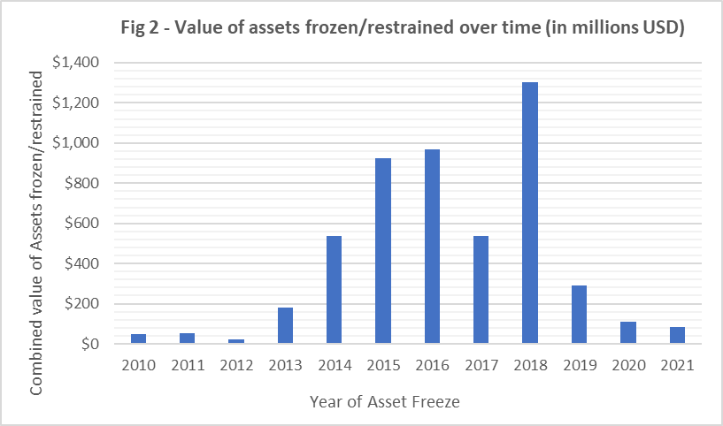
Based only on data from StAR survey. Duplicates excluded (where identified). Using annualized
figures for freezing actions over multiple years. No date provided for freezes totaling USD 131,948,625.

Slide 10
The largest players: states reporting largest values of corruption proceeds returned to other states or received by other states (cumulative)
Table 10 – Value of Reported Asset Returns by Countries of Asset Location
Reporting Country | Cumulative USD Value
USA* | 1,828,023,940
Switzerland* | 370,300,000
Jersey | 328,241,000
Singapore | 319,457,738
Liechtenstein | 203,142,811
Table 11 – Value of Reported Asset Returns by Countries of Origin
Reporting Country | Cumulative USD Value
Nigeria | 1,205,341,754
Malaysia* | 1,192,086,758
Russian Federation | 311,238,000
Tunisia | 138,360,000
Brazil | 82,198,770

Slide 11
Conclusions
Overall, many promising signs of progress towards the goals of UNCAC’s chapter V:
  Increase in the number of cases that countries are pursuing
  Larger geographic spread – countries in all regions of the world are involved
  Increase in the amounts of assets returned
  Increase in legal mechanisms available
  UNCAC serves a practical role as a legal basis for international cooperation
But also areas in need of improvement:
  Better data collection mechanisms
  Returns are still far from estimated amount taken out of countries annually
  Develop transparency norms for the recovery & return of corruption proceeds & how returned funds are being used

Slide 12
Thank you!

