Slide 1
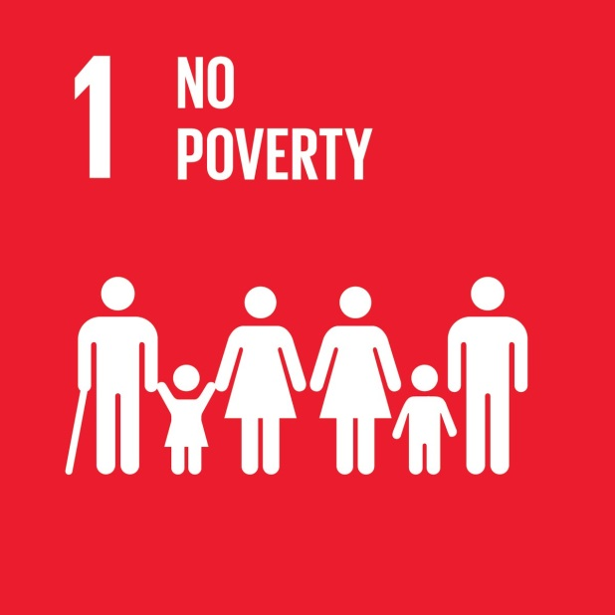
SDG 1: No Poverty
End poverty in all its forms everywhere
Targets include eradicating extreme poverty; implementing social protection measures; and ensuring equal access of men and women to economic resources.
Related human rights
Right to an adequate standard of living
[UDHR art. 25; ICESCR art. 11; CRC art. 27]
Right to social security
[UDHR art. 22; ICESCR art. 9; CRPD art. 28; CRC art. 26]
Equal rights of women in economic life
[CEDAW arts. 11, 13, 14(2)(g), 15(2), 16(1)]

Slide 2
SDG 2: Zero Hunger
End hunger, achieve food security and improved nutrition, and promote sustainable agriculture
Targets include ending hunger and malnutrition;
improving agricultural production, sustainable and
resilient food production; correcting trade distortions, and ensuring functioning food commodity markets.
Related human rights
Right to adequate food [UDHR art. 25; ICESCR art. 11; CRC art. 24(2)(c)]
International cooperation, including ensuring equitable distribution of world food supplies [UDHR art. 28; ICESCR arts. 2(1), 11(2)]

Slide 3
SDG 3: Good Health and Well-Being
Ensure healthy lives and promote well – being for all at all ages
Targets include reducing maternal mortality; ending preventable child deaths; ending or reducing AIDS other diseases; universal health coverage, affordable essential medicines, sexual and reproductive health care; vaccine research, and access to medicines.
Related human rights
Right to life [UDHR art. 3; ICCPR art. 6], particularly of women [CEDAW art.12] and children [CRC art. 6]
Right to health [UDHR art. 25; ICESCR art. 12], particularly of women [CEDAW art. 12]; and children [CRC art.24]
Special protection for mothers and children [ICESCR art.10]
Right to enjoy the benefits of scientific progress and its application [UDHR art. 27; ICESCR art. 15(1)(b)]
International cooperation [UDHR art. 28, DRtD arts. 3-4], particularly in relation to the right to health and children’s rights [ICESCR art. 2(1); CRC art. 4]

Slide 4
SDG 4: Quality Education
Ensure inclusive and equitable quality education and promote life-long learning opportunities for all
Targets include universal access to free, quality preprimary, primary and secondary education; improving vocational skills; equal access to education; expanding education facilities, scholarships, and training of teachers.
Related human rights
Right to education [UDHR art. 26; ICESCR art. 13], particularly in relation to children [CRC arts. 28, 29];
persons with disabilities [CRC art. 23(3), CRPD art. 24]; and indigenous peoples [UNDRIP art. 14]
Equal rights of women and girls in the field of education [CEDAW art. 10]
Right to work, including technical and vocational training [ICESCR art. 6]
International cooperation [UDHR art. 28; DRtD arts. 3-4], particularly in relation to children [CRC arts. 23(4), 28(3)], persons with disabilities [CRPD art. 32], and indigenous peoples [UNDRIP art.39]

Slide 5
SDG 5: Gender Equality
Achieve gender equality and empower all women and girls
Targets include eliminating discrimination and violence against women and girls; valuing unpaid care and domestic work; ensuring the full participation of women; access to reproductive health care; and equal access of women to economic resources.
Related human rights
Elimination of all forms of discrimination against women [CEDAW arts. 1-5] and girls [CRC art. 2], particularly in legislation, political and public life (art. 7), economic and social life (arts. 11, 13), and family relations (art. 16)]
Right to decide the number and spacing of children [CEDAW arts. 12, 16(1)(e); CRC art. 24(2)(f)]
Special protection for mothers and children [ICESCR art. 10]
Elimination of violence against women and girls [CEDAW arts. 1- 6; DEVAW arts. 1-4; CRC arts. 24(3), 35]
Right to just and favourable conditions of work [ICESCR art. 7; CEDAW art. 11]

Slide 6
SDG 6: Clean Water and Sanitation
Ensure availability and sustainable management
of water and sanitation for all
Targets include ensuring universal and equitable access to safe, affordable drinking water, sanitation and hygiene for all; reducing pollution; increasing water-use efficiency; and promoting participatory management of water and sanitation services.
Related human rights
Right to safe drinking water and sanitation [ICESCR art. 11]
Right to health [UDHR art. 25; ICESCR art. 12]
Equal access to water and sanitation for rural women [CEDAW art. 14(2)(h)]

Slide 7
SDG 7: Affordable and Clean Energy
Ensure access to affordable, reliable, sustainable and modern energy for all
Targets include ensuring universal access to affordable, reliable and modern energy services.
Related human rights
Right to an adequate standard of living [UDHR art. 25; ICESCR art. 11]
Right to enjoy the benefits of scientific progress and its application [UDHR art. 27; ICESCR art. 15(1)(b)]

Slide 8
SDG 8: Decent Work and Economic Growth
Promote sustained, inclusive and sustainable economic growth, full and productive employment and decent work for all
Targets include promoting sustained economic growth; improving resource efficiency in production and consumption; full and productive employment and decent work for all; eradicating forced and child labour and trafficking; protecting labour rights including those of migrant workers; and increasing access to financial services.
Related human rights
Right to work and to just and favourable conditions of work [UDHR art. 23; ICESCR arts. 6, 7, 10; CRPD art. 27; ILO Core Labour Conventions and ILO Declaration on Fundamental Principles and Rights at Work]
Prohibition of slavery, forced labour, and trafficking of persons [UDHR art. 4; ICCPR art. 8; CEDAW art. 6; CRC arts. 34-36]
Equal rights of women in relation to employment [CEDAW art. 11; ILO Conventions No. 100 and No. 111]
Prohibition of child labour [CRC art. 32; ILO Convention No. 182]
Equal labour rights of migrant workers [CMW art. 25]

Slide 9
SDG 9: Industry, Innovation and Infrastructure
Build resilient infrastructure, promote inclusive and sustainable industrialisation and foster innovation Targets include affordable and equitable access to quality infrastructure; employment generating industrialisation; access to financial services and markets; innovation and technology transfer, and increasing access to ICT.
Related human rights
Right to enjoy the benefits of scientific progress and its application [UDHR art. 27; ICESCR art. 15(1)(b)]
Right to access to information [UDHR art. 19; ICCPR art. 19(2)]
Right to adequate housing, including land and resources [UDHR art. 25; ICESCR art. 11]
Equal rights of women to financial credit and rural infrastructure [CEDAW art. 13(b), art. 14(2)]

Slide 10
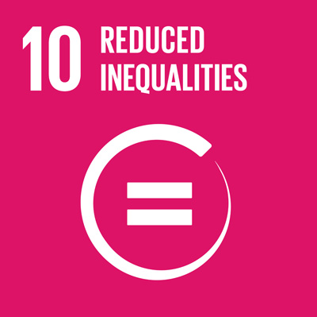
SDG 10: Reduce Inequalities
Reduce inequality within and among countries
Targets include promoting higher growth rates for the bottom 40 per cent; promoting social, economic and political inclusion; reducing inequalities in opportunities and outcomes; ensuring social protection for all; securing participation in economic decision making; facilitating migration, and reducing transaction costs for migrant remittances.
Related human rights
Right to equality and non-discrimination [UDHR art. 2; ICESCR art. 2(2); ICCPR arts. 2(1), 26; CERD art. 2(2); CEDAW art. 2; CRC art. 2; CRPD art. 5; CMW art. 7; DRtD art. 8(1)]
Right to participate in public affairs [UDHR art. 21; ICCPR art. 25; CEDAW art. 7; ICERD art. 5; CRPD art. 29; DRtD art. 8(2)]
Right to social security [UDHR art. 22; ICESCR arts. 9-10; CRPD art. 28]
Promotion of conditions for international migration [CMW art. 64]
Right of migrants to transfer their earnings and savings [CMW art. 47(1)]

Slide 11
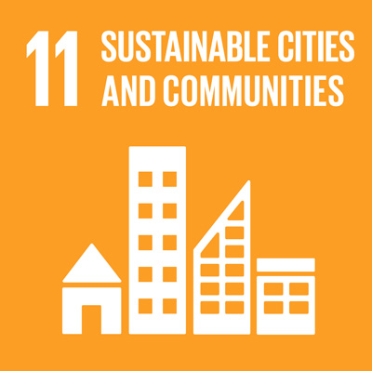
SDG 11: Sustainable Cities and Communities
Make cities and human settlements inclusive, safe, resilient and sustainable
Targets include ensuring access to housing, basic services and public transport for all; participatory planning of human settlements; safeguarding cultural and natural heritage; and strengthening resilience to disasters.
Related human rights
Right to adequate housing, including land and resources [UDHR art. 25; ICESCR art. 11]
Right to participate in cultural life [UDHR art. 25; ICESCR art. 15; ICERD arts. 5, 7; CRPD art. 30; CRC art. 31]
Accessibility of transportation, facilities and services particularly of persons with disabilities [CRPD art. 9(1)], children [CRC art. 23], and rural women [CEDAW art. 14(2)]
Protection from natural disasters [CRPD art. 11]

Slide 12
SDG 12: Responsible Consumption and Production
Ensure sustainable consumption and production patterns
Targets include achieving sustainable management and efficient use of natural resources; improving waste management; promoting sustainable public procurement; ensuring access to information; and building capacity for sustainable development.
Related human rights
Right to health including the right to safe, clean, healthy and sustainable environment [UDHR art. 25(1); ICESCR art. 12]
Right to adequate food and the right to safe drinking water [UDHR art. 25(1); ICESCR art. 11]
Right of all peoples to freely dispose of their natural resources [ICCPR, ICESCR art. 1(2)]

Slide 13
SDG 13: Climate Action
Take urgent action to combat climate change and its impacts
Targets include strengthening resilience and adaptation to climate change and natural disasters, including in marginalised communities; implementation of the Green Climate fund.
Related human rights
Right to health including the right to safe, clean, healthy and sustainable environment [UDHR art. 25(1); ICESCR art. 12; CRC art. 24; CEDAW art. 12; CMW art. 28]
Right to adequate food & right to safe drinking water [UDHR art. 25(1); ICESCR art. 11]
Right of all peoples to freely dispose of their natural wealth and resources [ICCPR, ICESCR art. 1(2)]

Slide 14
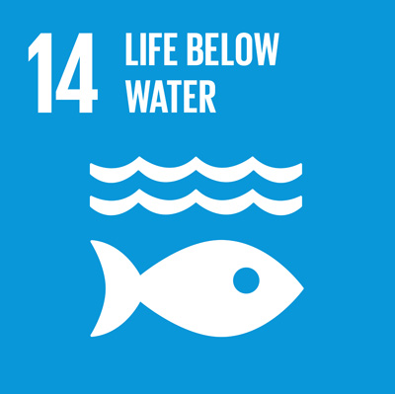
SDG 14: Life below Water
Conserve and sustainably use the oceans, seas and marine resources for sustainable development
Targets include reducing marine pollution; conserving costal ecosystems, costal marine areas and fish stock; securing market access for small scale fishers; protection of marine biodiversity.
Related human rights
Right to health including the right to safe, clean, healthy and sustainable environment [UDHR art. 25(1); ICESCR art. 12; CRC art. 24; CEDAW art. 12; CMW art. 28]
Right to adequate food & right to safe drinking water [UDHR art. 25(1); ICESCR art. 11]
Right of all peoples to freely dispose of their natural wealth and resources [ICCPR, ICESCR art. 1(2)]

Slide 15
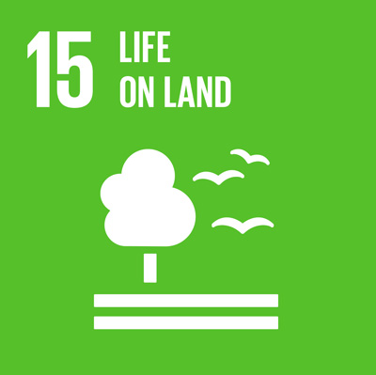
SDG 15: Life on Land
Protect, restore and promote sustainable use of terrestrial ecosystems, sustainably manage forests, combat desertification, and halt and reverse land degradation and halt biodiversity loss
Targets include the sustainable management of freshwater, mountain ecosystems and forests; combatting desertification; halting biodiversity loss; combatting poaching and trafficking of protected species.
Related human rights
Right to health including the right to safe, clean, healthy and sustainable environment [UDHR art. 25(1); ICESCR art. 12; CRC art. 24; CEDAW art. 12; CMW art. 28]
Right to adequate food & right to safe drinking water [UDHR art. 25(1); ICESCR art. 11]
Right of all peoples to freely dispose of their natural wealth and resources [ICCPR, ICESCR art. 1(2)]

Slide 16
SDG 16: Peace, Justice and Strong Institutions
Promote peaceful and inclusive societies for sustainable development, provide access to justice for all and build effective, accountable and inclusive institutions at all levels : Targets include reducing all forms of violence; ending violence against and trafficking of children; promoting rule of law and justice for all; reducing illicit financial and arms flows, corruption and bribery; developing effective institutions; participation in decision making at all levels; legal identity for all.
Related human rights
Right to life, liberty and security of the person [UDHR art. 3; ICCPR arts. 6(1), 9(1); ICPED art. 1] including freedom from torture [UDHR art. 5; ICCPR art. 7; CAT art. 2; CRC art. 37(a)]
Protection of children from all forms of violence, abuse or exploitation [CRC arts. 19, 37(a)), including trafficking (CRC arts. 34-36; CRC–OP1)]
Right to access to justice and due process [UDHR arts. 8, 10; ICCPR arts. 2(3), 14-15; CEDAW art. 2(c)]
Right to legal personality [UDHR art. 6; ICCPR art. 16; CRPD art. 12]
Right to participate in public affairs [UDHR art. 21; ICCPR art. 25]
Right to access to information [UDHR art. 19; ICCPR art. 19(1)]

Slide 17
SDG 17: Partnerships for the Goals
Strengthen the means of implementation and revitalize the global partnership for sustainable development
Targets include strengthening domestic and international resources; debt sustainability; technology transfer and capacity building; promoting trade; enhancing policy and institutional coherence; respecting countries’ policy space; promoting multi-stakeholder partnerships; measurements for progress, disaggregated data.
Related human rights
Right of all peoples to self-determination [ICCPR, ICESCR art. 1(1); DRtD art. 1(1)]
Right of all peoples to development, & international cooperation [UDHR art. 28; ICESCR art. 2(1); CRC art. 4; CRPD art. 32(1); DRtD arts. 3-5]
Right of everyone to enjoy the benefits of scientific progress and its application, including international cooperation in the scientific field [UDHR art. 27(1); ICESCR art. 15(1)]
Right to privacy [UDHR art. 12; ICCPR art. 17], including respect for human rights and ethical principles in the collection and use of statistics [CRPD art. 31(1)]

