Slide 1
Training course on Human Rights at International Borders

Slide 2
Session 1
Introduction
to human rights

Slide 3
Session 1 content
1.1. Human rights
1.2. Gender, migration and human rights
1.3. Human rights at international borders
1.4. Key human rights principles at international borders
1.5. Human rights of border officials and institutional accountability

Slide 4
Session 1 learning objectives
After this session, learners will be able to:
Describe the nature of States’ obligations under human rights law
Describe the concept of gender and how it is relevant to border governance
Identify some human rights potentially at risk at international borders
Describe three key human rights principles in the area of border governance
Identify the human rights of border authorities and their obligations in respecting and protecting human rights

Slide 5
1.1.
Human rights

Slide 6
1.1.1. What do we need to flourish as human beings?
In your groups, briefly discuss the question and write your ideas − using keywords − on the flip chart.
Tip: Think about yourselves and your families:
What do you need to lead dignified and fulfilled lives?
You have 5 minutes for the discussion.

Slide 7
1.1.2. What are human rights?
Expressions of human dignity
A set of agreed values/norms reflecting the principles of dignity, equality and freedom
Legal standards and agreements –international and regional
Inherent to individuals, and primarily define the relationship between the individual and the State

Slide 8
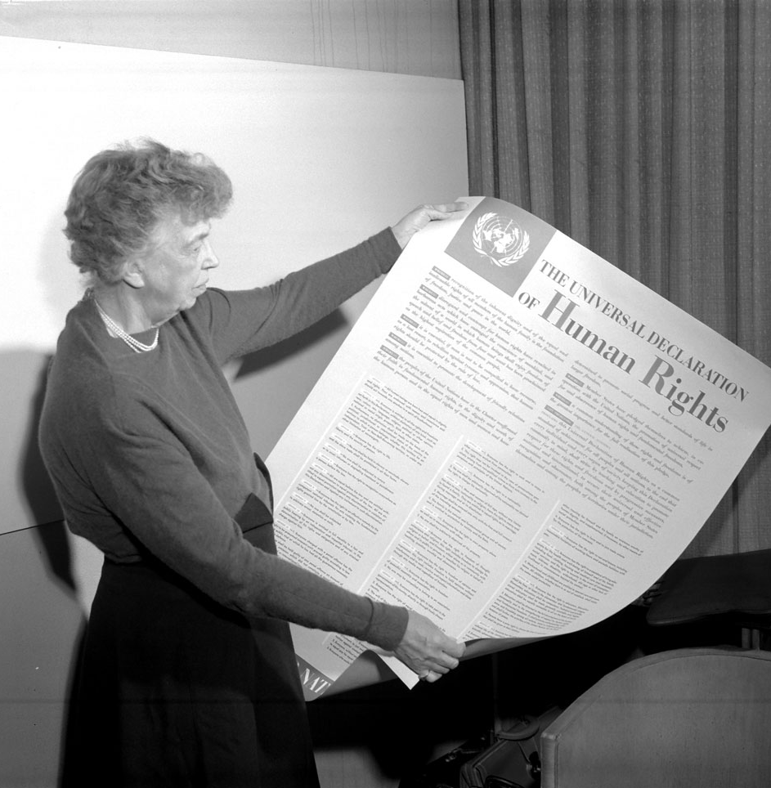
1.1.3. Universal Declaration of Human Rights
Affirms:
• The inherent dignity and the equal and inalienable rights of all members of the human family (Preamble)
• All human beings are born free and equal in dignity and rights (Article 1)
• Everyone is entitled to all the rights and freedoms set forth in the Declaration, without distinction of any kind (Article 2)
Notes:
Photo: Eleanor Roosevelt inspects a copy of the Universal Declaration of Human Rights in 1949. Copyright UN Photo.

Slide 9
1.1.4. Duty bearers and rights-holders
RIGHTS HOLDERS (individuals)
and
DUTY BEARERS (States)
DUTY BEARERS fulfil a
responsibility towards
RIGHTS HOLDERS
→ RIGHTS HOLDERS claim their
rights from DUTY BEARERS
fulfil obligations towards
ACCOUNTABILITY
PARTICIPATION
DUTY BEARERS
RIGHTS HOLDERS
claim their rights from

Slide 10
1.1.5. Nature of States’ human rights obligations
Human rights law establishes States’ obligations towards every person, including:
non-citizens,
irregular and smuggled migrants,
refugees,
asylum seekers,
trafficked persons,
suspected terrorists,
stateless persons
…

Slide 11
Human rights law obligates the whole of Government to protect human rights
Executive, legislative and judicial branches
National, regional, provincial and local levels
Including at international borders:
Border authorities ─ border police, border guards, customs officers, immigration officers, coast guards;
Health/medical personnel, child protection services;
Other law enforcement officials involved in border management.

Slide 12
Human rights law obligates States to protect all persons under their territorial jurisdiction and effective control
States are accountable for fulfilling the human rights of all persons under their jurisdiction, power or effective control, even if they are outside the territory. That is:
  wherever the State exercises authority or control extraterritorially, and
  regardless of their migration or residency status.
The privatization of border governance functions does not defer, avoid or diminish the human rights obligations of the State.

Slide 13
Human rights law holds States responsible for human rights abuses committed by private actors
States have a legal duty to protect the population from human rights violations by non-State actors, including business entities.
States are responsible for ensuring that non-State actors, including private companies or humanitarian organizations – including those involved in border security and management – deliver contracted services in line with States' human rights obligations.
States must hold corporate actors accountable for human rights abuses.

Slide 14
1.1.6. Legal human rights sources
Charter of the United Nations (1945)
Universal Declaration of Human Rights (1948)
Core international human rights treaties
Regional human rights treaties
Other relevant treaties
Customary international law
Human rights treaty bodies

Slide 15
Other areas of law that are relevant at international borders
Laws | Applicable to
International refugee law | Refugees
Conventions on statelessness | Stateless individuals
International humanitarian law | Situations of armed conflict
Law of the sea | Rescue and assistance at sea
International labour law | Migrant workers
International criminal law | Smuggling of migrants, trafficking in persons, corruption, deportation

Slide 16
1.1.7. States can restrict certain human rights
Requirements:
Is it lawful?
Is it justified to achieve a legitimate aim?
Is it necessary?
Is it proportionate to the aim?
Is it non-discriminatory?
– only if certain
requirements are met
e.g., the right to work ─
States can limit access to certain sectors of the labour market to their citizens.

Slide 17
1.1.8. The right to due process
Requires States to ensure that: every individual is treated fairly and reasonably; arbitrariness is avoided; any limitation imposed on an individual’s rights meets the tests of necessity and proportionality so that administration of justice is independent and effective.
Requires that appropriate laws, legal processes and other measures are in place to ensure the right to due process.
Applies across all border contexts, including screening, interviewing, detention and expulsion of a person.

Slide 18
The right to due process in the context of border governance
Encompasses the rights:
To be informed of any decision concerning oneself (e.g., detention, denial of admission, expulsion) in a language that is understandable;
To submit reasons against expulsion;
To have one’s case reviewed by a competent authority;
To be represented in such a review.
Notes:
[moved]

Slide 19
Questions?

Slide 20
1.2.
Gender, migration and human rights

Slide 21
1.2.1. What is meant by gender?
Not another word for women, nor a synonym of sex
Refers to socially constructed roles, functions and responsibilities assigned to women and men – including in relation to sexual orientation and gender identity
Several diverse factors within any gender category contribute to individuals’ experiences:
    → race, ethnicity, culture, religion, social class ─ which interact with and inform gender-based discrimination
Is not static; is changeable over time and across contexts

Slide 22
1.2.2. Gender in a human rights-based approach
Gender affects how people experience life and human rights issues.
Gender analysis may help us to understand the individuals with whom we engage ─ it is important to understand the role of social norms, power relations, resource distribution and entitlements in their lives and decision-making.
May determine specific, gender-responsive measures necessary to protect and promote everyone’s human rights.

Slide 23
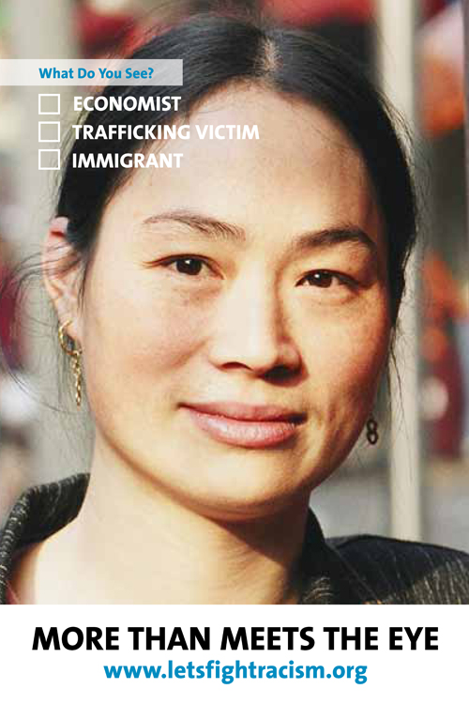
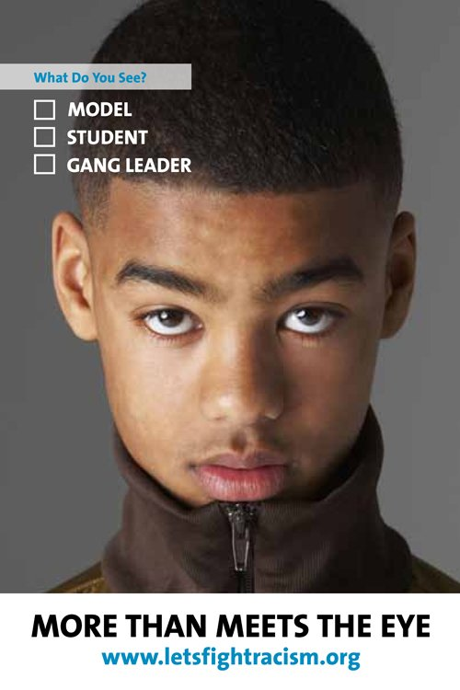
1.2.3. Gender in the context of migration: check your assumptions
It is important to be aware of one’s own biases and stereotypes regarding:
Gender
How gender intersects with other factors such as age, race, migration status, etc.
and to address them so that they do not negatively affect one’s work.
Notes:
Image source: http://www.un.org/en/letsfightracism/

Slide 24
1.2.4. Migration is not gender-neutral
Need to consider:
    Gender (and other) inequalities and discriminations
    Harmful gender stereotypes and traditional gender roles and social norms
    Gendered labour markets
    Universal prevalence of gender-based violence
The “vulnerability” stereotype

Slide 25
1.2.5. Gender and counter-terrorism at international borders
Assumptions may affect border officials’ approach to migrants at the border:
    → A young man may be subjected to stricter security checks
    → Women may be assumed to never participate voluntarily in any terrorist act
which can have implications for the individual’s enjoyment of human rights and for counter-terrorism efforts

Slide 26
Questions?

Slide 27
1.3.
Human rights at international borders

Slide 28
1.3.1. What are international borders?
Politically defined boundaries separating territory or maritime zones between States
Areas where States exercise border governance measures on their territory or extraterritorially
Including: land checkpoints; border posts at train stations, ports and airports; immigration and transit zones; the high seas; so-called “no-man’s land” between border posts, embassies and consulates
Borders are NOT zones of exemption of human rights

Slide 29
1.3.2. Exercise: What human rights could be at risk at international borders?
Read the case assigned to your group, briefly discuss and write your responses to the following questions on the flip chart.
What human rights issues can you identify in the case?
List at least four.
What gender-specific concerns can you identify in the case?
Do you think these individuals would/should be treated differently depending on their gender?
What can border officials do to protect the rights identified?

Slide 30
CASE A
Kai, 17 years old, and Sammy, 22 years old
Kai and Sammy are cousins who left their country together. They are poor and there is a lot of violence in their country. Kai liked school, but gang members told him that “real men” should work. Kai’s mother was killed as a bystander in a shoot-out a year ago.
Kai and Sammy are crossing several countries, travelling on buses and by foot, to Syldavia where Kai’s father is living.
One night, border security officials raided the place where they were sleeping; Kai escaped but Sammy was arrested, detained and forced to work. Sammy escaped after paying a bribe to a guard.
→ continued

Slide 31
CASE A continued
Kai, 17 years old and Sammy, 22 years old
At the border town, Kai is working to earn money to pay the expensive fees the smugglers are demanding to take them to Syldavia. It is too dangerous to cross on their own; people have been kidnapped and some have died in the desert.
Kai has been working long hours in a restaurant and has been injured at work several times. He has not sought treatment for his wounds for fear of being reported to immigration officials and deported. Sammy is depressed and has been unable to work.

Slide 32
CASE B
Amodita, 20 years old, and Ichanga, 23 years old
Amodita’s village had been experiencing a drought for decades; her family’s harvests had steadily decreased and could not sustain and feed everyone. Her father was ill and his medical treatment was very expensive. Amodita and her husband, Ichanga, saved up so as to migrate and support her family.
A friend of the family knew an agent who arranged documents for them to get to Elbonia. They left for Elbonia by bus when Amodita was five months pregnant. The journey was supposed to take three days through the neighbouring country of Liberto. → continued

Slide 33
CASE B continued
Amodita, 20 years old, and Ichanga, 23 years old
After crossing into Liberto, their bus was stopped by immigration officers who ordered Ichanga and another man off the bus. Amodita, who was seated in front, was prevented from getting off the bus; she was very distressed and started shouting and protesting, but could not speak the language. She started to get severe cramps.
There were no women officers on duty at the border of Elbonia. The male border guards denied Amodita entry because she did not have the right papers. She was in unbearable pain, but was not permitted to see a doctor because the authorities said she had tried to enter Elbonia irregularly.

Slide 34
1.3.3. Human rights particularly at risk at international borders
Right to life
Right to freedom from torture and other forms of cruel, inhuman or degrading treatment
Right to liberty and security of person
Right to freedom of movement
Right to privacy
Right to freedom of expression
Right to family life (unification)
Best interests of the child
Right to due process and fair trial guarantees
Right to health
Right to food
Right to water and sanitation
Right to an effective remedy

Slide 35
1.3.4. Discussion: If human rights apply to everyone, everywhere …
What about:
If the person is in “no man’s land”?
If the person is suspected of terrorism or on a watch-list?
If the person was smuggled across the border or does not have any papers?
In situations of large movements of migrants or mixed migrations?
Any other examples?

Slide 36
Questions?

Slide 37
1.4.
Key human rights principles at International borders

Slide 38
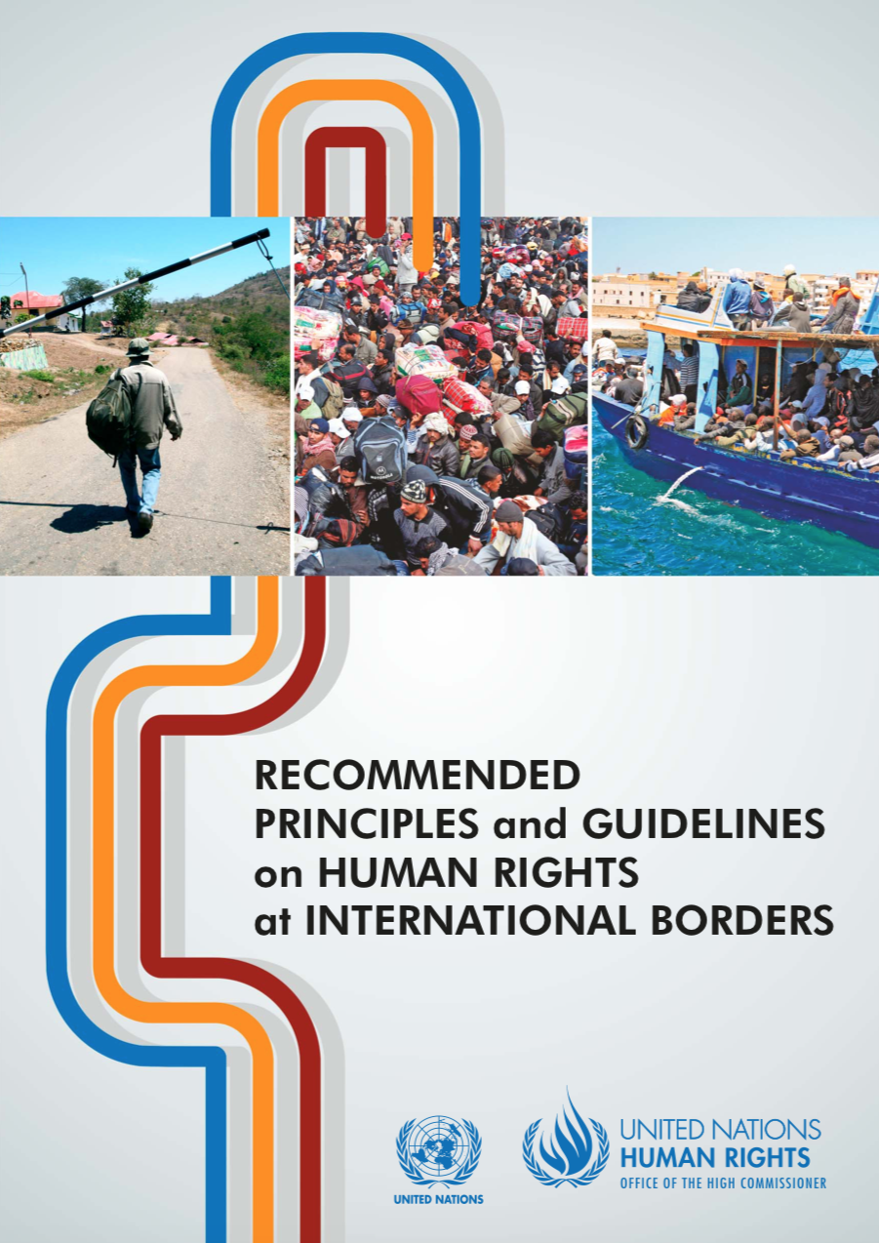
1.4.1. Recommended principles and guidelines on human rights at international borders
Support States in fulfilling their obligations to govern their borders in accordance with international human rights law and other relevant standards;
Underpinned by the belief that respecting the human rights of all migrants, regardless of their nationality, migration status or other circumstances, facilitates effective border governance.
Notes:
Handout: OHCHR Principles and Guidelines (hard copy or link)

Slide 39
1.4.2. Key principles to uphold at borders
Principle A: The primacy of human rights
The primacy of human rights calls for rights to be at the centre of all border governance measures
Derives from States’ fundamental obligation to effectively promote and protect the human rights of all migrants, regardless of their immigration status.
Encourages the implementation of policies that are non-discriminatory, gender responsive and child sensitive.

Slide 40
Principle A: The primacy of human rights (contd.)
Border governance measures to:
address cross-border crimes, such as trafficking in persons, smuggling of migrants and trafficking of drugs or other contraband
prevent irregular border crossings
prevent movement of suspected terrorists
should not adversely affect the human rights and dignity of persons at international borders.

Slide 41
Principle B: Non-discrimination
The non-discrimination principle requires migrants to be protected against any form of discrimination at borders
Human rights law provides that every person must enjoy their rights without any form of discrimination.
Prohibited grounds include race, colour, sex, language, religion, political or other opinion, national or ethnic origin, property, birth, nationality, migration status, age, disability, marital or family status, sexual orientation, gender identity, health status, economic or social situation.

Slide 42
Principle B: Non-discrimination (contd.)
Legitimate differential treatment vs. discrimination
Differential treatment is legitimate if:
It is discrimination if:
It is unlawful differential treatment
It makes distinctions on prohibited grounds
It is justified
In lawful pursuit of a legitimate State objective
Using proportionate means

Slide 43
Principle C: Assistance and protection from harm
This principle means that human rights obligations must take precedence over law enforcement and migration management objectives
Protection and assistance obligations should be prioritized over law enforcement and migration management objectives.

Slide 44
Principle C: Assistance and protection from harm (contd.)
Protection and assistance obligations:
Are the basis of all contacts between border officials and individuals at borders ─ initial detection, rescue, interception, screening, interviewing, identification, referral, also any necessary and exceptional detention or return.
Require border officials to treat everyone with respect for their dignity, and systems in place to identify migrants in vulnerable situations and refer them to the appropriate protection and services.

Slide 45
1.4.3. Exercise (true/false): Perceptions and misperceptions of migrants
Answer YES/TRUE or NO/FALSE
Are migrants who cross borders or stay in a country without proper permission committing a crime in international law?
Do irregular migrants pay taxes?
Are expats and migrants different?
NO/FALSE
YES/TRUE
NO/FALSE

Slide 46
1.4.4. Impacts of harmful language
Language matters because it informs our views and how we treat people; it also shapes our perception and thinking.
Avoid using gendered language;
Avoid using the term “illegal” to refer to migrants or migration
→ use migrants in an “irregular situation”, with “irregular status”, “irregular migration”, “undocumented” migrants.
Crossing a border is an administrative matter.
→ Unauthorized entry, the attempt to enter a country in an irregular manner or irregular stay, in general, should not be considered a criminal offence.

Slide 47
Questions?

Slide 48
1.5.
Human rights of border officials and institutional accountability

Slide 49
1.5.1. Discussion: Human rights of border officials
What human rights do border officials have?
Border officials have all human rights
Including the rights to life, to health, to an adequate standard of living, to just and favourable conditions of work, freedom from discrimination, among others.
The State is obliged to protect and fulfil the rights of border officials, including ensuring a safe working environment and adequate facilities.
Notes:
Animated to allow the trainer to pose the question for discussion before revealing the rest of the slide text

Slide 50
1.5.2. Exercise: Reality check ─ challenges faced by border officials
Discuss the following questions in your group:
What are some of the challenges you face in your (current or previous) day-to-day work in the context of migration or working with migrants?
Do border officials face different or additional challenges on the basis of their gender?
How do you think human rights can help improve your situation?
Prioritize no more than 2 or 3 points to share in the debriefing.

Slide 51
1.5.3. A gender-responsive working environment
Increased representation of women among border personnel:
  → Address stereotypical roles and responsibilities
  → Address marginalization and discrimination
  → Address sexual harassment and misogyny
Gender-responsive policies, protocols and procedures
Internal gender-responsive oversight and accountability mechanisms, including effective gender-responsive remedies
Participation of women’s organizations and human rights defenders in border management, reforms, capacity-building

Slide 52
1.5.4. Accountability
A human rights-based approach seeks to establish accountability between duty bearers and rights holders, through codes of conduct, monitoring mechanisms, etc.
Requires the creation of effective and independent gender-responsive mechanisms to:
  Oversee the enforcement of rights
  Hold perpetrators of human rights violations accountable
  Provide effective remedies for anyone whose rights have been violated

Slide 53
Questions?

