Slide 1



7 KEY GAPS IN LAWS PROTECTING WOMEN AND GIRLS FROM SEXUAL VIOLENCE
Laws allowing the perpetrator to walk free on reaching some form of “settlement”, including by marrying the victim
Laws framed in terms of morality rather than bodily integrity
Laws that explicitly permit rape in marriage, even of children
Laws that fail to recognise true consent is impossible in situations of dependency or extreme vulnerability
Laws or practices inhibiting investigation or prosecution of sexual assault
Laws requiring witness corroboration and other overly burdensome evidence
Laws allowing for judicial discretion to reduce charges or define evidence -> influenced by stereotyped assessment of victim’s behaviour
Notes:
Panel 2 - Antonia Kirkland, Global Lead, Legal Equality & Access to Justice and Jacqui Hunt, Europe Director, Equality Now

Slide 2

Key Gaps in Sexual Violence Laws in the Americas
Majority of laws based on violence or intimidation, not lack of consent placing burden of proof on victim
Estupro or similar prohibitions (31)
  Provides for lesser penalties for adults who rape adolescents
Common Exceptions to rape
  Marital exception even for Children (Caribbean, Canada,
  and some US states) and Adolescents (Estupro)
  Mistake-in-Age
  Close in Age
Limited Statute of Limitations for young and adolescent victims of sexual violence
Institutional Violence effect is doubled for indigenous and/or marginalized communities
Notes:
Panel 3 - Brisa De Angulo, CEO & Founder, A Breeze of Hope, and Bárbara Jiménez-Santiago, Americas Regional Coordinator, Equality Now

Slide 3
85%
7.4%
PERCENTAGE OF CONVICTIONS AT TRIAL
ACKNOWLEDGE
ADMITTED BY PROSECUTOR
1. Awareness
2. Training
The solution?
3. Comprehensive support
4. Political will for Budgeting
www.abreezeofhope.org

Slide 4

Recommendations for LAC
Regional Recommendations
  Amend penal codes to include consent based definition of rape
  Repeal the estupro provisions from the Penal Codes
  Eliminate harmful legislation and policies that limit adolescent girls’ ability to access justice following sexual violence (Exceptions, statute of limitation)
  Devise and implement compulsory training programs for those on the front line of the administration of justice (like Ley Micaela Argentina)
  Effective implementation of laws and policies, including budgeting resources
    Policy for the capture and recapture of perpetrators (Bolivia)
Notes:
Panel 3 - Brisa De Angulo, CEO & Founder, A Breeze of Hope, and Bárbara Jiménez-Santiago, Americas Regional Coordinator, Equality Now

Slide 5
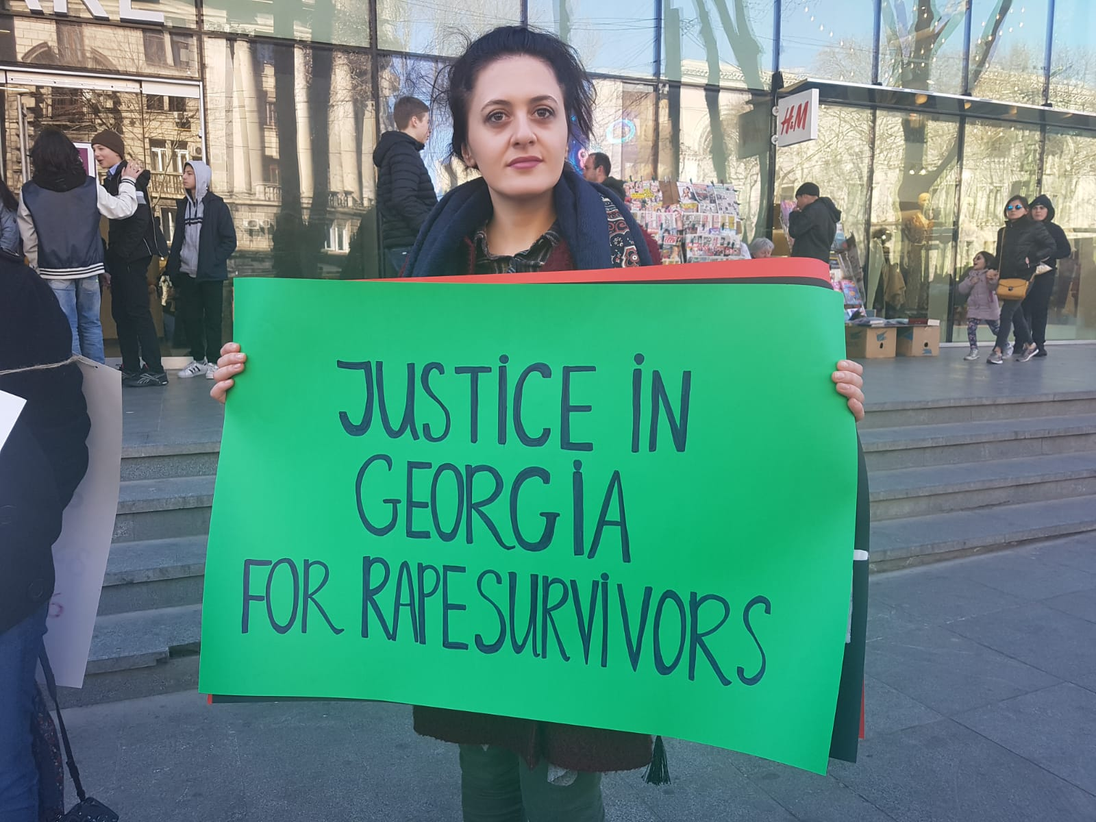
Impunity for Sexual Violence in Eurasia
Absence of consent-based definitions of rape:
Focus on force, threat of force, helplessness;
Lack of broad range of coercive circumstances;
Restrictive evidence rules limiting prosecutions to force-based crimes.
Absence of ex officio prosecutions & use of reconciliations:
Onus on the victim for prosecution;
Reconciliation - basis for terminating investigation (particularly problematic with child/forced marriages and bride kidnappings).
Discriminatory procedures:
Investigative experiment, confrontation, forensic examinations (hymen testing), questioning / cross examination.
Other issues:
Impunity for marital rape;
Failures of justice system for vulnerable women.
Notes:
Panel 3 - Tamar Dekanosidze, Eurasia Consultant, Equality Now

Slide 6
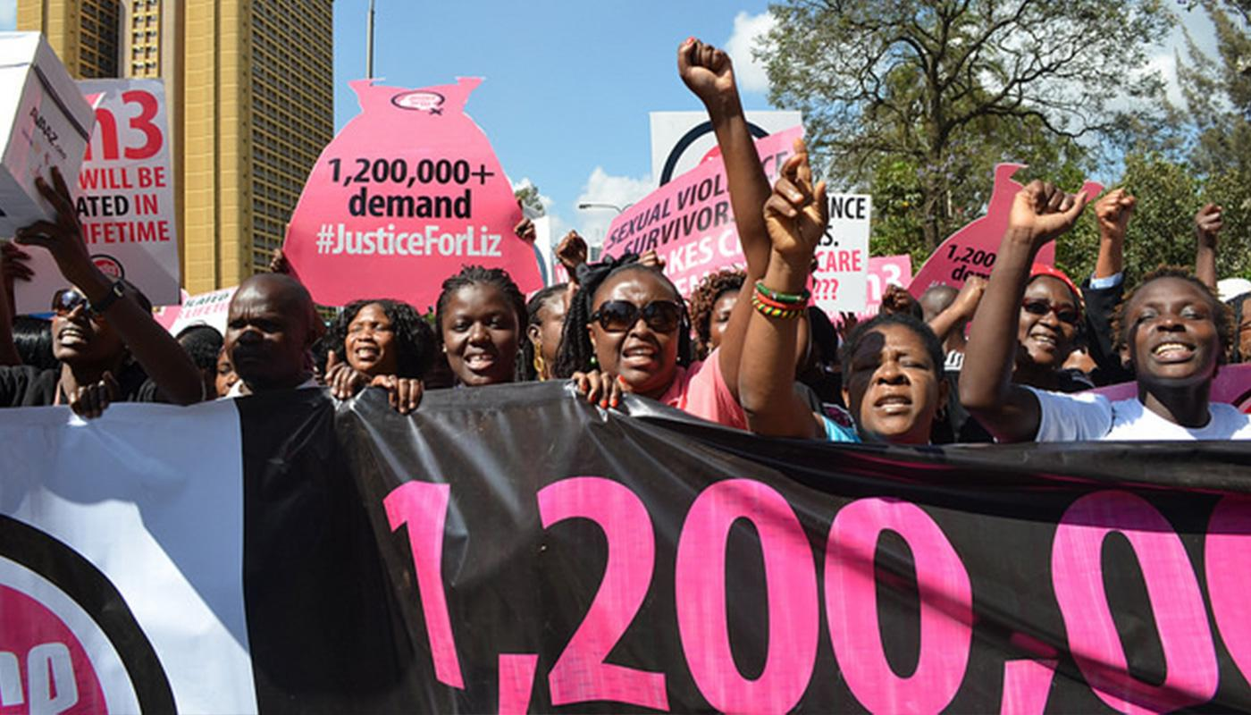
Impunity for Sexual Violence in Africa
Despite the heterogeneity in culture, demographic and numbers, there is still impunity for sexual violence especially against adolescent girls. This impunity is underpinned by gaps or flaws in law as well as implementation of the law, or lack thereof:
Legal flaws
Pluralistic legal regimes / systems that facilitate and ‘legalize’ sexual violence
    Attorney General v. Rebecca Gyiumi case (Tanzania)
Laws that permit rape in marriage, even of children Noura Hussein Case (Sudan)
Absence of consent-based definitions of rape:
      Focus on force, threat of force, helplessness;
      Lack of broad range of coercive circumstances;
      Restrictive evidence rules limiting prosecutions to force-based crimes
Flaws in implementation - Laws or practices inhibiting investigation or prosecution of sexual assault
Reconciliation and arbitration for sexual violence offences - Kenya
Evidentiary standards and procedures, eg Sudan
Notes:
Panel 3 - Judy Gitau, Regional Coordinator, Africa, Equality Now

Slide 7






Thank you!
@equalitynow
@equalitynoworg
@equalitynoworg
www.equalitynow.org

