Slide 1
RIGHT TO BE FREE FROM RAPE Legislation and state of play in Europe
Anna Błuś, Amnesty International
27 May 2020

Slide 2
THE RIGHT TO BE FREE FROM RAPE
“Right to be Free from Rape”, a report published in November 2018
Geographical scope:
31 countries in Europe: European Economic Area (28 European Union Member States, as well as Iceland and Norway) and Switzerland
Focus:
rape legislation;
prevalence of rape;
top-line findings on women’s access to justice for rape
March 2019: in-depth report on Denmark
April 2019: joint overview of situation in the Nordic countries (Denmark, Finland Norway, Sweden)

Slide 3
State of play in Europe – estimates and statistics
1 in 20 women in the EU has been raped after the age of 15. This corresponds to over 9 million women
More than 1 in 4 people believe that sexual intercourse without consent may be justified (i.e. if the person is drunk or under the influence of drugs, is voluntarily going home with someone, wearing revealing clothes, not saying “no” clearly or not fighting back)
More than 1 in 5 people in the EU believe that women often make up or exaggerate claims of abuse or rape
The EU average of reporting sexual violence to the police is 14%
Low level of convictions

Slide 4
State of play in Europe – definitions of rape
Only 9 countries in Europe out of 31 analysed recognize that sex without consent is rape in law
In the remaining countries, rape is defined on the basis of
force or
threat thereof
coercion or
the victim’s inability to defend themselves

Slide 5
Countries with consent-based laws are:
United Kingdom (comprising England and Wales, Scotland and Northern Ireland)
Ireland
Belgium
Cyprus
Luxembourg
Iceland
Germany
Sweden
Greece (since June 2019)

Slide 6
Anticipated developments
Several countries in Europe are expected to change their legal definition of rape to one based on consent soon:
√ Spain (LATEST NEWS)
√ Denmark
√ Finland

Slide 7
Barriers to access to justice: Key findings
Legislative gaps
Quality of investigations
Re-traumatization during the legal process
Rape myths and gender stereotypes
combined with and reinforced by
Gaps in training of police, prosecutors, judges
Shortcomings in sexuality and relationships education

Slide 8
The power of the law
Adopting consent-based laws will not stop rapes from occurring.
It’s only one step towards justice and must be accompanied by:
good practice; avoiding re-victimisation;
training of relevant professionals, incl. lawyers; to combat widespread stereotypes and rape myths;
comprehensive sexuality and relationships education;
raising awareness in society- debunking myths about rape
But:
Consent-based and human rights compliant law on rape is an important step towards achieving societal and normative change, guiding people’s attitudes and behaviours and thus is crucial in rape prevention in the long-term.

Slide 9
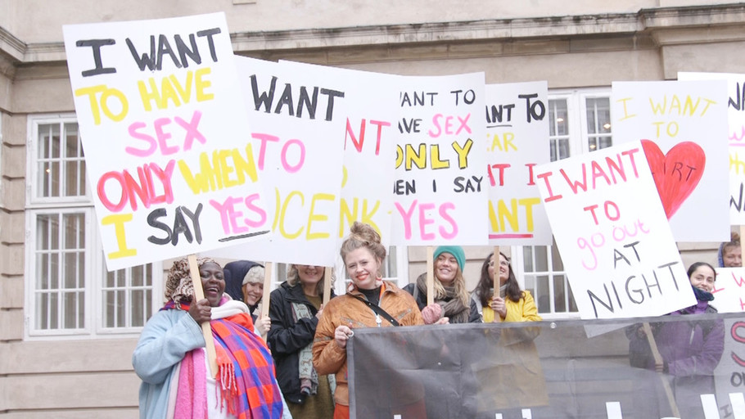
The power of the law
“The law is a symbol of what we in our society consider to be right and wrong. And the law should reflect what we think is wrong and what we think is right.
So, even though we don’t know if more people would be convicted… the important thing is that we have said that we think that every time you have sex without consent that it’s rape.
And I think that it will be reflected in our culture. And I think that’s actually the most important thing.”
“Anne”, 45, Denmark

Slide 10
More information on Amnesty International’s website
Let’s Talk About Yes regional campaign and resources:
https://www.amnesty.org/en/latest/campaigns/2018/11/rape-in-europe/
#LetsTalkAboutYes
Thank you
Anna Błuś, Researcher
Amnesty International, International Secretariat, London
anna.blus@amnesty.org
Twitter: @AnnaMBlus

