Slide 1
Máttuid máhccan Return of the ancestors. Sámi Repatriation processes in Finland
Luobbal-Sámmol-Aimo Áile
Áile Aikio
University of Lapland

Slide 2
Ohcejohka, Jámežiid guolbba

Slide 3
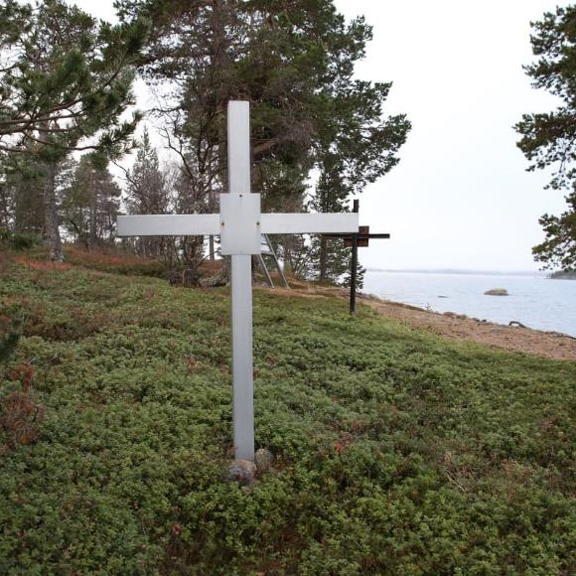
Schreiner Collection / University of Oslo
Sámi Museum Siida
Anár Jaamišsuáluij

Slide 4
Once upon a time in winter, there was a man who was driving old skulls by reindeer sledges from Ohcejohka graveyard to Anár over the mountain area Beazet. It was a long journey, over ten Scandinavian miles (ca. 100 kilometres / 60 miles) and the load was heavy, the pulling reindeer could barely pull the load. He had to stay for a night in a deserted cabin. He tied the reindeer to trees to graze for the night, ate and went to bed.
As soon as he had fallen asleep, someone came in and woke him up. He had lit a fire to the oven to warm the cabin and to cook his meal and there were still embers in the oven. In that weak light he could spot somebody standing by the door. It was a tall figure, clothed in winter gear. But alas! He had no head, there only was the empty neck of the fur coat.
The figure just stands there without saying a word. The man heartened himself and remembered that he had been taught that one must ask the spirits their name and what they wanted in order to make them go away. “Who are you and what do you want?” he asked. For a moment there was no answer. But then the figure spoke: “ My head. I can’t find peace when my head is missing. I have come to collect my head.” The man had to permit the figure to retrieve its head from the load and it disappeared. But before it left it once more turned around and spoke: “ I have plenty of information to share with you, but I can't, not without my head.” And then it left.

Slide 5
Sámi Anthropological Excavations in Current Finland
year | site | executor | number of collected individuals | mandator | most propabal present location | other
1838 | Eanodat, Márkán | L. L. Laestadius | ? |  | ? | several excavations over several years
1878 | Anár, Jaamišsuáluj | C. P. Solitander | 103 | University of Helsinki | reburied in Jaamišsuáluj in 1995
1878 | Muonioniska, Akamella | Edvard Pfaler | 26 | University of Helsinki | stored in Sámi Museum Siida since 2001
1880 | Rounál | Karl Bäcklund | 10 | University of Helsinki | stored in Sámi Museum Siida since 2001
1882-1883 | Ohcejohka, "old graveyard" | A. E. Jansson | 94 | University of Helsinki | part of the collection reburied in Jaamišsuáluj 1995, other part stored in Sámi Museum Siida since 2001 | The exact site uncertain, possibly from several sites
1914 | Rounál | Eskil Olsson | 21 | University of Helsinki | stored in Sámi Museum Siida since 2001
1922 | Ohcejohka, Áibmejohka | "norwegians" | 30 | University of Oslo | University of Oslo | At least 30 graves excavated
1922 | Ohcejohka, Nuvvus | "norwegians" | 27 | University of Oslo | University of Oslo | at least 27 graves excavated, excavations also in 1910
1934 | Anár, Jaamišsuáluj | Väinö Lassila | 49 | University of Helsinki | stored in Sámi Museum Siida since 2001 | 69 graves with 71 individuals excavated

Slide 6
The Memorial Cross erected on the reburial site in Jaamišsuáluij.
Photo: Harri Nurminen 1995
”The Sámi skulls, which were once taken by researchers, were returned to the grave in Inari in July 1995.” HS 6.8.2017
Photo: Anneli Lappalainen / Yle
Photo: Anneli Lappalainen / Yle

Slide 7
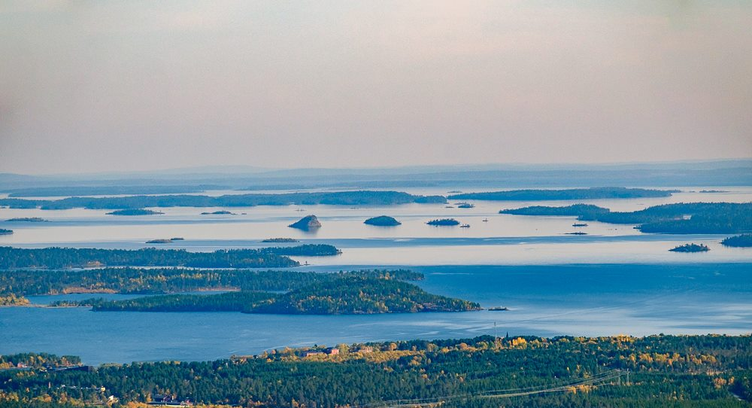
Photo: Vesa Toppari

Slide 8
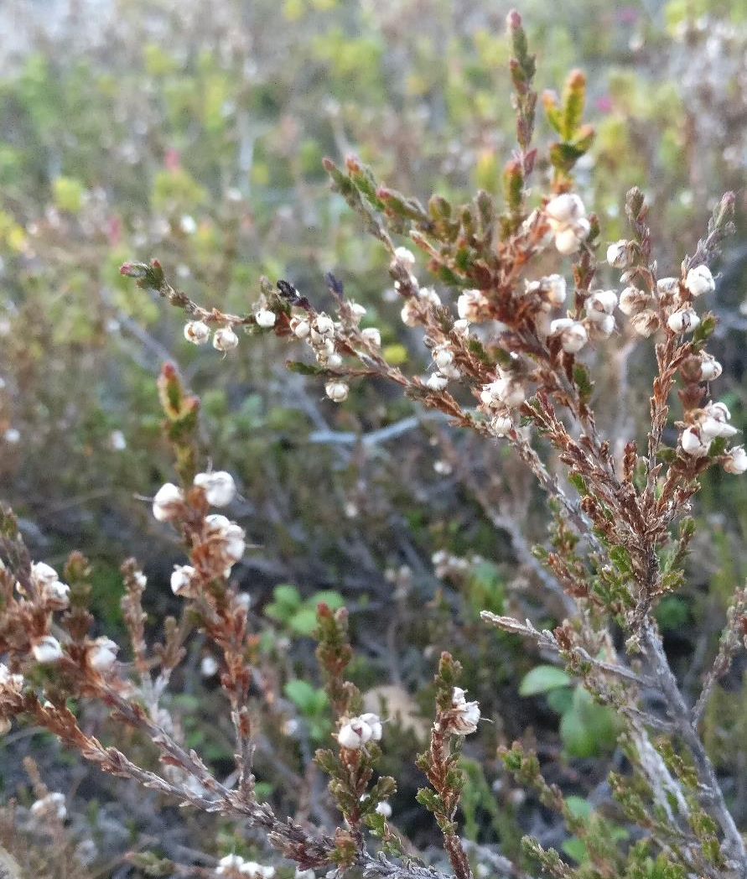
Unaswered Questions
Where to rebury the ancestors? Where are their homelands?
Where are the missing diaries?
Which individuals were reburied in 1995?
Where are the 1995 DNA samples and who manages them?

Slide 9
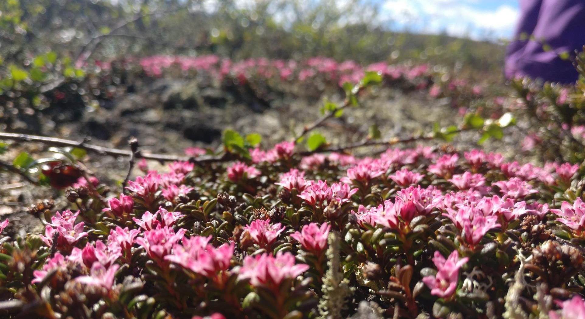
Giitu – Thank You
Áile Aikio
aile.aikio@ulapland.fi

