Slide 1
Right to Repatriation of Ceremonial Objects and Human Remains under UNDRIP: A Human Rights Focus, Vancouver, BC, March 2020
Yémes, sʔémit &
łúmuʔstn
Respect, Responsibility and Relationships
Angie bain, NŁEʔKEPMX
Lower Nicola Indian band (LNIB) Union of bc Indian chiefs (UBCIC)
1 of 20
Notes:
ʔéx kʷ n̓. Angie Bain he nskʷest. nłeʔkepmxkn tuł zuxt kn.
Good morning everyone. My name is Angie Bain. I am Nlaka’pamux or Interior Salish, a member of the Lower Nicola Indian Band of Merritt, BC and a researcher with the Union of BC Indian Chiefs. It’s truly an honour and privilege to join you here.
I stand here today with humility. I feel like I am still at the start of my repatriation journey, particularly around the sensitive and complex issues of repatriation of ceremonial objects, things we call xaʔxaʔ or sacred, and ancestral remains, the most sacred of which I was taught to treat with respect and care. At the same time, what I can share with you today are the lessons I have been taught my whole life.
I am an Indigenous person from a community of 1,300. I am nłeʔkepmx – it’s a simple truth, and all that should matter to museums, archives and other memory institutions.

Slide 2
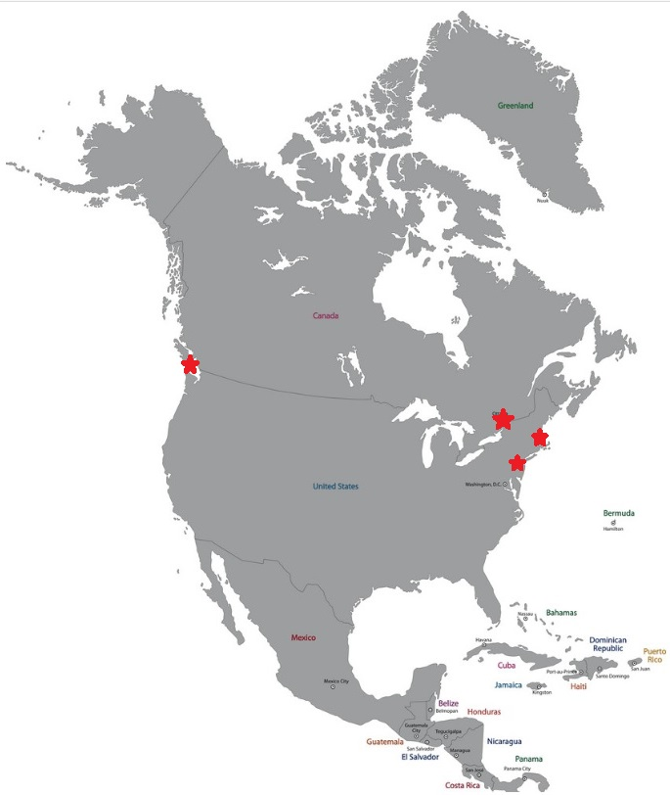
Victoria, BC
Royal British Columbia Museum
museums
Gatineau, QC
Canadian Museum of History
Cambridge, MA
Peabody Museum
New York, NY
American Museum of Natural History
5 of 20
Notes:
Chance has given me the opportunity to know and understand nłeʔkepmx museum collections, time has helped me see connections between a nqáykstn or shaman’s bowl in a museum collection in Gatineau Quebec and a collection of miscellaneous correspondence at a museum in New York.
My Nation knows the story of archaeologists like Harlan Smith, notorious for digging up the graves of our ancestors at places like Lytton, Kamloops and Spence's Bridge
My community has taught me the true names and lineages of the people who ethnologist James Teit bought adolescent clothing, puberty whistles, warriors weapons and sacred songs from for museums in Victoria, Gatineau, Cambridge and New York.
My aunties have taught me the importance of language, of ceremony, of why we don’t talk about some things and of doing this work in the right way.
My son, ever patient and willing to assist, as we make diversions to museums and archives while on family vacations, is living proof of why this work matters.

Slide 3
Our principles
Lower Nicola Indian Band Heritage Policy Core Principles
01
02
03
yémes
sʔémit
łúmuʔstn
respect
responsibility
relationships
It is important for LNIB to cooperate with other organizations to manage, preserve & protect our heritage.
LNIB has the stewardship responsibility to care for our heritage resources on behalf of our people.
LNIB has the right to have our unique heritage values recognized and respected.
6 of 20
Notes:
But you do not need to know all of that. I am nłeʔkepmx. That is all that should matter when I approach a museum, archive or memory institution – I am nłeʔkepmx and when I tell you this, I should not have to say anything more.
But I know that everyone in the room here today understands it has not been enough to open doors to memory institutions and facilitate the return of sacred and ceremonial objects and ancestral remains to my community.
When I thought about what I could share with you today, I thought about the lessons I learned from my community when we were drafting the Lower Nicola Indian Band Cultural Heritage Policy in 2017. This policy was the first attempt by my community to explain to others why our heritage matters, how it should be protected, how it could be used, by whom and why. In it, we included simple things like how to recognize burial sites and on a basic level, how we wish our cultural heritage to be respected. We also laid out three core principles.
In my language, these principles are yémes (Respect); sʔémit (Responsibility); and, łúmuʔstn (Relationships). If you truly understand them as I do, you can understand the disparity we face today in reconciling the expectations of indigenous peoples with the very real challenge of realizing the spirit and intent of Articles 11 and 12 of the Declaration of the Rights of Indigenous Peoples, of responding to the Calls to Action of the Truth and Reconciliation Commission and in moving forward in engagement with free, prior and informed consent.

Slide 4
Article 11
United Nations Declaration on the Rights of Indigenous Peoples
Article 11 1. Indigenous peoples have the right to practise and revitalize their cultural traditions and customs. This includes the right to maintain, protect and develop the past, present and future manifestations of their cultures, such as archaeological and historical sites, artefacts, designs, ceremonies, technologies and visual and performing arts and literature.
2. States shall provide redress through effective mechanisms, which may include restitution, developed in conjunction with indigenous peoples, with respect to their cultural, intellectual, religious and spiritual property taken without their free, prior and informed consent or in violation of their laws, traditions and customs.
6 of 20
Notes:
I am counting on my fellow panelists to better articulate Articles 11 and 12, but I have a couple of slides that summarize the articles.

Slide 5
Article 12
United Nations Declaration on the Rights of Indigenous Peoples
Article 12 1. Indigenous peoples have the right to manifest, practise, develop and teach their spiritual and religious traditions, customs and ceremonies; the right to maintain, protect, and have access in privacy to their religious and cultural sites; the right to the use and control of their ceremonial objects; and the right to the repatriation of their human remains.
2. States shall seek to enable the access and/or repatriation of ceremonial objects and human remains in their possession through fair, transparent and effective mechanisms developed in conjunction with indigenous peoples concerned.
6 of 20
Notes:
These particular articles speak to rights to access, use and revitalize culture, but much more importantly create space for stewardship, care and control.
If this work is to advance, all of these concepts need to be interpreted through the indigenous lens, including access as we understand it, use and we know it, revitalization as we live it and stewardship as we require it.
While you are struggling to define my rights, basic human rights, though policy, practice or program, I am fighting to fulfill my obligations, obligations to protect the sacred, honour and respect my ancestors and keep our traditions alive, vibrant and innovative. Whether a shaman’s bowl, puberty whistle or warrior’s weapon is to be found in a museum, in the ground, or in my community these obligations remain. I am nłeʔkepmx and this is what it means to be nłeʔkepmx.

Slide 6
the work
01
02
03
UBCIC
FPCC
LNIB
RESPECT
responsibility
relationships
Recognizing and Including Indigenous Cultural Heritage in BC (2019); Indigenous Advisory Council
Alignment of Heritage Conservation Act with DRIPA; Section 4 & G2G Relationships
LNIB Cultural Heritage Policy (2017), LNIB Repatriation Committee
6 of 20
Notes:
In Canada, particularly in British Columbia, we are at a unique point in time where we have both the opportunity and the challenge of understanding, interpreting and implementing UNDRIP. As a researcher at UBCIC I know work is being done at the national and provincial levels to do this in policy; as a community member involved in repatriation work I know that individual memory institutions are starting to do this in practice; as a nłeʔkepmx person I have experienced the challenges of access to accession records, museum collections and in even locating ancestral remains. We have work to do to move from an instrument of policy to realization of implementation and until we do that work it is our communities that suffer. Until my elder can walk into a museum and say “I am nłeʔkepmx “ and have doors open, until we act as we speak, we will have work to do.
This work needs to happen at every level, and it needs to embrace the 3 core concepts of respect, responsibility and relationships. And, I am happy to share, the work is being done. UBCIC, as part of the First Nations Leadership Council is actively working to prioritize the alignment of the Provincial Heritage Conservation Act (HCA) with the recently passed Declaration on the Rights of indigenous Peoples Rights Act (DRIPA, formerly Bill 41), including alignment with Section 4 of the HCA which would enable a government-to-government relationship regarding the protection and stewardship of cultural heritage sites and heritage resources valued by FNs in the Province of British Columbia; on behalf of the First Peoples’ Cultural Council I co-authored a policy paper on indigenous cultural heritage that advocates for indigenous control and adequate resourcing; as a member of LNIB our Cultural Heritage Policy and community-based Repatriation Committee are actively communicating and advocating for our rights.

Slide 7
Victoria, BC
Royal British Columbia museum
7 of 20
Notes:
I have only a few minutes left so I will just quickly share with you some of our experience to date. My community has undertaken what I call “knowledge repatriation” at four repositories. In Victoria, BC we have visited the Royal BC Museum.

Slide 8
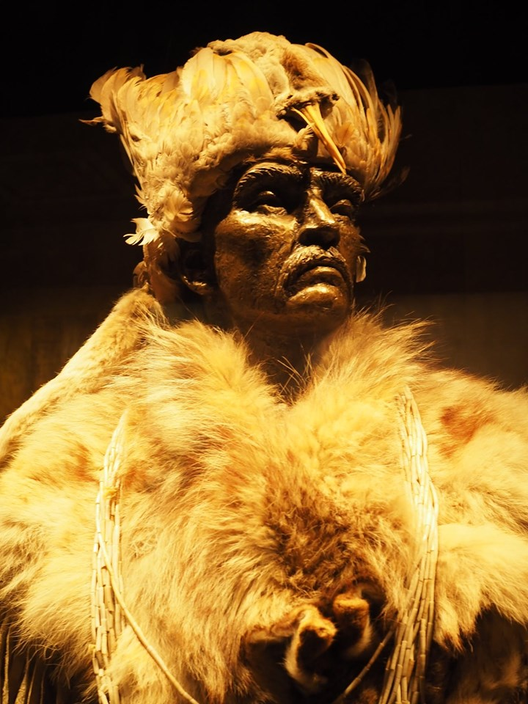
Approximately 500 items in ethnology collection are from the Nlaka’pamux cultural group.
8 of 20
Notes:
RBCM has an Indigenous Collections and Repatriation Policy. Thanks in large part to the work of the First Nations and Repatriation Department headed by Lucy Bell, in 2018 RBCM offered the inaugural Repatriation Grant funding that allowed 21 communities to secure funding to undertake repatriation work. My community was one of the funding recipients. We have also engaged with RBCM on their work around reconciliation and their response to the Truth and Reconciliation’s Report Calls to Action.
We are still determining the extent of this collection relevant to our community, but roughly 500 items in the ethnology collection are identified as being associated with our cultural group, and about 1,300 items are generally Interior Salish.
In 1995 we repatriated aboriginal human remains and associated burial objects. I was not part of that work but I understand it was done by a group of community volunteers, who managed to bring together some knowledge keepers, paid out of pocket to drive caravan style to Victoria, and that our ancestor was reburied within our territory at an undisclosed location.

Slide 9
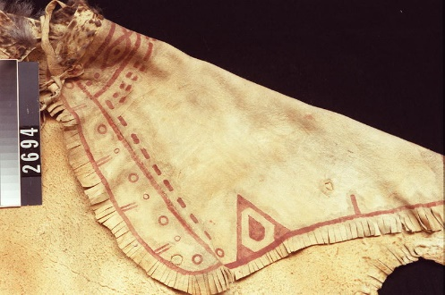
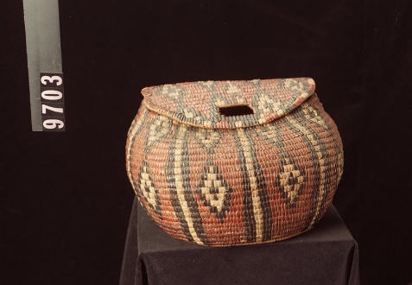
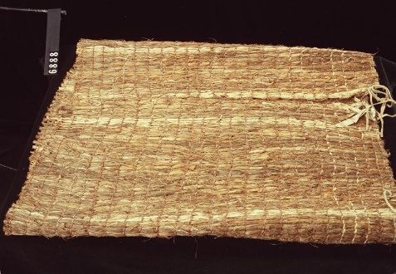
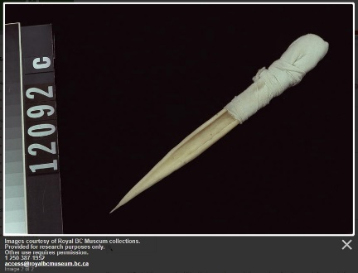
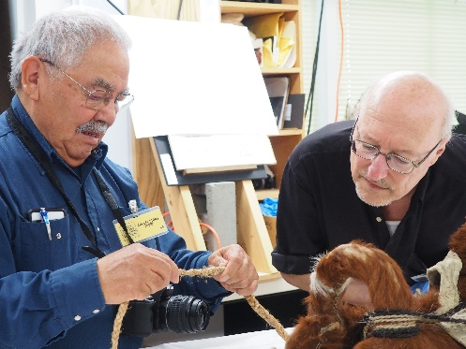
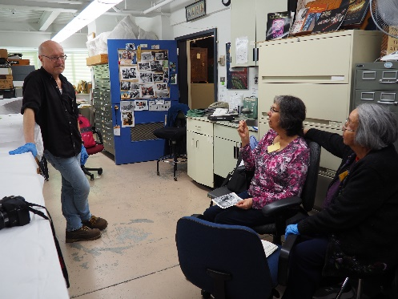
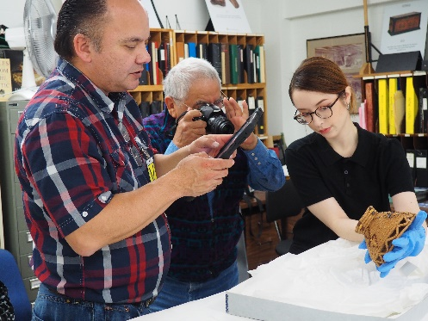
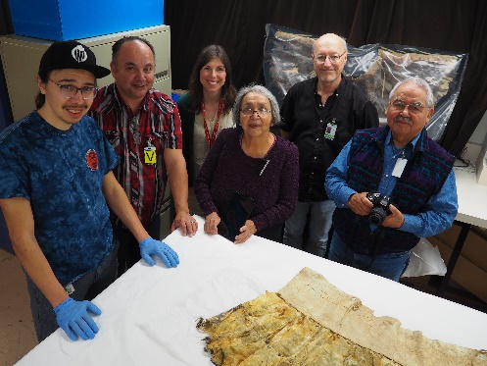
our RBCM Work
9 of 20
Notes:
Our work with RBCM continues and we have yet to engage on the issue of ceremonial objects.

Slide 10
Gatineau, QC
Canadian museum of history
10 of 20
Notes:
The second museum we visited was the Canadian Museum of History in Gatineau Québec.

Slide 11
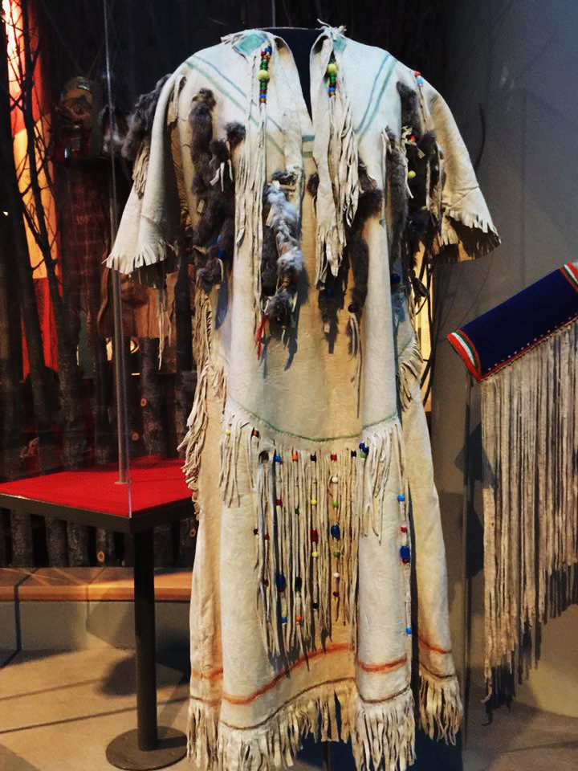
Approximately 1,000 items in ethnology collection are from the Nlaka’pamux cultural group.
11 of 20
Notes:
The CMH has a diverse collection including approximately 1,000 Nlaka’pamux artifacts, 90 from the Nicola Valley. When we visited the CMH we flagged some items of a sacred nature and had discussions with CMH staff about the proper access, care and control over those items.
This year, after the first thunder storm, we have been invited back to perform ceremony with these objects and further discuss these issues. CMH has been very open to these discussions, but we still have the difficult challenge of addressing ancestral remains in their collection.

Slide 12
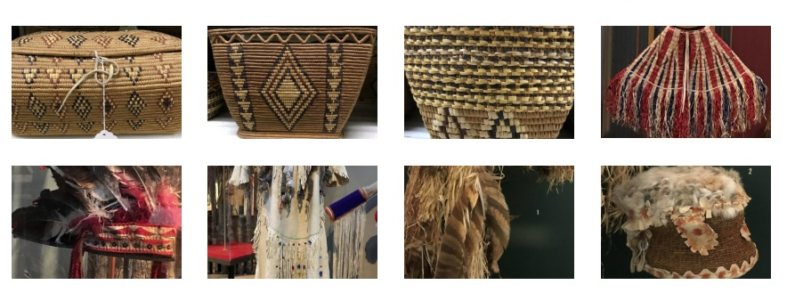
our CMH Work
12 of 20
Notes:
One of our challenges is that our community is reviving these practices with the intent to reintroduce them in the museum setting.

Slide 13
CAMBRIDGE, MA
Peabody museum of archaeology & ethnology at Harvard university
13 of 20
Notes:
The third museum we visited was the Peabody Museum.

Slide 14
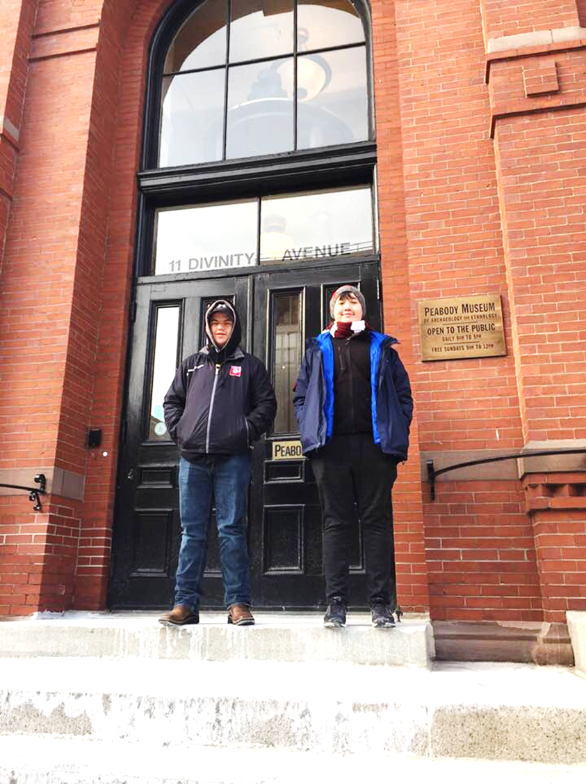
Approximately 400 items in ethnology collection are from the Nlaka’pamux cultural group.
14 of 20
Notes:
Peabody’s Nlaka’pamux ethnology collection is made up of clothing, weapons, household utensils, ceremonial objects, fishing and hunting gear, ornaments, implements, whistles, games, carriers, bags, mats and other related items. The collection is made up of approximately 400 exceptional items.

Slide 15
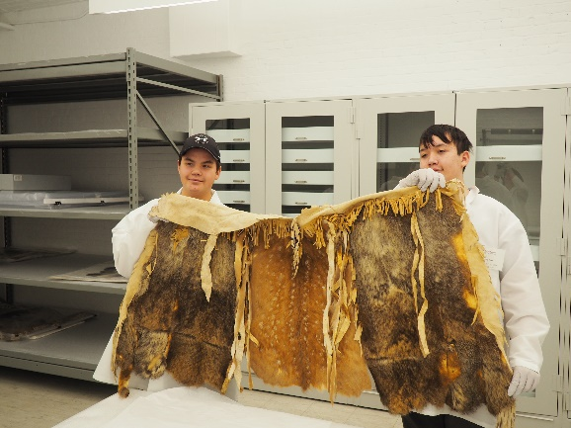
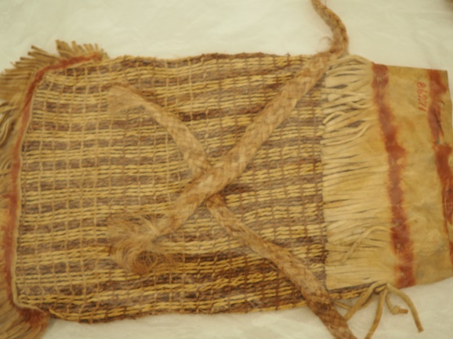
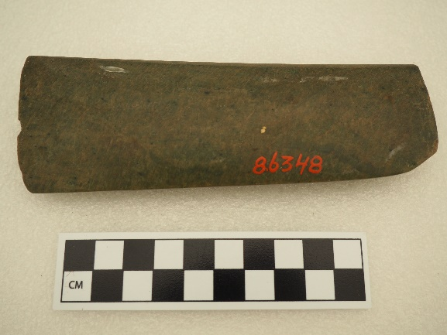
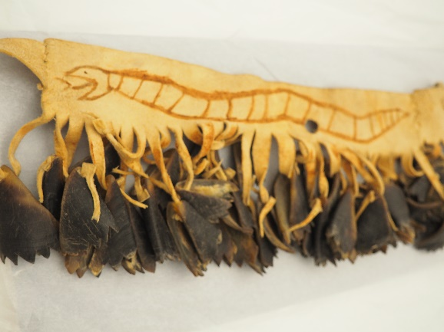
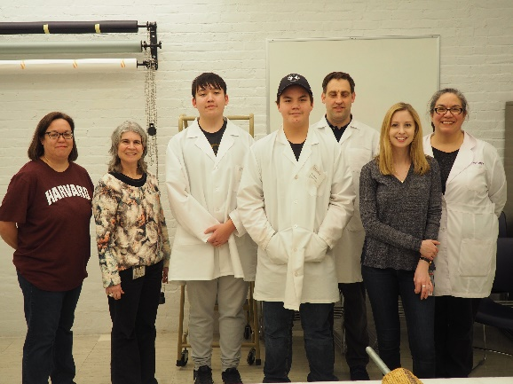
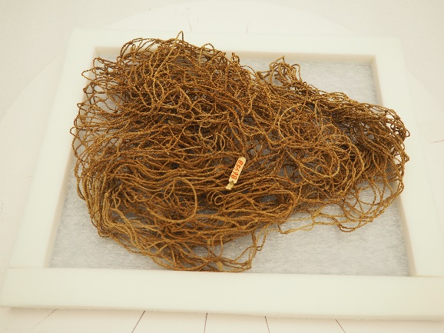
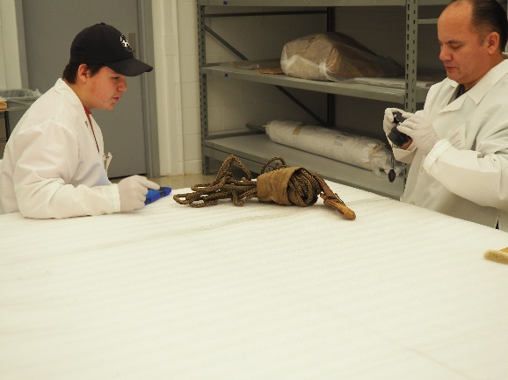
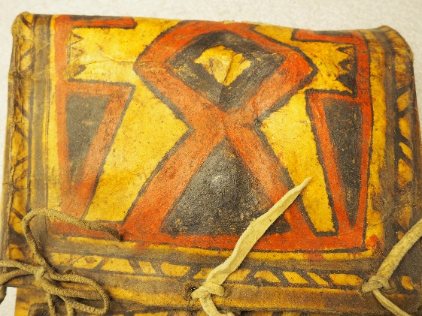
our Peabody Work
15 of 20
Notes:
As with the CMH, our discussions with the Peabody are ongoing and they are open to discussions around the care of ceremonial and sacred items.

Slide 16
New York, NY
American museum of natural history
16 of 20
Notes:
The final collection that I visited, on multiple occasions, was the AMNH museum collection.

Slide 17
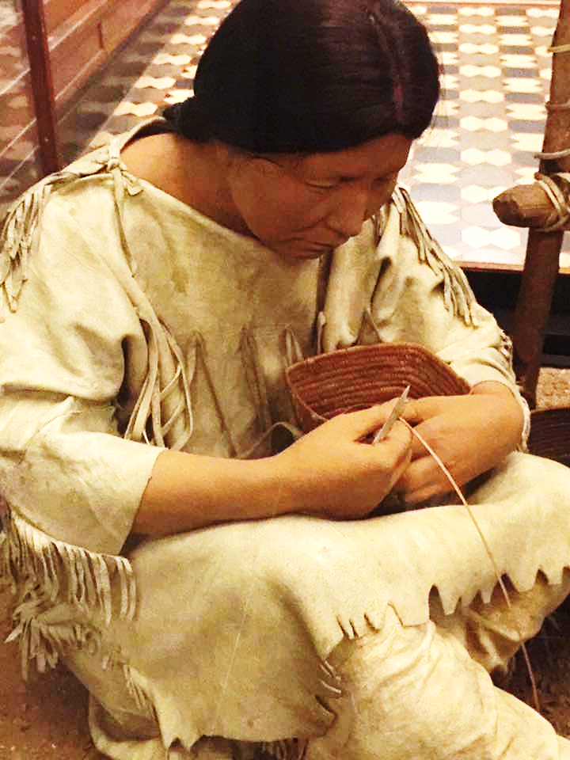
Approximately 850 items in ethnology collection are from the Nlaka’pamux cultural group.
17 of 20
Notes:
The AMNH has approximately 850 items relating to the Nlaka’pamux.

Slide 18
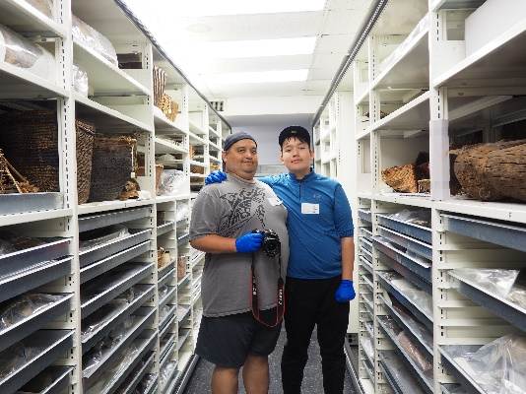
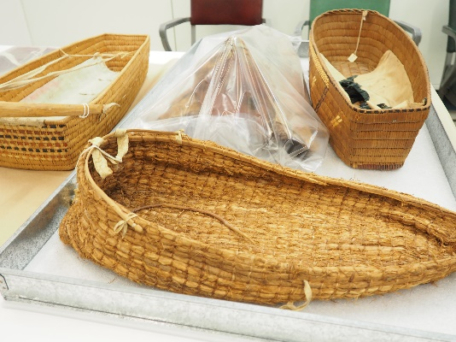
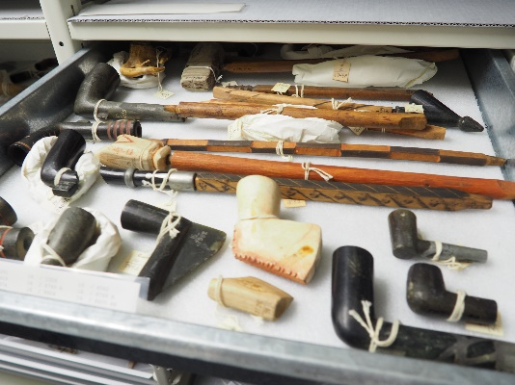
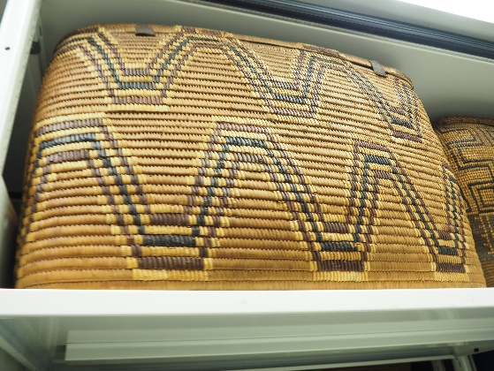
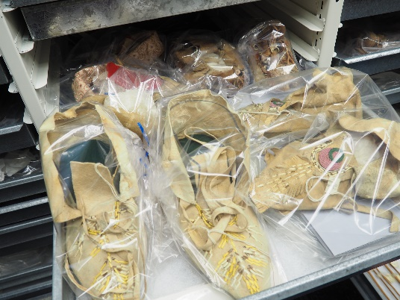
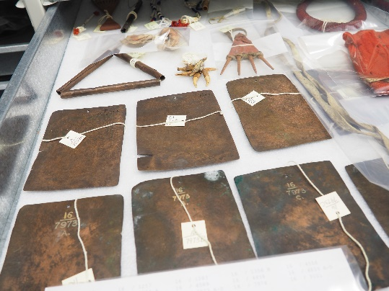
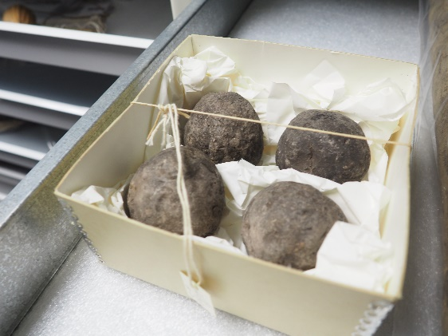
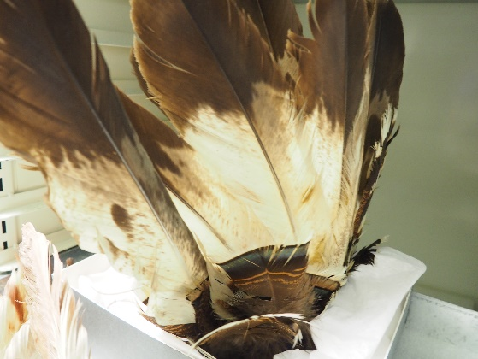
our AMNH Work
18 of 20
Notes:
Up until fairly recently, Nlaka’pamux material was on display in the Northwest Coast Gallery in the Great Hall. On my last visit, the items had been removed and put back into storage and I understand it will not be put back on display at this time.
The uncomfortable issue I think we must address is that museums value things differently than communities – they create space for things they value, and give these things resources.

Slide 19
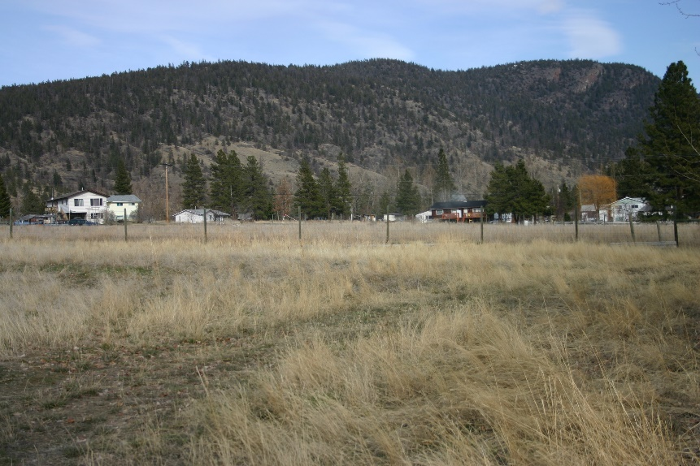
angie bain
Lower Nicola Indian Band/Union of BC Indian Chiefs Email: angie@ubcic.bc.ca
@angie_bain
linkedin.com/in/angie-bain-19000516
20 of 20
Notes:
Work is being done by organizations like UBCIC, FPCC, and communities on the difficult issue of repatriating ancestral remains and sacred and ceremonial objects. If we are to implement Articles 11 & 12 of UNDRIP, we have some challenges ahead:
Existing and Inadequate Policy needs to be revised and new Policy needs to become Practice – the spirit and intent of UNDRIP needs to be embodied at every level but particularly with front line staff, who have the ability to control access. Implementation is the hard but necessary work.
Interpretation needs to be from the Indigenous Lens – with Indigenous Leadership and Control. This requires sustainable funding, education, infrastructure and capacity
Indigenous led research and monitoring is required. We cannot silo our work. In Canada, diversity is both a challenge and an opportunity.
Our first step, as always, should be in opening the door for community members to engage with museums, archives and other memory institutions. I am nłeʔkepmx and I look forward to the day when that will be all I need to say to exercise my rights and stewardship obligations.

