Slide 1
25th session of the Human Rights Council
Side Event : «Protection of children from sexual exploitation in the context of major sporting events»
Organizer: UN Special Rapporteur on the sale of children, child prostitution and child pornography
“Ensuring sustainable prevention strategies and key partnerships
Geneva, 11th March 2014
Ignacio Packer
Notes:
COVER SLIDE 1

Slide 3
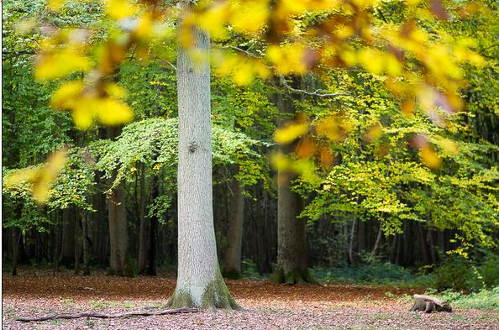
The tree and the forest
Child labour;
Displacement of children resulting from infrastructure development and street clearance;
Child sexual exploitation;
Human trafficking affecting children.

Slide 4
Collateral damage of MSE
Sexual and other exploitation resulting from the presence of construction projects;
Extension of school holidays without supervision or holiday programmes for children;
Inadequate housing resulting from displacement;
Increase of advocacy during MSEs that distorts local concerns regarding children;
Children left behind (migrant workers)
Responses (extra policing, child protection, etc.) ➔ specific risks for children (trafficking, child sex tourism)
Efforts on adult populations (evictions, migrant workers) and do not consider direct/indirect effects on children.

Slide 5
DOcumenting
VIEWS AND OPINIONS OF CHILDREN

Slide 6
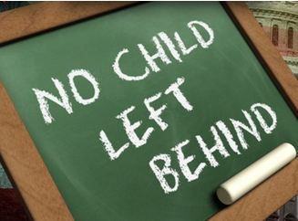
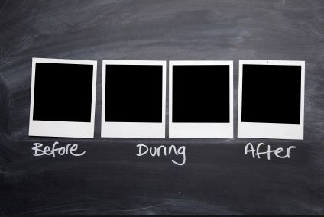
Before / During / After

Slide 7
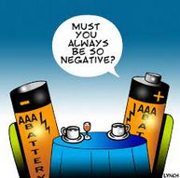
Postive and negative effects

Slide 8
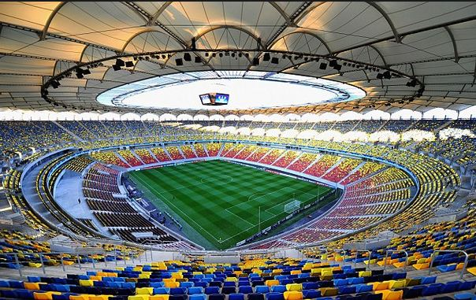
A new arena

Slide 9
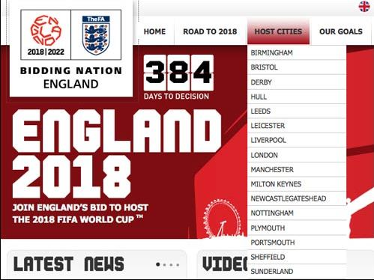
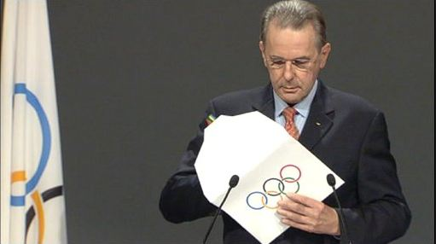
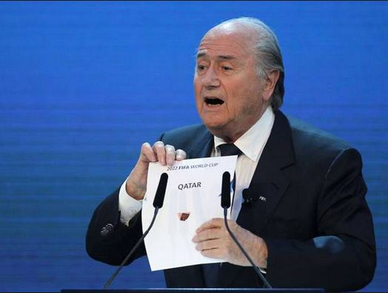
responsabilities of organisations awarding the MSE

Slide 10
introducing child focused criteria in the bidding process

Slide 11
Short path long view

