Slide 1


ECPAT
The Sport Event
Awareness-Raising Campaign
Tuesday 11st of March – Geneva
25th session of the Human Rights Council

Slide 2
THE GLOBAL PROJECT DON’T LOOK AWAY
The Sport Event campaign is part of « Don’t look away - be aware and report the sexual exploitation of children in travel and tourism”
Global objective : increase the protection of children from sexual exploitation in travel and tourism by reducing social tolerance and increasing responsible behaviours
Action on 4 axis to reduce social tolerance :
  Axis 1 : AWARENESS RAISING CAMPAIGNS (including Sport Event)
  Axis 2 : ASSESSMENT OF REPORTING MECHANISM IN AFRICA
  (Madagascar, Senegal, Gambia, Kenya, South Africa)
  Axis 3 : REINFORCEMENT OF ONLINE REPORTING MECHANISM IN EU
  (in collaboration with Police/Interpol/Europol)
  Axis 4: CAPACITY BUILDING (tourism professionals)/LOBBYING

Slide 3
JUSTIFICATION OF THE SPORT CAMPAIGN
  Support the efforts made in Brazil to limit the risk of an increase of CSE in the country during the World Cup linked to:
  A critical situation: 250,000 children victims of CSE (US State Department 2009)
  A huge increase of travelers in a festive context: 600,000 foreign tourists and 3 million Brazilian tourists expected for the World Cup
  An opportunity of income for poor families
Notes:
A prevention campaign

Slide 4
PRESENTATION OF THE CAMPAIGN
  Specific Objective: Reduce the number of cases of Child Prostitution by dissuading potential abusers during the Cup in Brazil
  Specific target: people travelling and football supporters from Europe and specifically to the World Cup in Brazil
  Localization: dissemination in 16 European countries and Brazil: France, Italy, Spain, Netherlands, Germany, Belgium, Switzerland, United Kingdom, Austria, Luxembourg, Poland, Bulgaria, Romania, Ukraine, Czech Republic, Estonia
  Donors: European Union & SESI (Social branch of Industry in Brazil)
  Partners: Tourism industry, Sport media, Police, European and Brazilian Government and NGO

Slide 5
MESSAGE & COMMUNICATION TOOLS
  Conception of the visual/message by a technical comity (Tourism Industry, Sport Media, NGO, Police) to ensure appropriation of the message and mass-dissemination
  Positive message are delivered to avoid stigmatization of supporters
  Different communication tools has been develop to deliver different key messages to travelers and increase change of behaviors
  Adaptation and translation in 10 languages to be disseminate in the 16 EU countries and Brazil
Notes:
Message focus on:
- the law/risk of punishment/incarceration
- the risks of “temptation” in a particularly festive and exotic environment
- the difficulty to “determinate the age” of a victim
Video à bord des compagnies aériennes et aux aéroport et après certains matchs de sélection en fonction disponibilité des espaces

Slide 6
POSTCARD
    Inform about the law/risk of punishment/incarceration
    “What happen in Brazil doesn’t stay in Brazil”

Slide 7


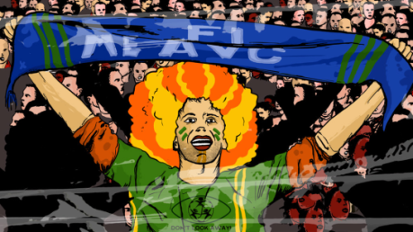
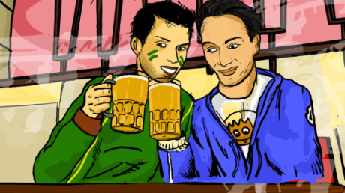
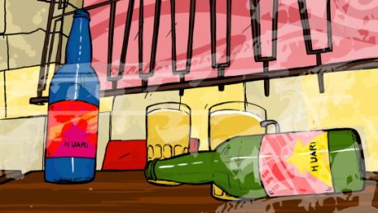
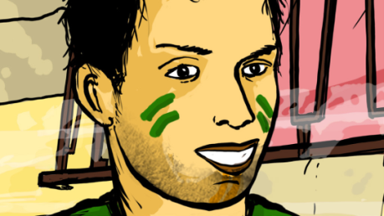


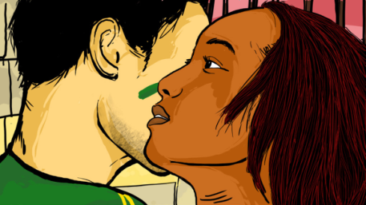

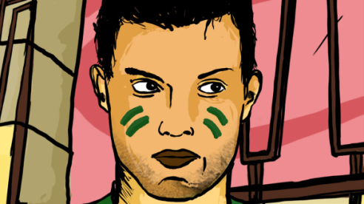
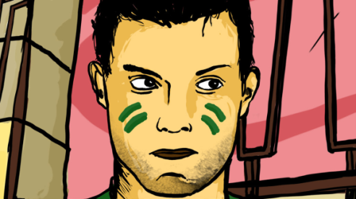
VIDEO SPOT/LEAFLET/RADIO SPOT
    Inform about the risks of “temptation” in a particularly festive and exotic environment
    Inform about the difficulty to “determinate the age” of a victim

Slide 8
CARTEL/WEB BANNER
    Involve 2 football players (Kaka and Juninho) to deliver the message
    Encourage responsible behavior “be a responsible supporters”
Notes:
Show SESI support

Slide 9
INVOLVEMENT OF BOTH SIDE
  Involvement of both side: hosting country and sending countries
    Campaign developed in collaboration between Brazilian and EU actors/to support efforts from brazil
    An International expert meeting organised in Warsaw in June 2013 to share Good Practices on prevention and protection during Mega Sport Events with a delegation from Brazil (Human right Ministry, Justice, Police, NGO)
    A common message is delivered in “sending” European countries and “hosting” country (Brazil) to ensure more impact
    A common logo and brand “Don’t Look Away” has been created to unify and ensure coherence between all stakeholders involved
Notes:
Initiative comes from Brazil – EU supports the efforts made in Brazil
Support of the Human Right Ministry in Brazil in December 2013
(Euro 2000 in Germany, 2006 FIFA World Cup in Germany and 2010 in South Africa, Euro 2008 in Austria and Switzerland, Euro 2012 in Poland and Ukraine, and London 2012 Olympic games)/ experiences shared to inspire brazilian program

Slide 10



INVOLVEMENT OF SPORT ACTORS
    Partnership with Sport Media to reach supporters/to enter the stadium
    Partnership with Football players to deliver the message/not stigmatize supporters
    Dissemination plan adjusted to the Sport calendar to increase interest/attention of the media/more impact
Notes:
To ensure appropriation and avoid stigmatization of supporters or any short-cut
For instance, not possible to enter the stadium however a postcard can be put inside the Equipe and distributed inside stadium
Sport Calendar:
European launching 1 year before in Warsaw in June 2013
National press conference during the opening of sale of the game tickets by FIFA,
Brazilian launching during the selection of the team for the world cup
Press conference organized in France at the sport media l’Equipe before the game France-Netherland/100 days before the World Cup

Slide 11







INVOLVEMENT OF TOURISM ACTORS
    Partnership with Tourism Industry (Airlines companies, Airports, Travel Agencies, Tour Operators, Hotels, Travel Guides, etc.)
    Video on Board on Flight Companies :
    Dissemination during Tourism Fairs in Europe
    Involvement of Tourism Ministry in Europe and Brazil
Notes:
Au démarrage du projet, créer une cohésion entre les différents acteurs (partenaires & associés) pour du projet et une adhésion au projet : marque du projet!
Pour trouver un message qui pourrait être diffusé à la fois par les professionnels du Tourisme, les acteurs sportifs et les 16 pays européens concernés et le Brésil il a été constitué un comité technique pour valider les messages et le visuel choisi

Slide 12



PROTECTION OF CHILD/REPORTING
  Encouraging reporting to decrease social tolerance/create collective consciousness
  Giving concrete tools to report suspicious cases:
    In Brazil Disk 100
    In Europe: www.reportchildsextourism.eu
Notes:
Au démarrage du projet, créer une cohésion entre les différents acteurs (partenaires & associés) pour du projet et une adhésion au projet : marque du projet!
Pour trouver un message qui pourrait être diffusé à la fois par les professionnels du Tourisme, les acteurs sportifs et les 16 pays européens concernés et le Brésil il a été constitué un comité technique pour valider les messages et le visuel choisi

Slide 13
REHABILITATION OF VICTIMS
  Ensuring reintegration services to victims
  Partnership with SESI on the program VIRAVIDA: psychosocial support and professional training to child victims of sexual exploitation:
    SESI is social branch of Industry working in close collaboration with Industries and give training adapted to employment
    Currently in 19 city in brazil (12,000 beneficiaries), the objective is to open “Viravida” program in all cities welcoming the World Cup
Notes:
Au démarrage du projet, créer une cohésion entre les différents acteurs (partenaires & associés) pour du projet et une adhésion au projet : marque du projet!
Pour trouver un message qui pourrait être diffusé à la fois par les professionnels du Tourisme, les acteurs sportifs et les 16 pays européens concernés et le Brésil il a été constitué un comité technique pour valider les messages et le visuel choisi

Slide 14
COMMUNICATION PLAN in EUROPE
13rd of June 2013: Official European launching in Warsaw
(1 year before the World Cup and during the Confederation Cup)
From September to January 2014: National launching in France, Italy, Spain, Luxembourg, Vienna & Brazil through Press Conference & Tourism Fair
  From September to June 2014:
  Internal Communication support, basic web support & social network
  Specific events in Europe: Charity Football Games, Conference, Flash Mob with students
  Free dissemination through Partners (Tourism + Sport media + NGO)
  Video on board (Flight companies, airport)
  Mobilisation of media (Sport Media)
One week in May 2014: Mass dissemination in Europe through partners, media and social networks.
June – July 2014: World Cup: Mass dissemination in Brazil and in the Sport media.
,
Notes:
Calendrier opportuniste en fonction du calendrier sportif
Lancement européen à Varsovie en présence de tous les pays (dont les pays organisateurs des derniers évènements sportifs) et le Brésil qui a permit de donner un accent européen
Lancement national autours de conférence de presse qui ont permis de mobiliser des journalistes

Slide 15

THANKS
&

