Slide 1
Lessons from Transitional Justice
Professor Patricia Lundy

Slide 2
IRELAND: Historic Child Abuse
Inquiries/Reviews: Ryan (2009), McAleese (2012), Commission of Inquiry Mother & Baby Homes (current);
HIA Inquiry (Report Jan 2017)
Redress: Industrial Schools & Magdalene Laundries; redress recommended N. Ireland.
Remain unresolved issues: exclusions; illegal adoptions not addressed; revelations mass grave containing remains of up to 800 babies/ infants (Mother & Baby Home, Galway)

Slide 3
Large scale & systemic abuse
Transitional justice dominant international framework for redressing mass harm
Transition from conflict to peace/ authoritarianism to democracy; fragile political arena; constraints
Four pillars; prosecutions, truth-seeking, reparations, reform
Victims/survivors are centre stage; participation

Slide 4
WHY TRUTH COMMISSION? Survivors perspective
Victims right to know, ‘truth’ & justice
Give voice, testimony, tell ‘their story’
Silence, secrecy, denial, cover-up
Recognition, vindication, restore dignity, healing, ‘closure’
Acknowledge a contested or denied past/ struggle over memory

Slide 5
WHY TRUTH COMMISSION?
Macro analysis: patterns, policies
Context, causes, consequences
Myth busting, authoritative record, can’t deny
Michael Ignatieff, "narrow the range of permissible lies”
Not a blue print; must be country specific

Slide 6
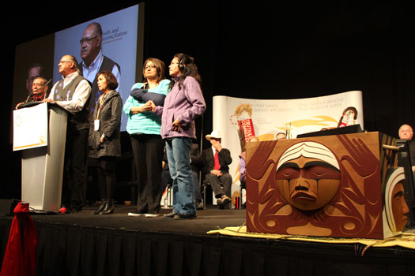
TJ Scope & Bounds Canada TRC (State level)
Indian Residential Schools
Redress Settlement

Slide 7
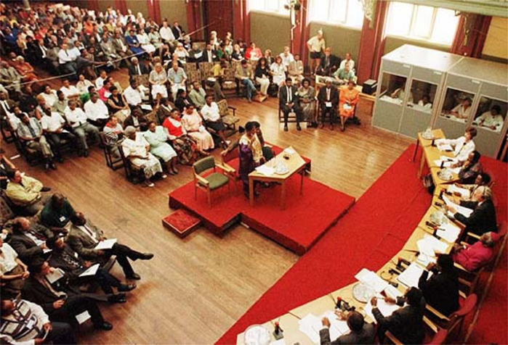
US Greensboro TRC community level
‘Bottom-up’ TJ
Ku Klux Klan & Union protest clashed –
5 people killed and 10 injured

Slide 8
Won’t go away
Spain – after Franco regime – ‘pact of silence’
Decades later campaign to excavate mass graves in Spain
Illegal adoptions legacy dark past; unresolved
Next generation seek ‘justice’/ ‘truth’

Slide 9
Reparations/ Redress
Reparations are the most victim-centred of all TJ measures. Because they address victims' needs
Redress can be material or symbolic: compensation, apology, memorial, support services
Key point - decisions on redress are made elsewhere

Slide 10
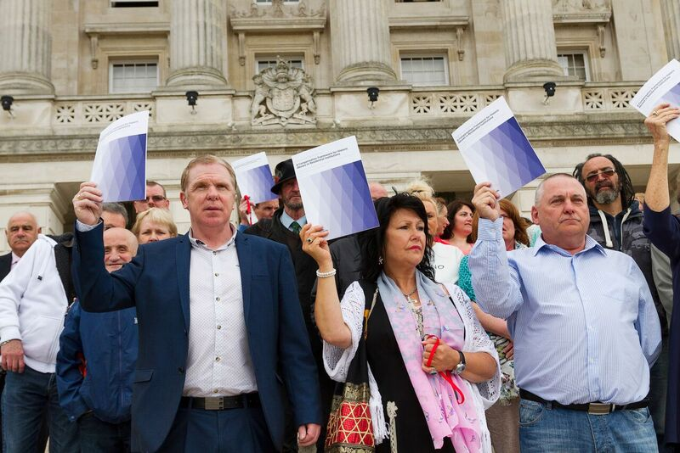
What do survivors want from redress?
State’s inaction/ survivors fragmented
The Panel of Experts on Redress: survivor groups, Amnesty Int, academics, lawyers, experts local/ inter
Survivor-led process
Process - empowerment

Slide 11
‘Bottom up’ TJ
Wide consultation with survivors
Litigation deeply unsatisfactory
Out-of-court-settlement

Slide 12
Published 3 Reports
1. What survivors want from redress
2. Compensation Framework
3. Cost Analysis
4. Negotiating Team; ‘equality of arms’
5. Caution over-eulogising

Slide 13
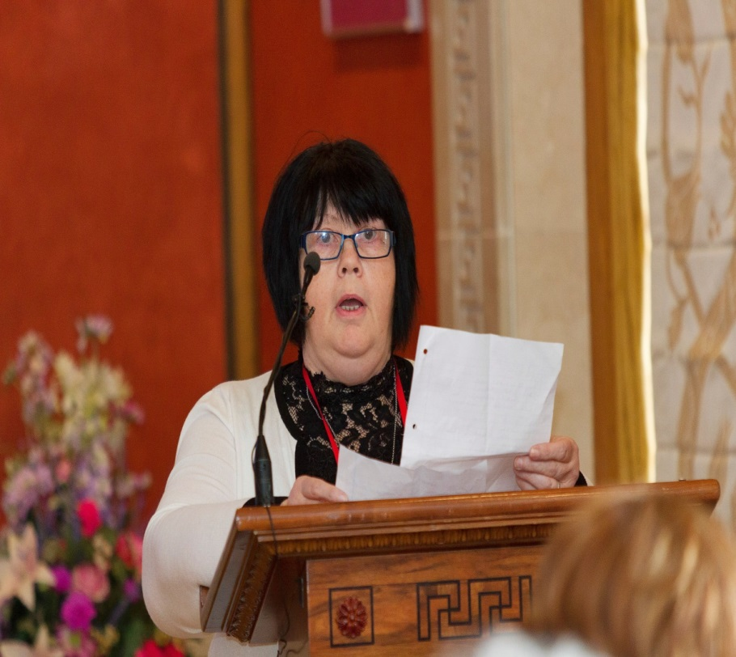
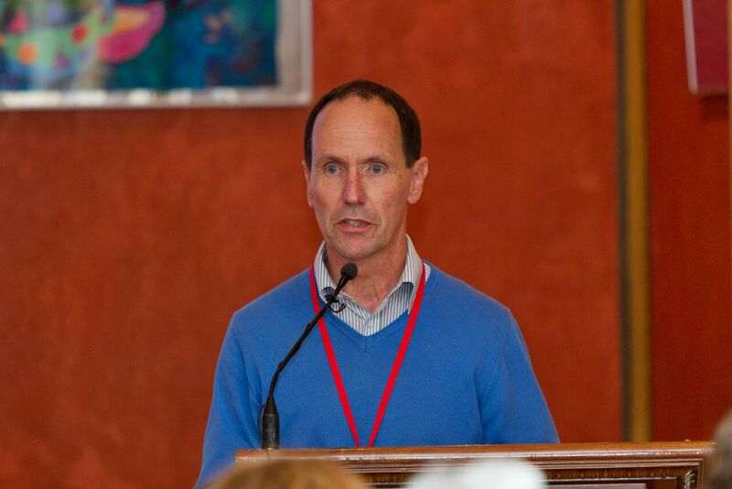
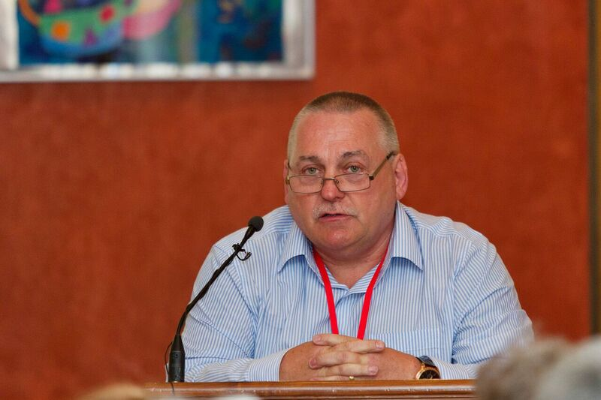
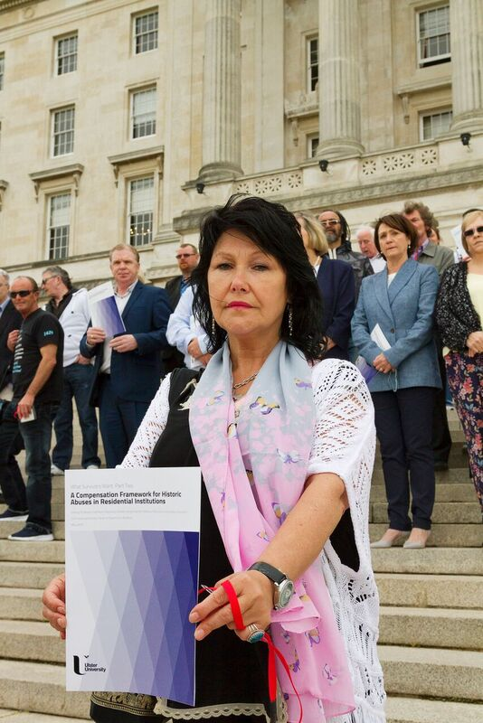
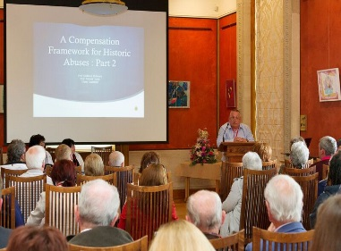

Slide 14
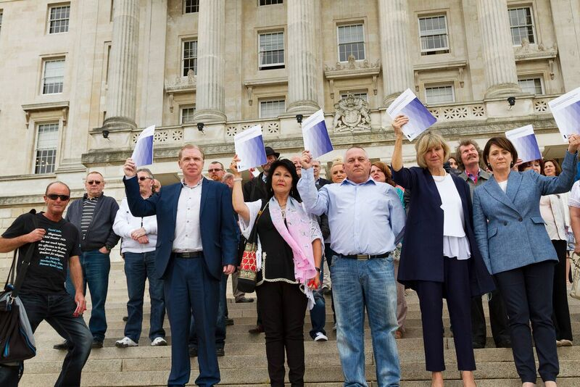
The point is not merely to understand the world, but to change it.

