Slide 1


“Ensuring accountability for illegal adoptions:
The experience of the UN-backed International Commission against Impunity in Guatemala
March 2017

Slide 2
Commision against Impunity in Guatemala
-CICIG-
* Creation
* Faculties and goals
* Features
* Work with the Prosecutor´s Office

Slide 3
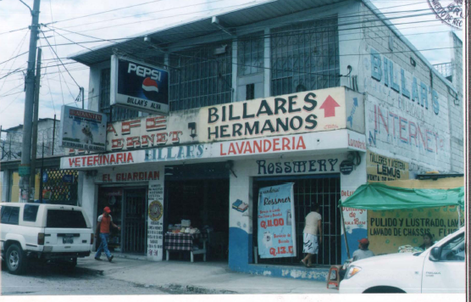
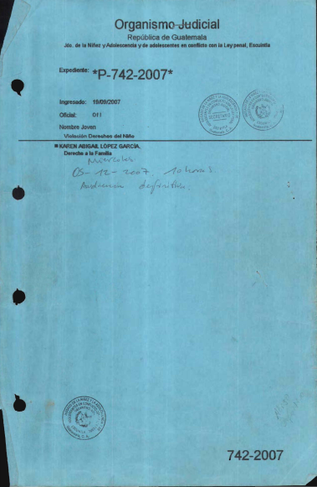
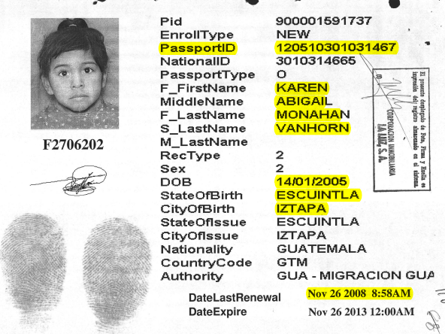
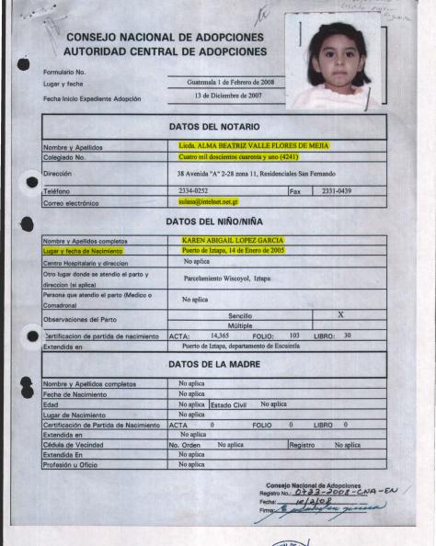
CASE UNDER INVESTIGATION BY SPECIAL PROSECUTOR’S OFFICE FOR CICIG
FACTS
VICTIM´S HOME
JUVENILE JUDGE
“CHILD LAUNDERING”
ILLEGAL ADOPTION

Slide 4


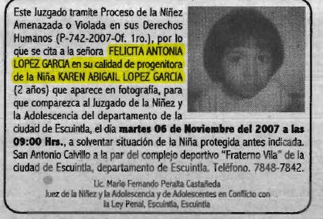
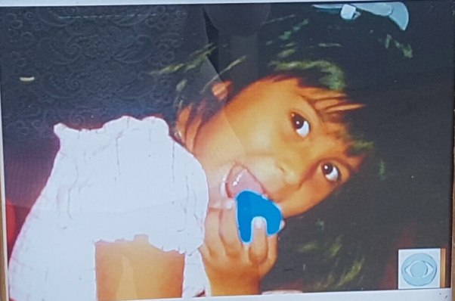
Angelí Liseth Hernández Rodríguez
VICTIM
1 week after she was kidnapped.
One and a half year after she was kidnapped.
5 months after she was kidnapped.
8 years after she was kidnapped.
CBS News

Slide 5
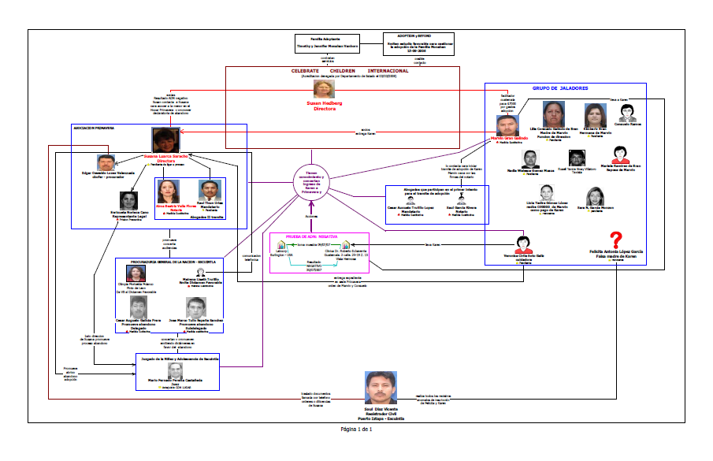
CRIMINAL NETWORK

Slide 6
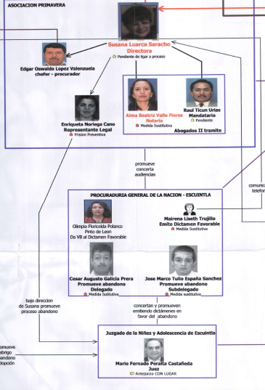
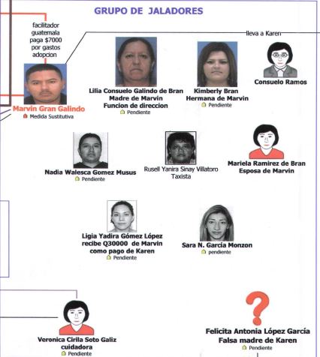
CASE UNDER INVESTIGATION BY SPECIAL PROSECUTOR’S OFFICE FOR CICIG
“ASOCIACIÓN CIVIL PRIMAVERA”
Criminal network
CHARGED 12 GUATEMALAN CITIZENS WITH CONSPIRACY, ILLEGAL ADOPTION, TRAFFICKING IN PERSONS AND USE OF COUNTERFEIT DOCUMENT/FRAUD

Slide 7
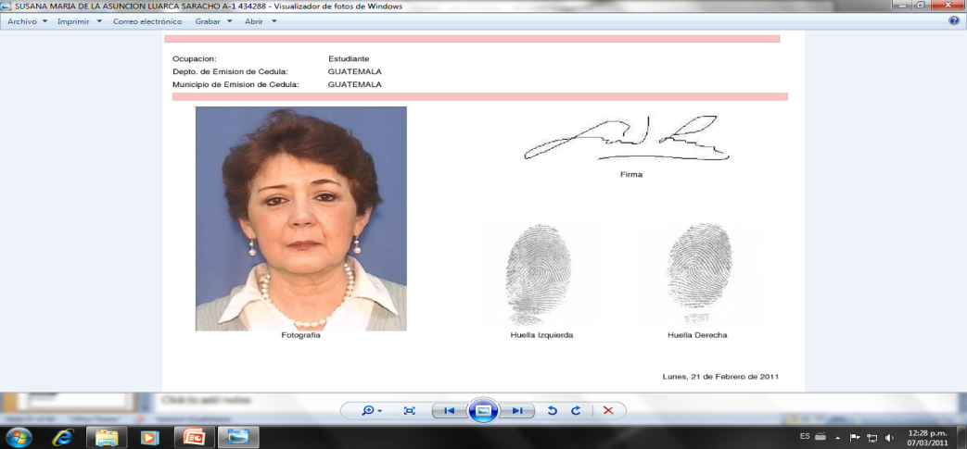
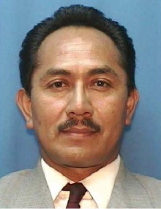
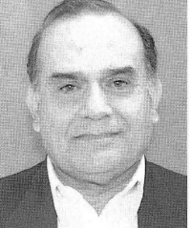
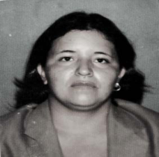
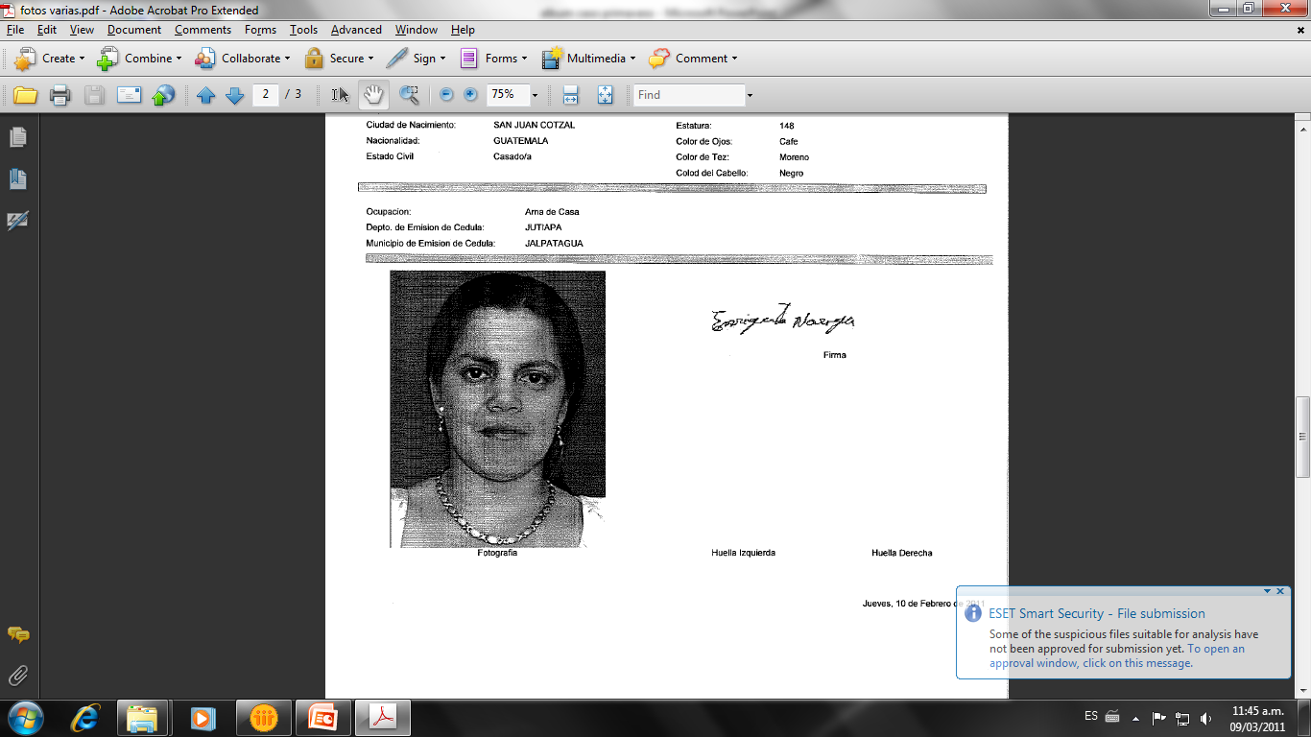
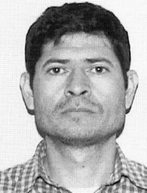
CONVICTIONS IN THE PRIMAVERA ASSOCIATION
CASE 2009 - 2015
CONVICTIONS
18 YEARS IN PRISON
TRAFFICKING IN PERSONS
CONSPIRACY
8 YEARS IN PRISON
TRAFFICKING IN PERSONS
CONSPIRACY
LEADER DIRECTOR OF A.P.
Susana Luarca Saracho
Directora Asociación Primavera
Notary
Raúl Ticún Urías
JUVENILE JUDGE
Mario Fernando Peralta Azurdia
4 YEARS IN PRISON
PREVARICATION
ALLEGED MOTHER
Sandra Noemí Maldonado Velásquez
16 YEARS IN PRISON
TRAFFICKING IN PERSONS
CONSPIRACY
USE OF COUNTERFEIT DOCUMENTS
16 YEARS IN PRISON
TRAFFICKING IN PERSONS
CONSPIRACY
4 YEARS IN PRISON
IRREGULAR PROCEEDING OF ADOPTION
LEGAL REPRESENTATIVE CASA HOGAR
Enriqueta Francisca Noriega Cano
Notary
Saúl Vinicio

Slide 8
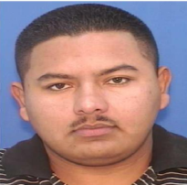
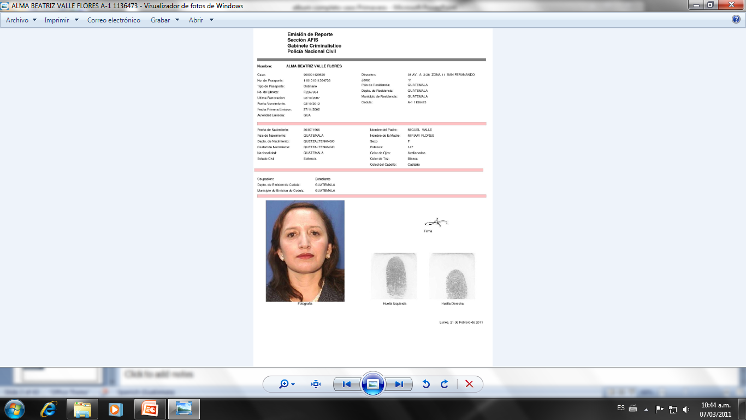
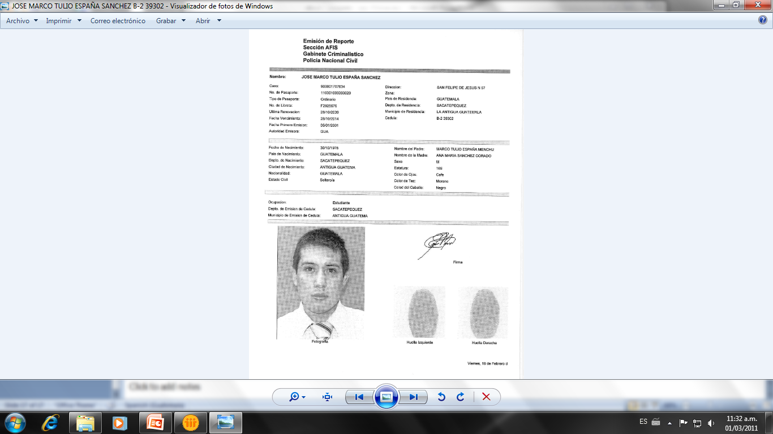
CONVICTIONS IN THE PRIMAVERA ASSOCIATION
CASE 2009 - 2015
CONVICTIONS
FUGITIVE
TRAFFICKING IN PERSONS
LAWYER OF STATE ATTORNEY-GENERAL´S OFFICE
Mairena Liseth Ríos Trujillo
3 YEARS IN PRISON
BREACH OF PROFESSIONAL DUTY
RECRUITER
Marvin Josué Bran Galindo
22 YEARS IN PRISON
TRAFFICKING IN PERSONS, CONSPIRACY, USE OF COUNTERFEIT DOCUMENTS
REPENTANT
3 YEARS IN PRISON
BREACH OF PROFESSIONAL DUTY
Notary
Alma Beatriz Valle Flores
LAWYER OF STATE ATTORNEY-GENERAL´S OFFICE
Marco Tulio España
3 YEARS IN PRISON
BREACH OF PROFESSIONAL DUTY
LAWYER OF STATE ATTORNEY-GENERAL´S OFFICE
César Augusto Galicia Prera

Slide 9
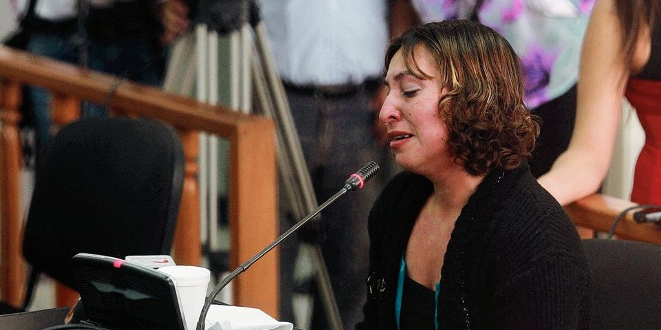
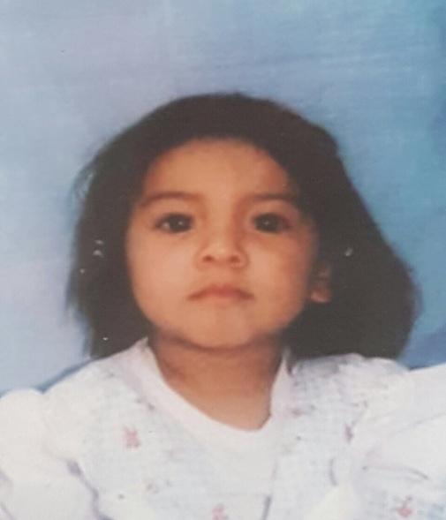
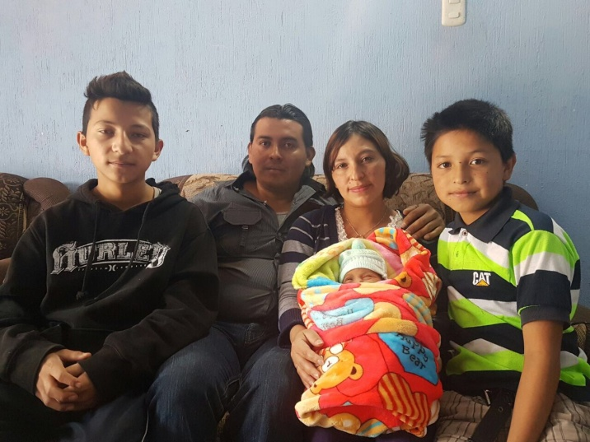
Loyda Elizabeth Rodríguez
Angelí Liseth Hernández Rodríguez
Familia Hernández Rodríguez
“Quizá no hay indicadores sociales más claros que hablen sobre el desarrollo de un país que aquéllos referidos a la niñez, en ellos se traslucen la salud o la enfermedad de un pueblo, en ellos quedan claramente reflejados los equilibrios o desequilibrios de una sociedad”
Monseñor Juan José Gerardi

Slide 10
THANK YOU

