Slide 1
Military Justice
South Asian Countries
24 Nov 2014
Wg Cdr (Retd) Dr U C Jha

Slide 2
Military Justice: South Asian Countries
Pakistan
Nepal
Bhutan
India
Bangladesh
Maldives
Sri Lanka

Slide 3
Military Force: South Asia
 | Army | Air Force | Navy
Bangladesh | 126,000 | 14,500 | 16,000
Bhutan | 10,000
India | 1,100,000 | 120,000 | 55,000
Maldives | 4,200 |  | MCG
Nepal | 69,000 | 650 (Army-Air Wing)
Pakistan | 550,000 | 45,000 | 22,000
Sri Lanka | 200,000* | 18,000 | 15,000

Slide 4
South Asia: 2.4 million military and 1.6 million paramilitary—governed by an ancient legal system.
Induction in the military is voluntary.
Women working in non-combat arms.
Contribute 33 % of the force for UN Peacekeeping (Oct 2014).
Two are nuclear weapon states.

Slide 5
Ratification of Human Rights Treaties
Treaty | Bangladesh | India | Nepal | Pakistan | Sri Lanka
ICCPR/ICESCR | ✓ | ✓ | ✓ | ✓ | ✓
CRC | ✓ | ✓ | ✓ | ✓ | ✓
OP to CRC Child Soldier | ✓ | ✓ | ✓ | SNR | ✓
CEDAW | ✓ | ✓ | ✓ | ✓ | ✓
CAT | ✓ | SNR | ✓ | ✓ | ✓
Enforced Disappearance | X | SNR | X | X | X
SNR: Signed but not ratified

Slide 6
Ratification of IHL Treaties
COUNTRY | Geneva Conv. I-IV | AP I of 1977 | AP II of 1977 | Rome Statute of ICC | Ottawa Treaty APM
Bangladesh | ✓ | ✓ | ✓ | ✓ | ✓
India | ✓ | X | X | X | X
Nepal | ✓ | X | X | X | X
Pakistan | ✓ | X | X | X | X
Sri Lanka | ✓ | X | X | X | X

Slide 7
1. Military Justice Systems
2. Security laws giving special powers to armed forces.
3. Judicial interventions.
4. Recommendations.

Slide 8
1. Military Justice System: SA Countries
The British Indian military law of 1911 is the progenitor of the SA military legal systems.
Fundamental rights of the armed forces-- restricted by the Constitutions.
Each wing of the military has independent legal system.
Action against military offender is by way of summary trial and ad hoc military tribunals or court martial.

Slide 9
A. Summary Trials
For the officers up to the rank of Major and other ranks.
Accused is not entitled to legal help.
Law of evidence does not apply and proceedings are not open to public.
No right to appeal.

Slide 10
Summary punishments (Officers and JCOs):
Forfeiture of service/seniority up to 12 months;
Stoppage of pay & allowances;
Reprimand.
Personnel below JCO rank:
Imprisonment and detention up to 28 (42) days;
Field Punishment;
Extra duties;
Fine, deprivation of rank;
Reprimand.

Slide 11
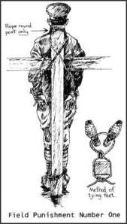
Rope around post only
Bangladesh
India (AF)
Nepal
Pakistan
Sri Lanka
Method of tying feet
Field Punishment Number One

Slide 12
B. Court Martial
 | General Court Martial | District Court Martial | Summary/Field General Court Martial | Summary Court Martial
Bangladesh | ✓ | ✓ | ✓ | ✓
India | ✓ | ✓ | ✓ | ✓
Nepal | ✓ | ✓ | ✓ | ✓
Pakistan | ✓ | ✓ | ✓ | ✓
Sri Lanka | ✓ | ✓ | ✓ | X

Slide 13
General and Summary General Court Martial can award death sentence (except Nepal).
In Pakistan a military offender can be stoned to death: AA s 60/70/ 80.
In Nepal a GCM may award life imprisonment and confiscation of the entire share of the ancestral property (offences relating to the enemy, mutiny and desertion).

Slide 14
Other punishments in descending order:
Amputation of hand, foot or both (in Pakistan);
Life imprisonment;
Imprisonment up to 14 years;
Whipping (in Pakistan);
Cashiering in the case of officers;
Dismissal;
Field punishment;
Reduction to ranks and forfeiture of service;
Stoppage of pay & allowances;
Reprimand.

Slide 15
Trial in GCM and DCM
Ad hoc military tribunals;
The members of court martial (officers) are detailed by convening authority;
Judge Advocate must only in a GCM;
In Sri Lanka prosecution as well as the defence can be represented by a counsel;
Findings of court and sentence are subject to confirmation by convening authority.

Slide 16
Summary/Field General Court Martial
Can be convened on active service or during peace;
Composition: three officers with one year service;
Judge advocate not a must;
Statement of offence may be made briefly to disclose an offence;
Can try any individual and award punishment up to death (with concurrence of all members).

Slide 17
Summary Court Martial (SCM)
Origin: the 1857 mutiny in India.
The CO alone conducts the trial for accused (up to senior NCOs).
The trial is brief and accused has no right to counsel or defending officer.
Punishment: 1-year imprisonment and dismissal.
No review of punishment (appeal in India since 2009).

Slide 18
Confirmation, Revision, and Appeal
Pre and post-confirmation petition by accused to confirming authority--but no right to participate.
Finding and sentence may be once revised by order of confirming authority.
No right to appeal (now available in India).

Slide 19
Role of Judge Advocate General (JAG)
JAG is a military executive appointed by the chief of the staff—he has no functions of an advocate or of a judge.
Remains under the functional control of the convening authority.
Since not independent, they cannot be expected to give a fair and just opinion.

Slide 20
C. Powers of Convening Authority
Who shall be tried;
Charges;
Composition of the court;
JA, prosecutor and defending officer remain under his command;
Confirms finding and sentence;
Can send back the proceeding for revision;
Decides post-confirmation petitions.
There is NO RIGHT to appeal against his decision.

Slide 21
Appeal: The Armed Forces Tribunal in India
The Tribunal and its Benches are functioning since August 2009.
It has original jurisdiction over service matters and appellate jurisdiction over court martial.
Decided 5500 cases in the last 5yrs.

Slide 22
Lacuna: The Tribunal cannot get its orders executed by way of civil contempt.
An appeal against order of the Tribunal to be filed in the Supreme Court.
2012 Amendment to the AFT Act to give it civil contempt power was resented by the armed forces.

Slide 23
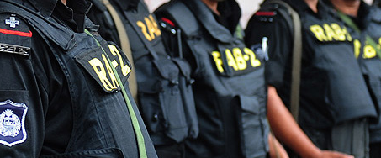
2. Security and Anti-terrorism Laws:
South Asian Countries

Slide 24
The armed forces in the SA countries have been deployed in ‘aid to civil power’ to deal with terrorism and militancy.
The Security and Anti-terrorism laws have given additional powers to the armed forces.

Slide 25
Bangladesh: The Armed Forces (Special Powers) Ordinance, 1942.
India: The Armed Forces (Special Powers) Act.
Nepal: The Terrorists and Disruptive Activities (Control & Punishment) Ordinance.
Pakistan: Suppression of Terrorists Activities (Special Court) Act and Special Military Court during Martial Law regime.
Sri Lanka: Public Security Ordinance and Prevention of Terrorism Act.

Slide 26
The members of the armed forces have been accused of:
Enforced disappearances / extra-judicial executions.
Illegal imposition of curfew.
Rape and sexual harassment.
Killing of protected persons.
Arbitrary detention and torture.

Slide 27
3. Judicial Interventions and Inactions

Slide 28
Bangladesh
The Rapid Action Battalion (RAB), a special police force has been accused of over 800 killings in last 10 years.
A number of RAB commanders are officers seconded from the army and Government has not taken any action against violators.
Human Rights Commission does not have any mandate to take action against “discipline” forces (includes army).

Slide 29
BDR Mutiny
In February 2009, Bangladesh Rifles, a paramilitary force on a two-day mutiny killed 74 people (57 army officers) and committed rapes.
A number of victims were dumped in sewers and shallow graves.
The accused were tried in special civil courts.

Slide 30
The Court has awarded 152 death sentences, 161 life sentences and 262 sentences of 3-10 years imprisonment--under appeal process.
Reasons of mutiny: low pay, no perks, no participation in UN peacekeeping—lack of effective grievance redress machinery.

Slide 31
Nepal
The 2013 Ordinance ‘On the Investigation of Disappeared Persons, Truth and Reconciliation Commission’ has been struck down by the Supreme Court.
Torture and enforced disappearance have not been criminalized despite a Supreme Court order of June 2007.
No military person has been prosecuted for human rights abuses committed during conflict which lasted for 10 years.

Slide 32
In January 2013, Colonel Lama of Nepal Army, deputed to UN peacekeeping was arrested by the police in London during his visit to the UK.
He is accused of intentionally “inflicting severe pain or suffering” as a public official on two individuals in Nepal (April-May 2005).
He has been charged under sec 134 of the British Criminal Justice Act, a law that defines torture as a “universal jurisdiction” crime.

Slide 33
Nepal Army Act 2006:
Section 22 provides immunity for the serious offences if committed on duty: “in the course of discharging duties in good faith.”
In June 2011 Supreme Court has ordered the Government to review the Army Act --to ensure its compliance with Nepal’s human rights obligations.

Slide 34
India
On 13 Nov 14 , general court martial has sentenced five military men, including two officers, to life imprisonment.
They were accused of the staged killing of three civilians and passing it off as an anti-militancy operation in Jammu and Kashmir's Machil sector in 2010.

Slide 35
On 23 Sept 2014, the Supreme Court in People’s Union for Civil Liberties case has issued guidelines to be followed in cases of police encounters resulting in the death.
An independent agency to investigate the matter under the supervision of a senior officer.
Applicability in disturbed areas?

Slide 36
Public Interest Litigation (PIL) case:
In 2007, a PIL was filed in the Supreme Court: few military personnel were accused of selling their private weapons contrary to Army instructions.
On the direction of the Court, the Army held court martial / took administrative action against 71 personnel.

Slide 37
Considering the punishments very lenient, the Supreme Court has asked (on 17 Sept 14) for fresh proceedings in these cases.
The Supreme Court has power under Article 142 to pass any order necessary for doing justice in a matter pending before it.

Slide 38
The Indian Penal Code s. 375 has been amended in 2013, which dead with ‘rape’.
A member of armed forces, if commits rape, may be imprisoned for at least 10 years---extended to life imprisonment.

Slide 39
Pakistan
The Protection of Pakistan Ordinance IX of 2013 has been amended in 2014.
It authorizes secret and unacknowledged detention, and nondisclosure of grounds for detention (sec 9)
It allows for exclusion of the public from hearings on the ground of “public safety” (sec 10)..

Slide 40
It reverses the burden of proof on the accused--inconsistent with presumption of innocence (sec 15 and 5).
It confers blanket immunity from prosecution for actions done in good faith (sec 20).
Trials in Special Courts do not meet the standard of a competent, independent and impartial tribunal (Art 14, ICCPR).

Slide 41
During 2012-2013, a few army personnel had removed 35 detainees from an internment centre and their whereabouts are not known.
In December 2013, the Supreme Court held that their removal amounted to enforced disappearance; and directed action against the army personnel.

Slide 42
March 2014: the Defence Minister has lodged FIRs under the Penal Code for wrongful confinement against suspected army officers.
The Supreme Court constituted a 5-member Bench to consider the trial of military members in civilian court.
Army has refused to take any action stating--its personnel can only be tried by a military court.

Slide 43
Sri Lanka
The Emergency Regulations have severely limited the accountability of the military.
Over 30,000 people were killed towards the end of the ethnic conflict in 2009 when the LTTE was finally crushed.
War crimes committed by both-- government troops and LTTE (UNHRC resolution of March 2013).

Slide 44
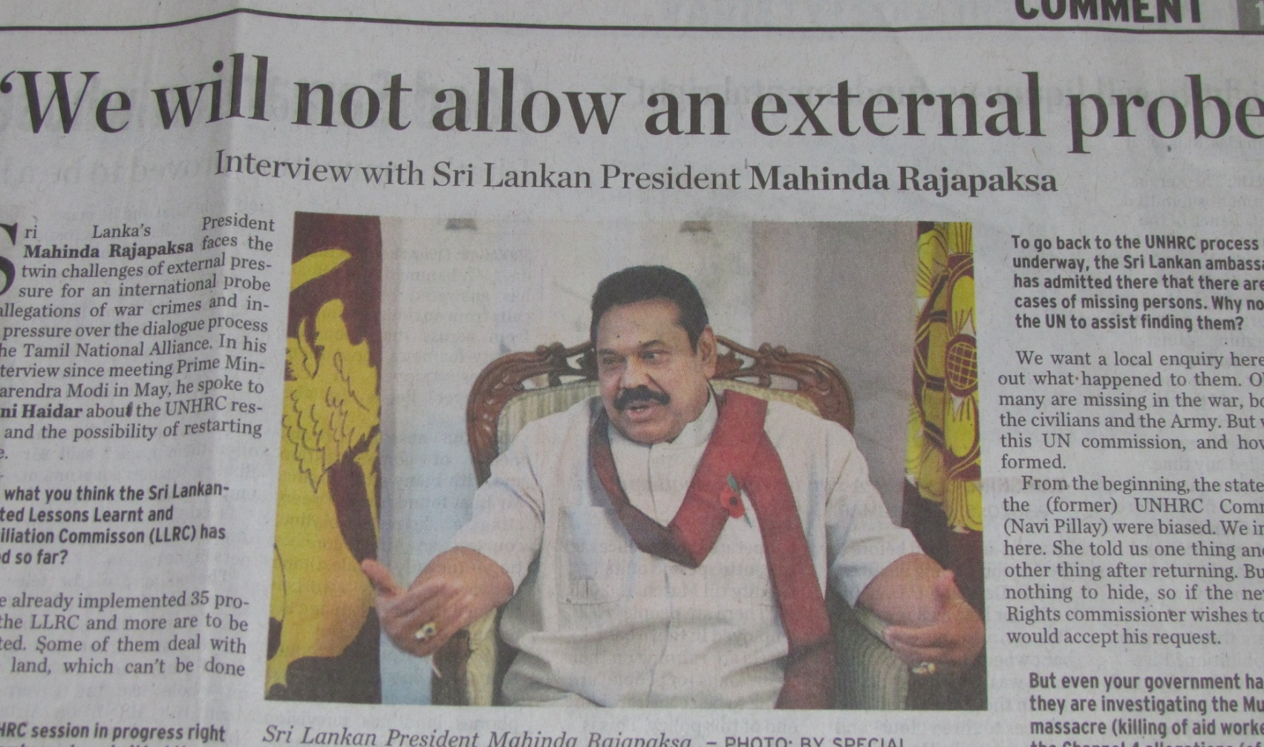
No action has been initiated against military personnel for alleged war crimes.

Slide 45
Problems in the SA Countries
The military law does not include war crimes as defined under the Rome Statute.
The concept of command responsibility has not been incorporated in military laws.
The right to a fair trial (Art 14, ICCPR) not observed in military trials.
No Manuals on the laws of war.
Civil society doubts fairness of a military trial.

Slide 46
In SA, the armed forces personnel are being deprived of the benefit of the developments which have occurred internationally in human rights and judicial thinking.

Slide 47
4. Recommendations:
a. Abolition of Summary courts (SGCM and SCM).
b. Rationalization of the powers of convening authority.
c. Insulation of JAG from the military chain of command.
d. Abolition of degrading/ humiliating punishments.

Slide 48
e. Effective legal aid to accused during trial and appeal (Art 14, ICCPR).
f. Establishment of Appeal Courts.
g. Updating Military legal system: include crimes contained in Rome statute and the concept of command responsibility.

Slide 49
ROADBLOCK
“There was only one thing more difficult than getting a new idea into military mind and that was getting an old idea out.”
-Sir Basil Liddell Hart, a military thinker and a soldier.

Slide 50
Thank you

